Slide 1
Science At Bryn Mawr College
Teaching and Research at Park science center and beyond

Slide 2
Park Science Center
Biology
Chemistry
Computer Science
Geology
Math
Physics

Slide 3
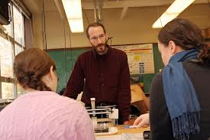
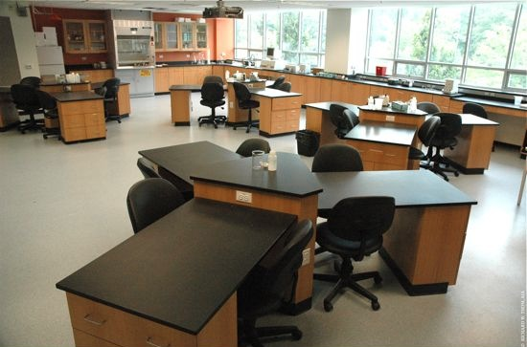
Park Classrooms

Slide 4
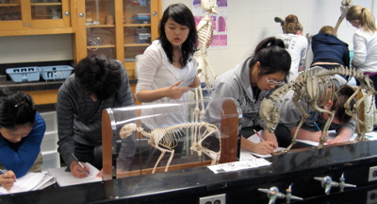
Park Teaching Labs

Slide 5
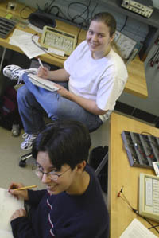
Park Teaching Labs

Slide 6
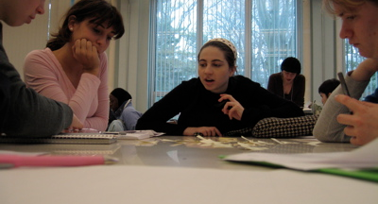
The Culture in Park
Serious About Women in Science
Demanding
Collaborative
Interactive
Inclusive
Research-Based
First Year Biology Class

Slide 7
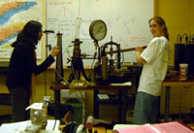
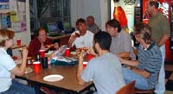
More Collaboration
In the Lab
In PLI Study Group
At Lunch

Slide 8
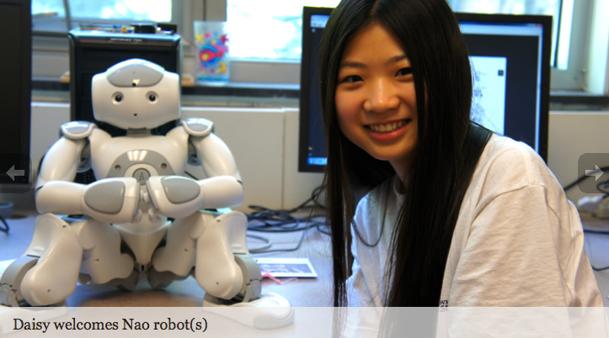
Research at Bryn Mawr: Computer Science Robotics

Slide 9
Research at Bryn Mawr: Chem Student Researcher

Slide 10
Research at Bryn Mawr : Typical Student Research Lab

