Slide 1
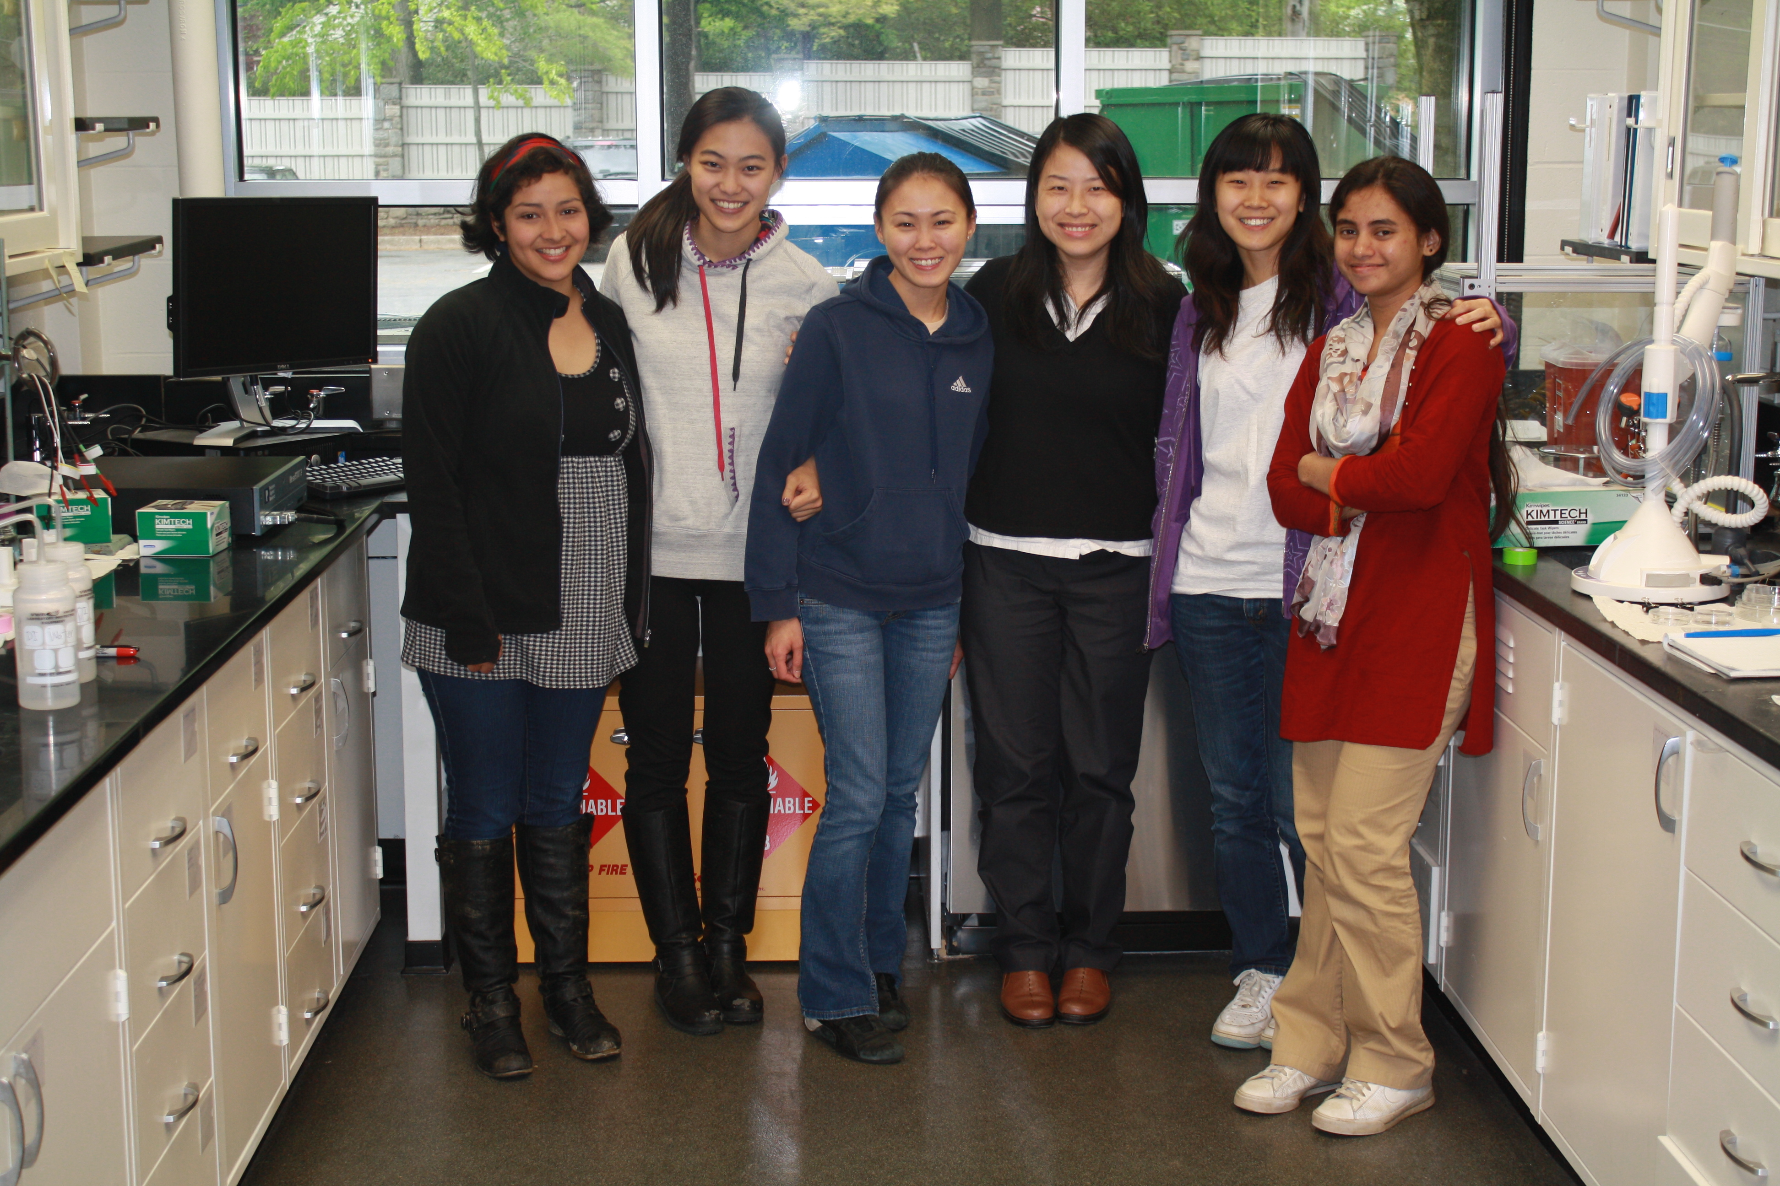
Research at Bryn Mawr: Nanoscience Lab

Slide 2
Research at Bryn Mawr: Geochemistry Lab
Pedro Marenco

Slide 3
Research at Bryn Mawr: Mass Spectrometry Lab

Slide 4
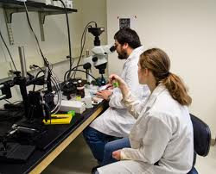
Research at Bryn Mawr: Microscopy Lab

Slide 5
Research Afar: BMC Geologists in the Arctic

Slide 6
Research Afar: BMC Physicist at Argonne National Lab

Slide 7
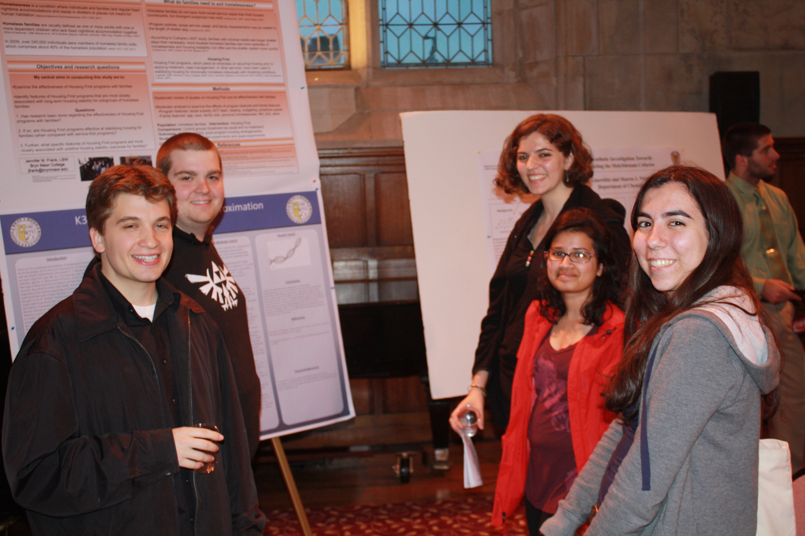
Student Research Presentations
At Bryn Mawr
At National Meetings
American Chemical Society
Biophysical Society
American Geological Society
American Mathematical Society
and many more

Slide 8
Planning for Success
Our Expectations
For Your Preparation
For Study
~3 hours/week for each hour in class
Independent vs. Collaborative
Homework
Resources for Success
Peer Led Instruction (PLI) Reviews
Faculty/TA Office Hours
Q Skills Center
Academic Support Center

Slide 9
Start Thinking About…
Placement Exams
Quant Skills
Math
Chemistry
Others?
Math Review?
Purple Math (Alegebra Review)
Physics Department Math Readiness Exam
Khan Academy
Selecting 1st Semester Courses (Math + Science!)
Getting Your Textbooks
Exploring Possible Majors

Slide 10
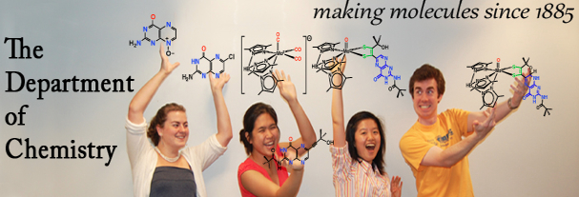
Learning About the Departments
www.brynmawr.edu → Academics → Fields of Study
Major/Minor/Concentration Requirements News & Events
Faculty Research Courses Contact Information

Slide 11
We Love STEM!

