Slide 1
Ableist Restrictions in capitalism: an exploration of inspiration porn
By Grace Caterine

Slide 2
“And these images, there are lots of them out there, they are what we call inspiration porn….those images objectify disabled people for the benefit of nondisabled people. They are there so that you can look at them and think that things aren't so bad for you”
- Stella Young, TEDxSydney, 3:11 – 4:30

Slide 3
My Story: Objectification through Photography

Slide 4
In October 2018, I took a trip to Barcelona with a friend while studying abroad in Ireland. We were just two young women, lost like typical tourists, but nevertheless enjoying ourselves. We decided to pass through a park to get to our bus stop. I now regret that decision.
Suddenly, a young Spanish boy jumped in our way, asking repeatedly “Cuantos anos? Cuantos anos?” No words passed between myself and my friend, but we both knew he was referring to my Achondroplasia, a form of dwarfism. My friend attempted to distance us, repeatedly yelling “Stop!” and shoving him away. The boy’s teenage family member appeared and suddenly I was his photography object in that moment. Never before had I been in the position of an unwanted object so actively. For a moment, I became a deer in the headlights. Then, instinctually, I knew what to do. I turned away my face and gave him the middle finger. Presumably, he captured my picture in this position. Eventually, we crossed the street and the family disappeared into the crowd. Much like the permanency of the picture the teenager took, however, the memory remains fixated in my mind and I cannot help but ask -

Slide 5
Why was my instinctual reaction to poise defiantly and belligerently? What was I trying to prevent from happening?

Slide 6
Inspiration Porn
Resisting against becoming what Stella Young calls “objects of inspiration” (1:36)
Harder for those who viewed the picture to gain benefit from it
Altered how others would perceive that experience
“It is important to examine the nondisabled position and its privilege and power. It is not the neutral, universal position from which disabled people deviate, rather, it is a category of people whose power and cultural capital keep them at the center” (Linton, 32)
How then does inspiration porn keep non-disabled people “at the center,” granting them more privilege and power? What negative effects then carry onto people with disabilities, such as myself?

Slide 7
Main Idea
Through the objectification, infantilization, and medicalization of disability in the following inspiration porn images, society attempts to fit people with disabilities within the restrictions of capitalistic individualism. In reality, because the images do not grant subjectivity to those with disabilities, non-disabled people use them as a superficial show of sympathy for disabled people while still ignoring the social constructs that enable their disabilities.

Slide 8
Objectification

Slide 9
“Before You quit, try…”
Before You
by William Arthur Ward
Before you speak, listen.
Before you write, think.
Before you spend, earn.
Before you invest, investigate.
Before you criticize, wait.
Before you pray, forgive.
Before you quit, try.

Slide 10
“Before You Quit, Try…”additional images

Slide 11
Reduction of Person with disability’s perspective
In this image, the girl’s “disability cancels out other qualities, reducing the complex person to a single attribute” (Garland-Thomson, 12)
Single attribute: perseverance DESPITE her disability.
Do not see the girl’s daily life activities outside of this event
Constantly perseverant throughout her life
Activity avoids using disability during the process
The sock on her arm highlights that this disability exists
“Trying” is in opposition to her disability
Her body “becomes an analyzed body…one's own subjectivity and autobiography become denigrated to sub-texts” (Eisenhauer, 18)
The girl is an object of inspiration:
No mutual gaze, which subordinates her to the audience
The girl is not the “you” in the picture; “you” is the viewer themselves
“Awe-inspiring figures placed up on pedestals” in inspiration porn (Norden, 81)
The viewers know nothing about her life or disability, other than that it should inspire them to try actions instead of quitting.

Slide 12
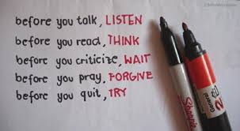
Introduction of the “What’s your excuse” Trope
Capitalism “requires “fit” and productive bodies” (“DISABILITY, SOCIETY, AND THEOLOGY,” 86)
Productive physicality - “To try” = “to be physically productive”
“Before You” - “Before you speak, listen” and “Before you write, think”
Reader is abled bodied and neurotypical
Connects to capitalism : “Before you spend, earn” and “Before you invest, investigate” – capitalist economic structure of spending and investment.
The girl with a mobility related disability then “calls into question such concepts as will, ability, progress, responsibility, and free agency, notions around which people in a liberal society organize their identities” (Garland-Thomson, 47)
Amputations = “a loss to be compensated for, rather than difference to be accommodated” (49)
“What’s Your Excuse?”trope - mirrors the competition within a capitalistic sytem – whoever can participate the most fully in capitalism wins
Capitalism then creates the “cultural construction of disability as property” (Eisenhauer, 11)
Owned, but also sold by its owner, who earns capital through selling.
Disability = separate from identity
Something the owner can choose whether or not to possess

Slide 13
“Your Excuse is invalid” and counter meme

Slide 14
Invalidity of disability
“You” is centered
No eye contact
Participates in a productive physical activity
Not actively using wheelchair
Term of “invalid” for disability
Invalid “does not confine the weakness to the specific bodily functions; it is more encompassing” (Linton, 28-29)
Disability = “best understood as a marker of identity” (12)
the child can either let this “weakness” encompass him or become part of society through defying it
“Excuse” creates “boundaries between animal and machine, organic and mechanical, me and not-me” when these boundaries do not need to exist in a complex identity (Garland-Thomson, 14)

Slide 15
Counter-Example to Objectification
Centers the non-disabled perspective, but introduces “me,” or the disabled perspective
Establishes mutual gaze – equalizing status with viewer
Separates the disabled person from inspiration porn through “your inspiration porn”
The woman’s disability does not “become subject to rehabilitation (if possible) or elimination (if necessary)” (“Disability,” 86)
Autobiographical form = “eliminates the dynamics of sympathy and the potential for objectification that often emerge” (Garland-Thomson, 126)
Aggressive stance against inspiration porn
Still, Aimee Mullins is “attractive, cute, and perfect in every way (in other words, lived up to the mass-media representation of the typical person) except for their disability” (“Charity,” 45)
Mullins must gain authority through her race, attractiveness, and celebrity status
Compensating for disability
Adult - full control over her own agency. Why then does so much inspiration porn use children at the center of their images?

Slide 16
Infantilization

Slide 17
Cochlear Implant Video
https://www.youtube.com/watch?v=mbe7x8GP2Ds
Title and Description: “Cochlear Implants: People hearing for the first time!” and “(Little) people hearing for the first time. :-) Just a little compilation of videos I've found about this beautiful phenomenon.”

Slide 18
Prom pictures

Slide 19
“embodiments of pitiable childlike innocence” (Luckily)
Interspersed footage of adults receiving cochlear implants with children and babies
Footage & description emphasizes the youthfulness of the recipients
General stereotype of people with disabilities as “more dependent, childlike, passive, sensitive, and miserable and are less competent than people who do not have disabilities” (Linton, 25)
Adults often shown crying, much like the babies before and after them
Cochlear implant = the first step into “adult life” or non-disabled life.
Equalizing of adulthood with non-disability = “projections of the adults than on the unadulterated feelings of the child” (21)
“Beautiful phenomenon” = focuses on the superficial viewing experience
A couple of the babies began to cry after getting their implants in discomfort
Did not enjoy “beautiful phenomenon”
Children = projections of adults
“Almost exclusively middle class, well groomed, white, and attractively attired” (“Charity,” 45)
Connects to an audience who may have access to this video. The children gaining implants brings hope that anyone can succeed in a capitalistic society

Slide 20
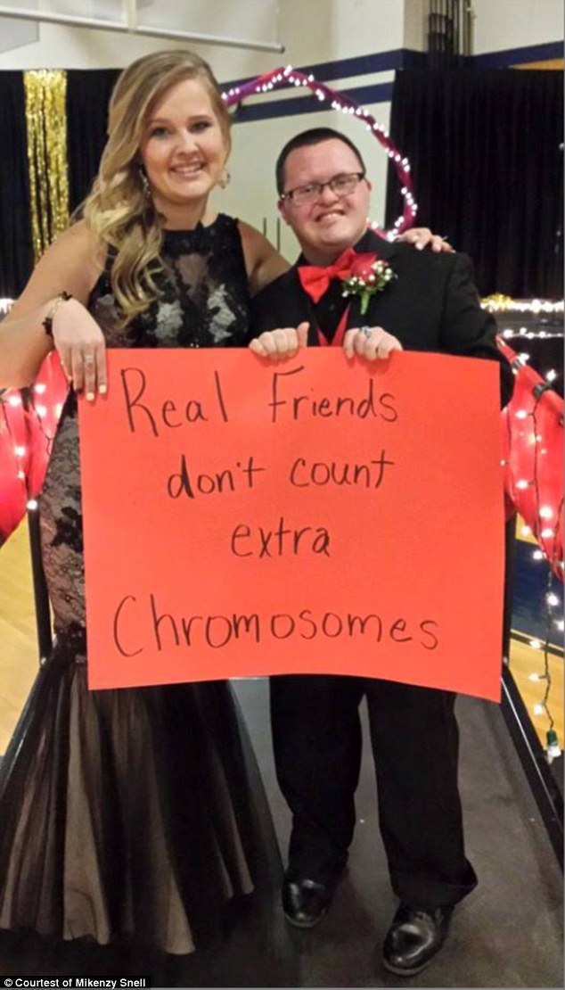
Do-Gooder Mentality Trope/Sideshow Virality
“Where capitalism posits a market economy…benevolence posits a moral economy of contractual obligations based on the pledge of human sympathy” (Garland-Thomson, 89)
“Even in her condition” = asking a disabled person to prom is unusually kind
“Real friends” = implies that most other friends do judge the young man for his Down Syndrome. The young woman then becomes special through her “real” kindness.
The “contractual obligation” portrays the person with disabilities as “dependent upon her supporter” (89) and supports “do-gooder mentality” (Linton, 14) that maintains institutional standards, “rather than restructuring the social environment”(Garland-Thomson, 51)
In the left image, the young man looks down at the young woman as he holds her hand. This position mimics that of parent and child. In the right image, the young woman has a hand placed on top of her date’s shoulder, which again suggests subservience.
Both pictures also occur at prom, an institutionalized high school experience. The disabled individuals can only then engage in the social environment through permission to conform from a non-disabled person.
Those with disability are then “the consequence of a comparative relationship in which those who control the social discourse and the means of representation recruit the seeming truth of the body to claim the center for themselves and banish others to the margins” (62)
“Like and share = respect” represents that the young man gains respect as the photo becomes more viral. As the young woman is “banished to the margins,” she does not gain anything.
Making a sign = there is an expected viewership. Not only does the sign declare that the two are “real” friends, but that the man has Down Syndrome. The “seeming truth” of the young man’s body connects to the young woman’s friendship
Questions how much of the friendship depends on viralness
What then happens with disabled representation when the person with disabilities has supposed free will?

Slide 21
Medicalization

Slide 22
“The Only disability in life is a bad attitude”

Slide 23
Overcoming Trope
Stereotypical presentation of people with disabilities as “physically flawed individuals who only need the right attitude to succeed” (Norden, 80)
Implies that disability is a choice
Narrows the wide spectrum of disability into one choice
Avoids pronoun use altogether;
Still functions as inspiration porn for the non-disabled viewer
Delegitimizes perspective of the disabled viewer.
Overcoming Trope = “personal triumph over a personal condition” (Linton, 18)
Depicts running or racing
One can win by “surpassing” their physical condition
Actively engage with their disabilities - good attitudes “overshadow” their disabilities
Depicted smiling
By “overcoming” their disabilities, they become happier.
This rhetoric creates “no need for civil rights legislation or affirmative action” for people with disabilities (19)
Responsibility lies in change of thinking
essentially “cures” them from their disability

Slide 24
“On the Spectrum” Model
https://twitter.com/thegirlfinch/status/1098951727712223234

Slide 25
Cult of Normalcy in The Medical model
The girl’s modeling skills surprised the babysitter because of her “cult of normalcy” expectations
“Cult of Normalcy”: “a set of rituals that police a normal way of being in society” (“Disability,” 86)
The girl cannot, therefore, be quirky and beautiful at the same time, due to cult of normalcy standards of beauty. She instead has to overcome her quirks through transforming them into “magic.” The babysitter is therefore not proud of the girl’s identity, but proud that she can appear as “normal.”
Both the “overcoming” trope and “cult of normalcy” = components of the medical model:
The medical model treats disability “as an individual’s physical and psychological problem to be overcome” (Norden, 80)
Especially problematic for the girl on the spectrum, or the girl with down syndrome, or for children who cannot afford prosthetic legs, because they can never “overcome” their disability
Lowers self-confidence and hinders “self-determination and subjectivity of people with disabilities” (“Disability,” 98)
The model also “acts with capitalist institutions, and helps identify any persistent obstacles that get in the way of participation in the free market” (86)
Encourages those without “good attitudes” or “normal ways of being” to not participate in society

Slide 26
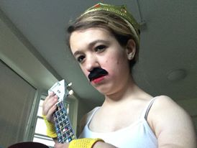
Conclusion: Where do we go from here?
By the end of this presentation, it may scare viewers to consider the power of objectification, infantilization, and medicalization with the disabled identity. Each of these projections functions as a tool of capitalism, which often defines the makeup of United States society. To assume that these capitalist ideas are unavoidable is to perpetuate conformity, however. It is to assume that I must pose nicely for others’ non-consensual pictures, that non-disabled people must post on the disabled perspective, that inspiration porn must become viral. We ignore another essential component of the American identity, individualism, through these actions. To avoid objectivity, we must grant and re-claim subjectivity. It is possible for the disabled person to wield the camera. Non-disabled people must give us the necessary resources and support to do so first, however.

Slide 27
Works Cited
Bruijn, RWL de. Cochlear Implants: People Hearing for the First Time! YouTube, YouTube, 1 June 2012
“Charity: The Poster Child and Others.” Picturing Disability: Beggar, Freak, Citizen and Other Photographic Rhetoric, by Robert Bogdan et al., Syracuse University Press, Syracuse, New York, 2012, pp. 42–56
Dailymail.com, Erica Tempesta For. “Down Syndrome Teen and Friend's Inspiring Prom Picture Hits Back against Disability Discrimination.” Daily Mail Online, Associated Newspapers, 8 Apr. 2015
“DISABILITY, SOCIETY, AND THEOLOGY: The Benefits and Limitations of the Social Model of Disability.” Reconsidering Intellectual Disability: L'Arche, Medical Ethics, and Christian
Friendship, by Jason Reimer Greig, Georgetown University Press, 2015, pp. 82–113
Eisenhauer, Jennifer. “Just Looking and Staring Back: Challenging Ableism through Disability Performance Art.” Studies in Art Education, vol. 49, no. 1, 2007, pp. 7–22
Garland-Thomson, Rosemarie. Extraordinary Bodies: Figuring Physical Disability in American Culture and Literature. Columbia
University Press, 2017.
“I'm Not Your Inspiration, Thank You Very Much.” Performance by Stella Young, YouTube, YouTube, 9 June 2014
Linton, Simi. Claiming Disability: Knowledge and Identity. New York University Press, 2010
Norden, Martin F. “‘I’M LUCKY – I HAD RICH PARENTS’: DISABILITY AND CLASS IN THE POSTWAR BIOPIC GENRE.” Cold War Film Genres, edited by Homer B. Pettey, Edinburgh
University Press, Edinburgh, 2018, pp. 79–98
Ward, William Arthur. “Inspirational Words of Wisdom.” 92 Vacation Quotes, Inspirational Words, 2019

Slide 28
Images Works Cited
Images:
“20 Attitude Memes To Show You're Not A Difficult Person.” Inspiring Pictures Quotes - SayingImages.com, 22 Dec. 2017, sayingimages.com/attitude-meme/.
Andrist, Lester. “The Problem with the Inspiration Porn of Super Bowl XLIX.” The Sociological Cinema, 2015, www.thesociologicalcinema.com/videos/category/disability. Artist. “The 12 Year Old Girl I Babysit Is on the Spectrum but Once She Says She Wants to Model and I Have the Camera on Her, All of Her Little Quirks Turn into Magic. All You Can See Is Her Beauty. Look at Those Fierce Eyes, You Have No Idea How Proud I Am of Her. Pic.twitter.com/Sa1FT1CQSw.” Twitter, Twitter, 22 Feb. 2019
“Before You Quit, Try.” Goody Webs, www.goodywebs.com/2013/02/before-you-quit-try.html
“Before You Talk, Listen. Before You React, Think. Before You Criticize, Wait. Before You Pray, Forgive. Before You Quit, Try.” Quotespictures.com, quotespictures.com/before-you-talk- listen-before-you-react-think-
before-you-criticize-wait-before-you-pray-forgive-before-you-quit-try/
Dupere, Katie. “New Comic Series Hilariously Depicts What It's like to Live with a Disability.” Mashable, Mashable, 19 Oct. 2016, mashable.com/2016/10/19/disability-comic-the-disabled-life/#SwIhmENzTOqb. Hooper, Andy. “‘The Only Disability in Life Is a Bad Attitude’ Meme.” Fabric of Digital Life, 2012, fabricofdigitallife.com/index.php/Detail/objects/2836. “MEME.” MEME, 30 Nov. 2016, me.me/i/the-only-disability-in-life-is-a-bad-attitude-scott-4764898.
mmort91. “Pity and The Prom.” Disabled Identity, 10 May 2016 “Runner Things #44.” Fuel Running, 5 Aug. 2011, www.fuelrunning.com/quotes/before-you-quit-try Tanaka, Alisa. “Dear Scott Hamilton: a Bad Attitude Is Not the Only Disability.” The Mighty, 10 Mar. 2019, themighty.com/2016/06/dear-scott-hamilton-a-bad-attitude-is-not-the-only-disability/. Wilson, Andrew. “Your Excuse Is Invalid.” Andrew Wilson's Blog, 17 Oct. 2016, blogs.ubc.ca/andrewwilson/2016/10/17/your-excuse-is-invalid/.

