Slide 1
10 Week Project
Reading Adventures with Sydney & Allie

Slide 2
For our Ten Week Project we chose to investigate the diversity of the authors (and in some cases editors) of the works we’ve read for our classes this semester.
French 001 and 003
Gothic Literature
Biological Anthropology
Cleopatra
Changing Our Story: Shifting Identities, Altering Environments

Slide 3
Research
Name of Writer/Editor
Title of Work
Gender of Writer/Editor*
Social Class of Writer/Editor*
Ethnicity of Writer/Editor*
Place of Origin of Writer/Editor
Publishing City of the Work
Genre of Text
Setting of Text
Job of Writer/Editor
Education of Writer/Editor
*Biased (explain)

Slide 4
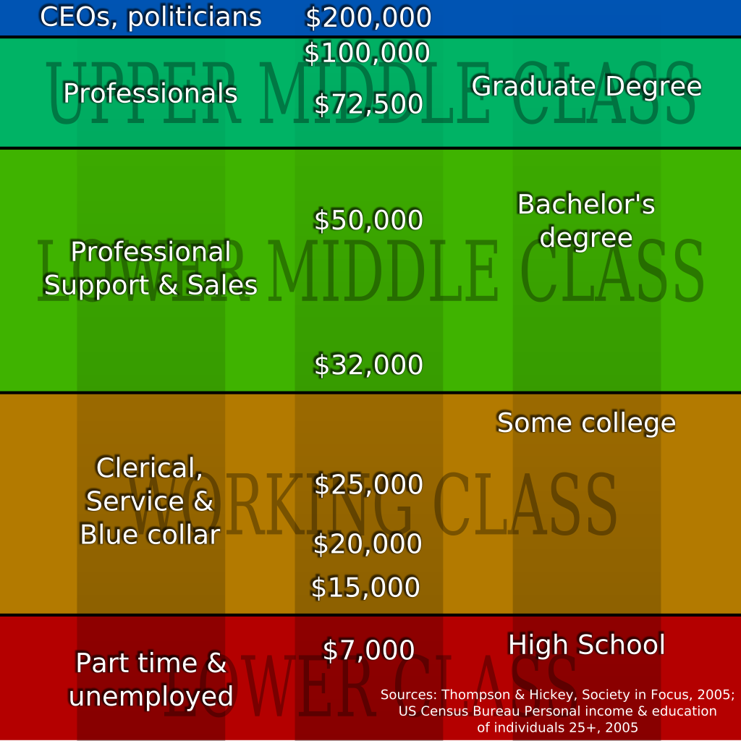
Let’s Talk About This Bias
Limited means of understanding someone’s gender
  Going off pictures, guys.
Income Assumptions
Average Income of Professors $98,564 (http://www.higheredjobs.com/salary/salaryDisplay.cfm?SurveyID=24)
  Therefore Profs= Upper Middle Class
Racial Bias
  Again, pictures
  Also, people with established careers/advanced degrees tend not to be People of Color because of Racial Inequality 1960’s (and onward).

Slide 5
Higher Education &
Socioeconomic Inequality
Year | White (%) | POC (%) | Foreigners (%) | Race/Ethnicity Unknown (%)
1998 | 67.9 | 18.8 | 10 | 3.3
2008 | 59.9 | 20.5 | 12 | 7.5
Age of Scholars→ Racial Bias

Slide 11
Conclusion
Something should be done about this.

