Slide 1
Which alternatives/ methods would you like to explore to replace the Prison Industrial Complex?
Challenging the Prison-Industrial Complex: Activism, Arts, & Educational Alternatives
Stephen John Hartnett
Are Prisons Obsolete?
Angela Y. Davis
Souls: A Critical Journal of Black Politics, Culture, and Society
Rethinking Global Justice: Black Women Resist the Transnational Prison-Industrial Complex
The New Jim Crow Michelle Alexander

Slide 2
Policing Policy Reforms
End to Criminalizing harmless and innocent victims
More education around telling people they can refuse police officers from searching their cars, so police can not find or plant illegal substances
Eradicate “stop-and-frisk” which allows police to search anyone “suspected” of engaging in drug activity
End to Federal Funding to Law Enforcement Agencies for making arrests that are connected to drugs
Eradicate “pretext stops”- routine traffic stops to take people out of their cars so police can search their vehicles

Slide 3
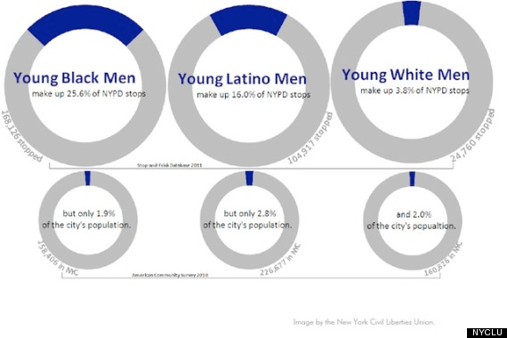
  Police should be required by law to obtain warrants to search people’s cars

Slide 4
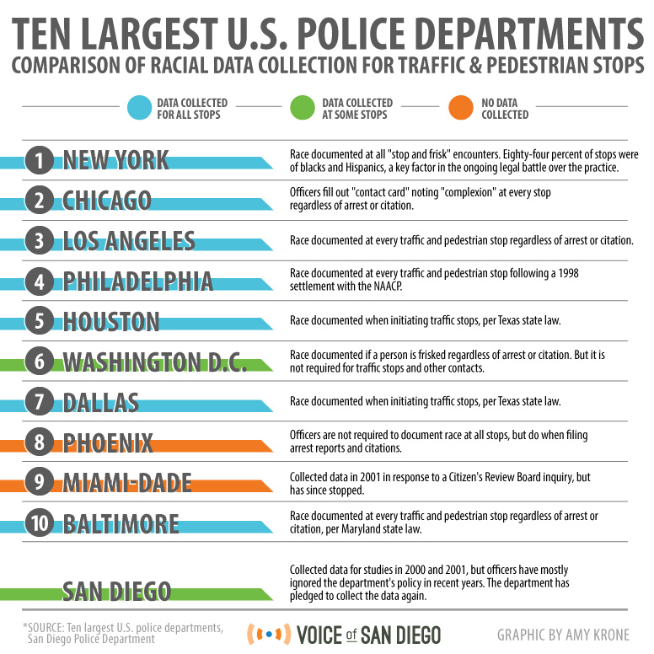
  Police should be rewarded for the “quality” and concern with the people they are accusing of a crime rather than the amount of people they arrest

Slide 5
Are Prisons Obsolete? Angela Y. Davis
End Correlation Between Imprisonment and Profit/ Industry Growth
Education Reform
Reconciliation and Reparation
Health System that Provides Free Physical and Mental Healthcare
Change Media Representation of Crime

Slide 6
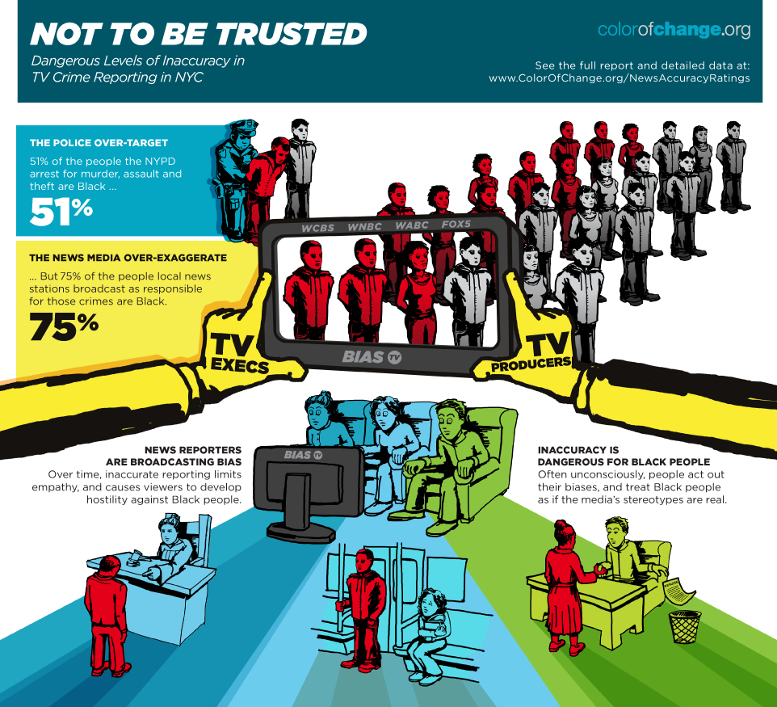

Slide 7
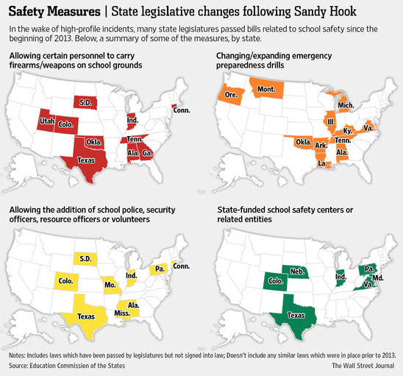
Angela Davis
Education Reform
Revitalization of education
Demilitarization of schools

Slide 8
Angela Y. Davis
Create health system that provides free mental and physical care for all
  Free drug rehabilitation programs should be accessible to everyone
Construct justice system that is based on reparation and reconciliation
Decriminalize immigrants
Drug use should be decriminalized to prevent systemic racism when determining who and where to search for drug offenders
Decriminalize womyn who defend themselves from or escape sexual abuse

Slide 9
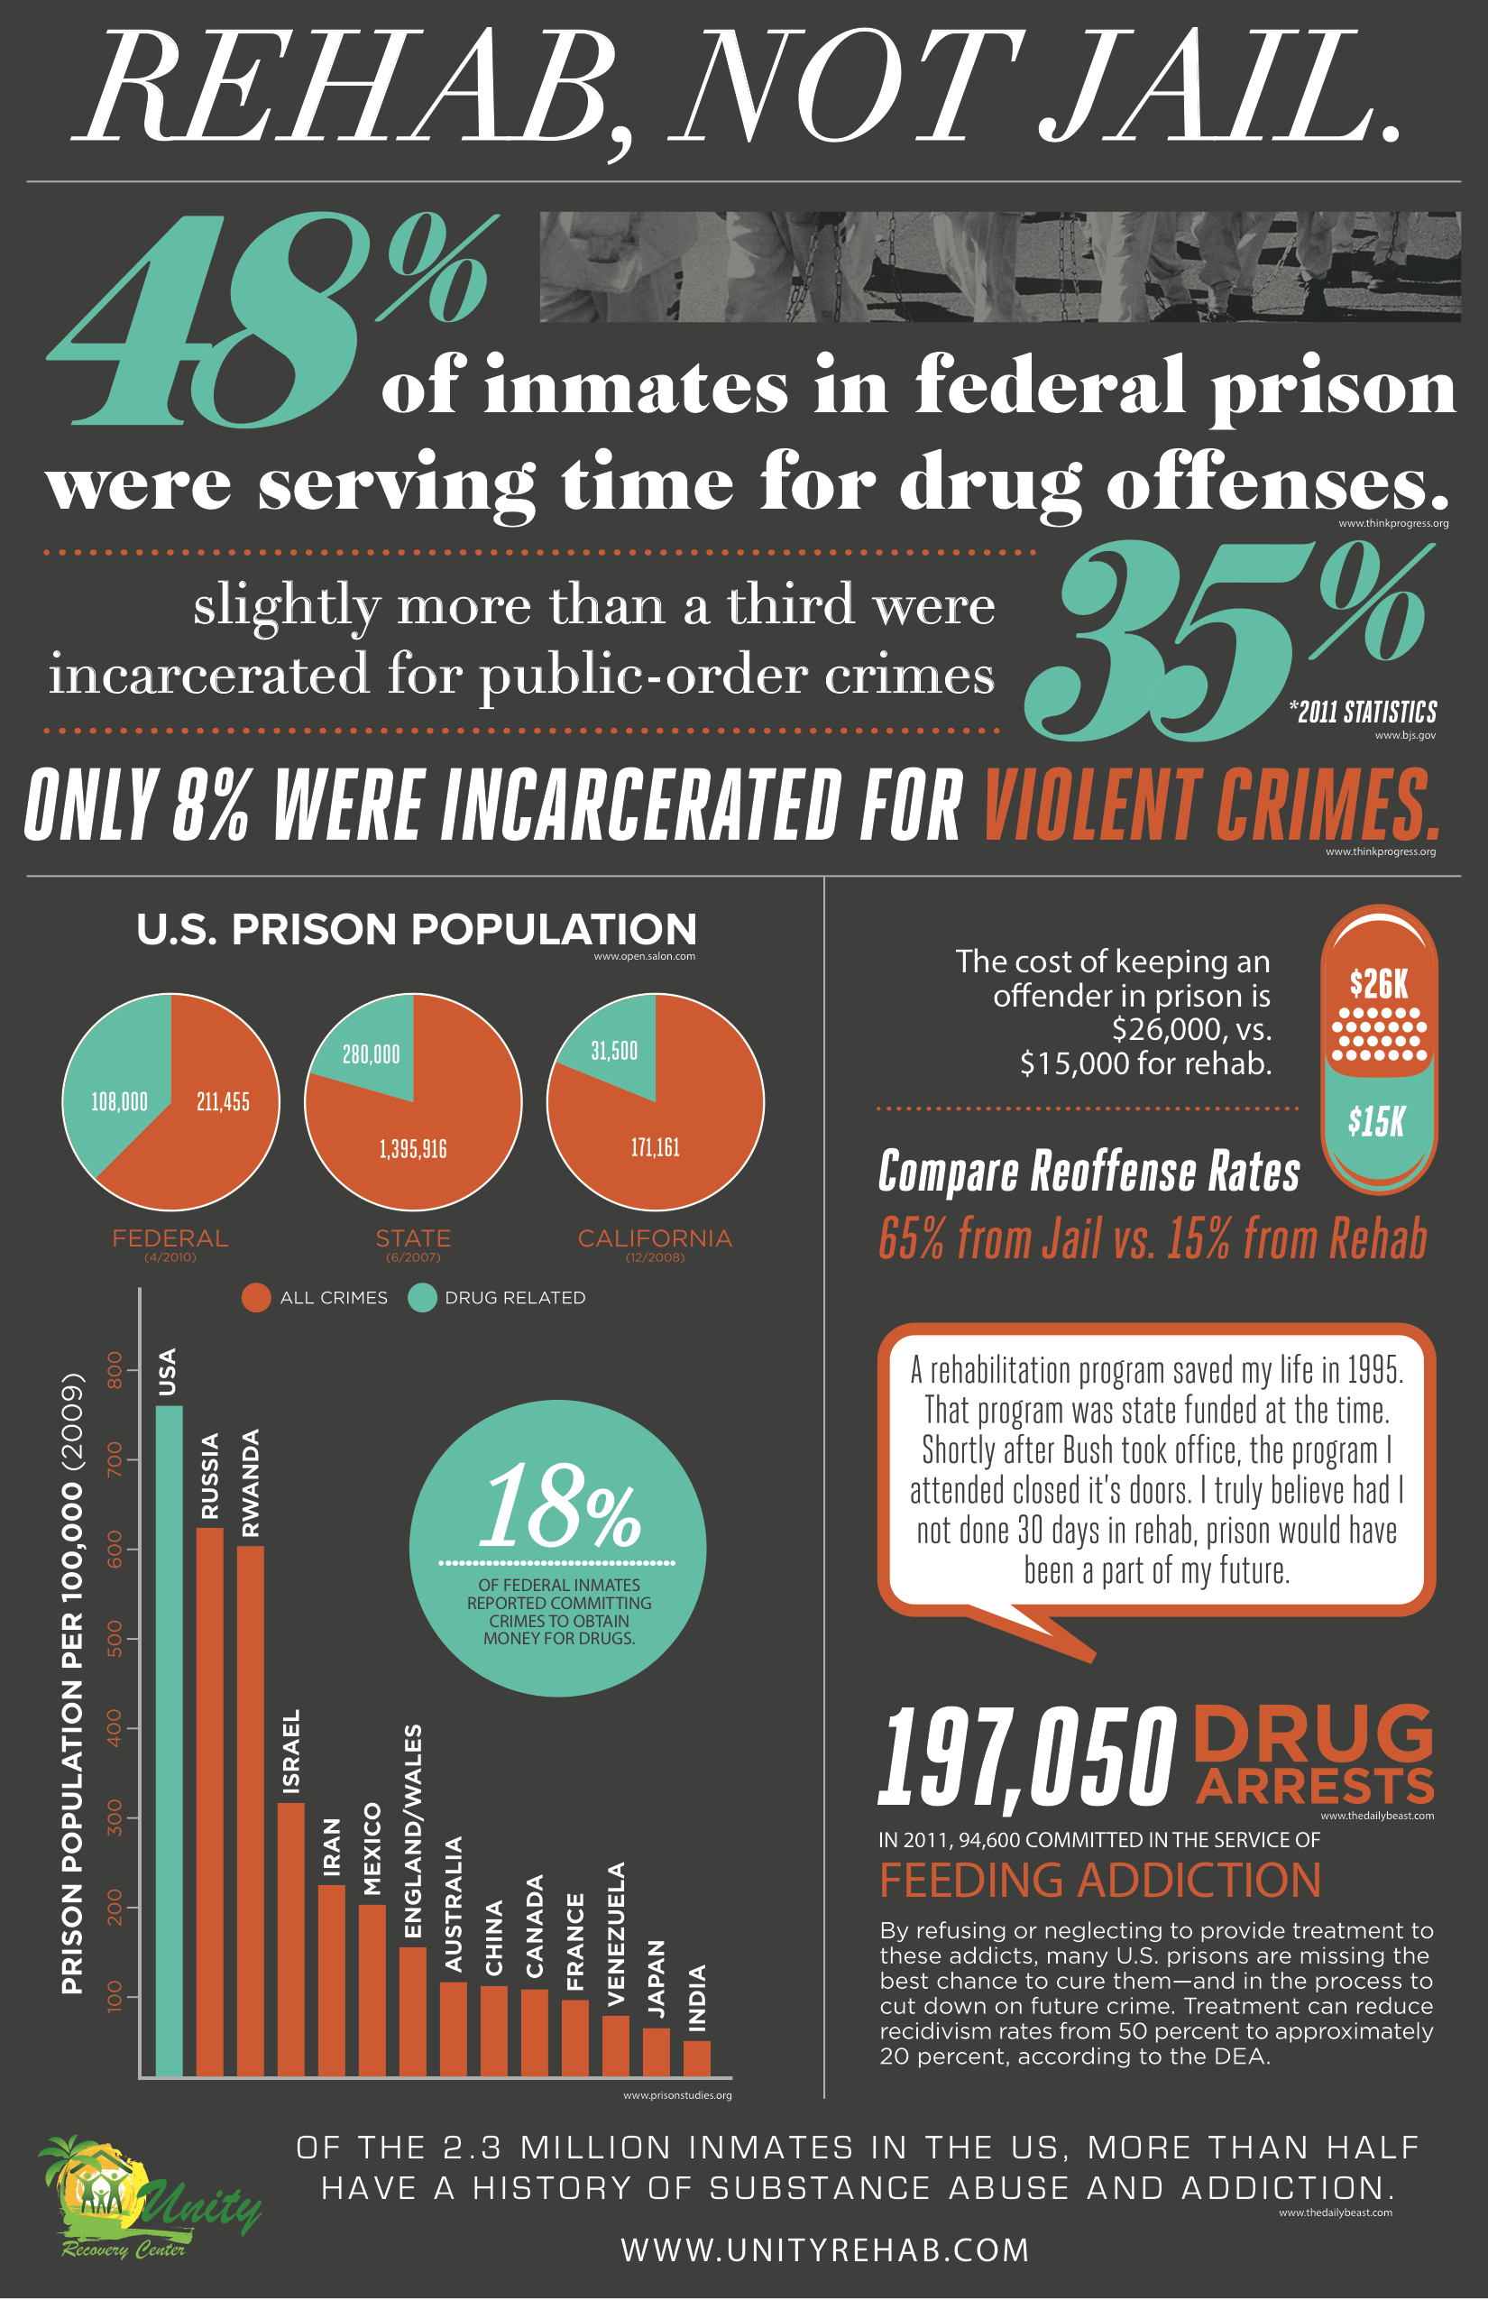
  Davis’ Approach/ Alternative to War on Drugs is..
    Free drug rehabilitation programs should be accessible to everyone

Slide 10
Angela Y. Davis’ Alternatives
  Decrease violence womyn encounter in relationships with the state and intimate relationships
End War on Drugs
Analyze media representation of crime and criminals
  “If we insist that abolitionist alternatives…strive to disarticulate crime and punishment, race and punishment, class and punishment, and gender and punishment, then our focus must not rest only on the prison system as an isolated institution but must also be directed at all the social relations that support the permanence of the prison” (112).

Slide 11
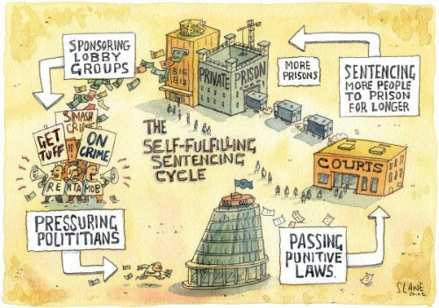
End Mass Incarceration:
Angela Davis and Michelle Alexander
https://youtu.be/EhObhSenc5s?t=1m

Slide 12
Michelle Alexander’s Solutions
  End to race determining position in social hierarchy
System of racialized social control
  Condemn racial violence
  "The superlative nature of individual black achievement today in formally white domains is a good indicator that the old Jim Crow is dead, but does not necessarily mean the end of racial caste" (21)
Change Media Images that perpetuate the stereotype that being a criminal equals being black
  Colorblindness
End the War on Drugs
Racial Sensitivity Training & Proper Legal Representation
Housing Discrimination Alternatives

Slide 13
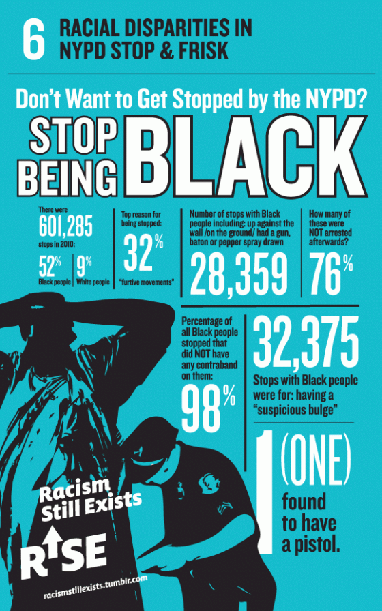
Media Portrays African Americans as Criminals
Sets-up “Us and Them” Dynamic
Police are encouraged to racially profile because of image of “black criminal”
Question and eliminate ideology that working-class African Americans are in their place because they did not “Work hard enough”

Slide 14
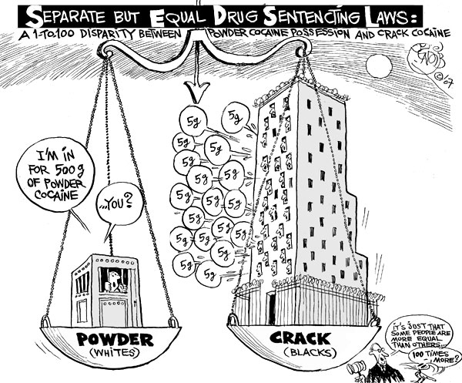

Slide 15
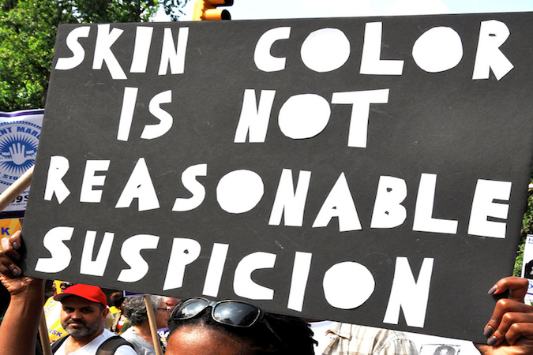
Michelle Alexander’s Solutions
Prison Industrial Complex specifically targets people of color and funnels them into a second-class status

Slide 16
Expose public to racial injustice of mass incarceration
  African Americans should be given tools to defend themselves from police crackdowns, especially in poverty-stricken neighborhoods
  "Once prisoners are released, they enter a parallel universe—much like Jim Crow—in which discrimination in nearly every aspect of social, political, and economic life is perfectly legal" (Alexander 192).

Slide 17
More accessible/ easier avenues for people to claim that police behavior or court conduct is racist

Slide 18
Challenging the Prison-Industrial Complex: Activism, Arts, & Educational Alternatives
Societal understanding that people live rich and problematic lives
Process of creating connection and community through theater programs where incarcerated youth and high school students act out and create plays, drawing from troubling life experiences and trauma- ridden life realities
Self-discovery of skills that can be shared and help improve people’s lives

Slide 19
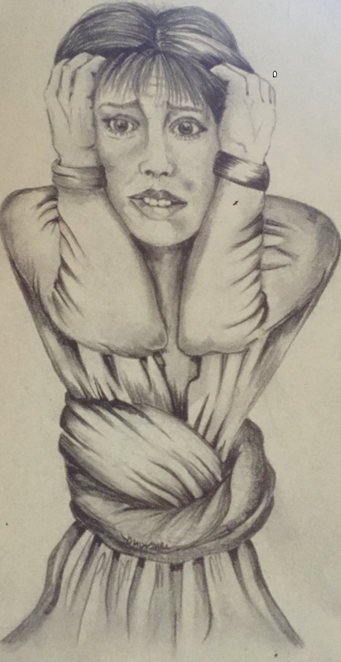
Nancy Jean King, Stressed, 1997
“King creates pencil drawings of children separated from their mothers and portraits of women filled with stress, anxiety, anger, and fear. Thus reminding us of the suffering of women serving disproportionately long sentences. Because her work speaks to and for the millions of families whose lives have been torn apart by the prison industrial complex, it stands as an indictment of recent laws that permanently take children away from their mothers” (Hartnett 151).

Slide 20
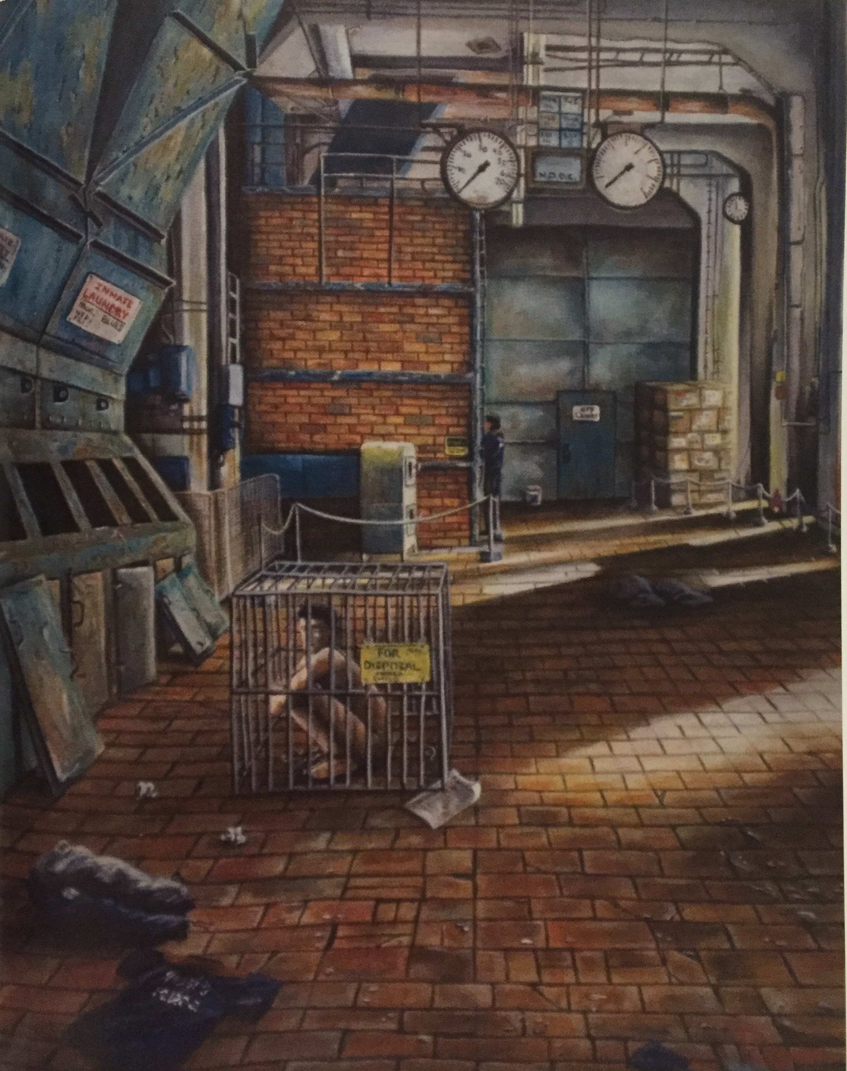
Bryan Picken, Confiscated Goods, 2009
“Picken’s early works offered vivid colored pencil drawings of rural life; they focused on details like the pattern on an old woman’s sweater, the quilt in her lap, and the wrinkles on an old man’s face. This year he turned his impressive skill at rendering space, light, and form to this depiction of the horrifying reality of prison warehousing, thus showing us what the prison industrial complex does in its daily routine” (Hartnett 153).

Slide 21
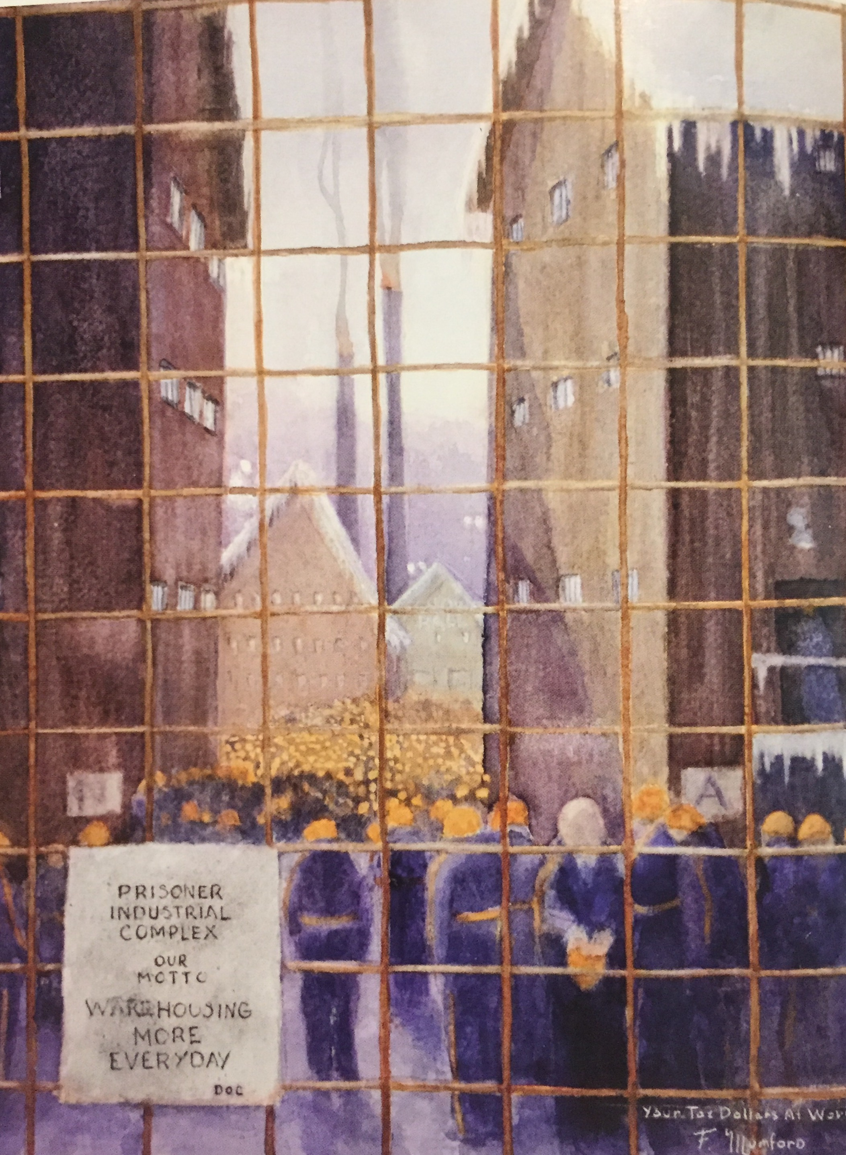
Fred Mumford, Prisoner Industrial Complex, 2007
“Mumford practiced his watercolor techniques so that he could create landscapes that took him back to the places he loved in the rural landscapes of Michigan. Then he began to turn his technique toward picturing prison realities, sometimes evocative, like a bush flowering in front of a barbed- wire fence, and sometimes more direct, like this image of the prison industrial complex” (Hartnett 152).

Slide 22
“In addition to dismantling the prison-industrial complex, abolition means generating alternative strategies for dealing with interpersonal harms that threaten the safety of individuals from oppressed groups” (Sudbury 355) ….
Responses to criminal activity, specifically regarding drugs should be determined not by one’s race but by…
  How harmful that person’s actions were to his/her/their community
  Taking into account one’s background and the reasons that lead to a person’s involvement with drugs
  Penalties should be the same/ relative for people who commit the same crime
  Counseling and social integration of ex-convicts
    Anyone who made a mistake no matter how egregious should be given the opportunity to reexamine his/her/behavior with others

Slide 23
Michelle Alexander’s Solutions
Racial/ inclusivity training
Each person should be able to properly defend themselves in court
Everyone should have access to a qualified lawyer who has had racial sensitivity and bias training
    Many people accept plea bargains when faced with large sentences even if they did not commit the crime they are being accused of

Slide 24
  Lawyers should be rehearsed in negotiating and determining plea-bargaining
  Access to representation by a lawyer who has had substantial experience in the type of crime that a person is being accused of
  Public defenders should have a limited number of cases, so they can put in the time to more effectively represent their clients.
  Witnesses should be more heavily scrutinized and background checks should be implemented to prevent them from being paid or coerced

Slide 25
Following a drug conviction
  Felons experience housing discrimination
  Everyone should be allowed to vote as a way to connect with the larger society and participate in one’s government

Slide 26
  Federal policies that allow housing agencies to evict tenants on the basis of suspected criminal activity should be deemed unconstitutional
  Anyone leaving prison should be given a place to stay and a living-wage job so they can more successfully reintegrate into society.
    Many ex-convicts are homeless after leaving prison
  No one should leave prison with debt that was accumulated as a result of their period of incarceration

Slide 27
  Many states prisoners are not allowed to vote
    Some can not vote on parole
  Give felons the opportunity and agency to influence elections and therefore have a positive impact on their community
  No one should be barred from jury duty based on race or prior convictions

Slide 28
  More difficult to access federally funded public assistance like food stamps, Medicaid, jobs once one is convicted of a felony

Slide 29
  Criminal defendants who plead guilty should have more access to information about consequence of being labeled a “felon”
  Judges should be required to educate defendants about these rights they are being coerced to relinquish once they plead guilty to felonies
    “As a result, judges are not required to inform criminal defendants of some of the most important rights they are forfeiting when they plead guilty to a felony… Yet these civil penalties, although not considered punishment by our courts, often make it virtually impossible for ex-offenders to integrate into the mainstream society and economy upon release” (Alexander 143).
- The highest quality of medical assistance and welfare should be available to everyone and be free

Slide 30
Law enforcement arrests that are connected to drugs…
  These arrests are: systematic rounding up of millions of people under the guise of drug enforcement
    Number 1 reason for black disenfranchisement
    Should be made illegal for police officers to steal people’s property in drug raids
    Drug activity normally occurs in plain sight in poor communities that do not have access to private spaces- more police presence

Slide 31
    More stringent regulations on where and when police can invade homes “looking for drugs”
      Laws that make warrants mandatory for a police officer to search someone’s car
      Laws prohibiting police from searching people without probable cause
        Many young black men are forced to spread their legs and place their hands on the wall in anticipation of seeing police or SWAT military
          Mistrustful relationship with police
          Opportunities and methods for police to regain their trust and connection with communities of color
      Prevent poor, black neighborhoods from being “occupied” by constant police presence

Slide 32
  Federal funding for law enforcement agencies should not be determined based on the number of arrests police officers make, but rather for how well law enforcement resolve conflicts through dialogue, assisting people in finding drug addiction services, and other types of support to improve people’s social and economic mobility
    Abolish laws that maintain the War on Drugs
  Police should be retrained so their objectives are to prevent more violence from occurring rather than steal people’s property and inhibit personal rights through “search and seizures”

Slide 33
Racial bias training to address and debunk racist beliefs
  Prevent police from picking drug offenders based on race

Slide 34
Social services to help everyone access meaningful education
Demilitarization of Schools

Slide 35
Prison Industrial Complex Crisis
“In less than thirty years, the U.S. penal population exploded from around 300,00 to more than 2 million, with drug convictions accounting for the majority of the increase” (Alexander 6).
Deconstruct the innocent/guilty binary

Slide 36
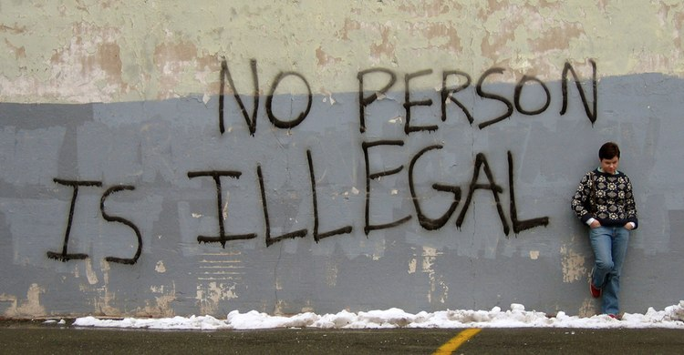
Decriminalizing all Immigrants

Slide 37
Community- Based Solutions to Conflict
Conferencing Circles and Mediation to Resolve Disputes
Alternative neighborhood watches
  Provide safe living environments/ support
Critical Resistance, an organization that was formed by Angela Davis and other Bay Area activists in 1998 describes abolition as: “[A] political vision that seeks to eliminate the need for prisons, policing, and surveillance by creating sustainable alternatives to punishment and imprisonment…. An abolitionist vision means that we must build models today that can represent ho we want to live in the future. It means developing practical strategies for taking small steps that move us toward making our dreams real and that lead the average person to believe that things really could be different. It means living this vision in our lives” (Sudbury 355).

Slide 38
Establishing affordable housing
  Laws should be created that prevent homeowners from evicting tenants because of suspected illegal activity
  Eliminating legal discrimination

