Slide 1
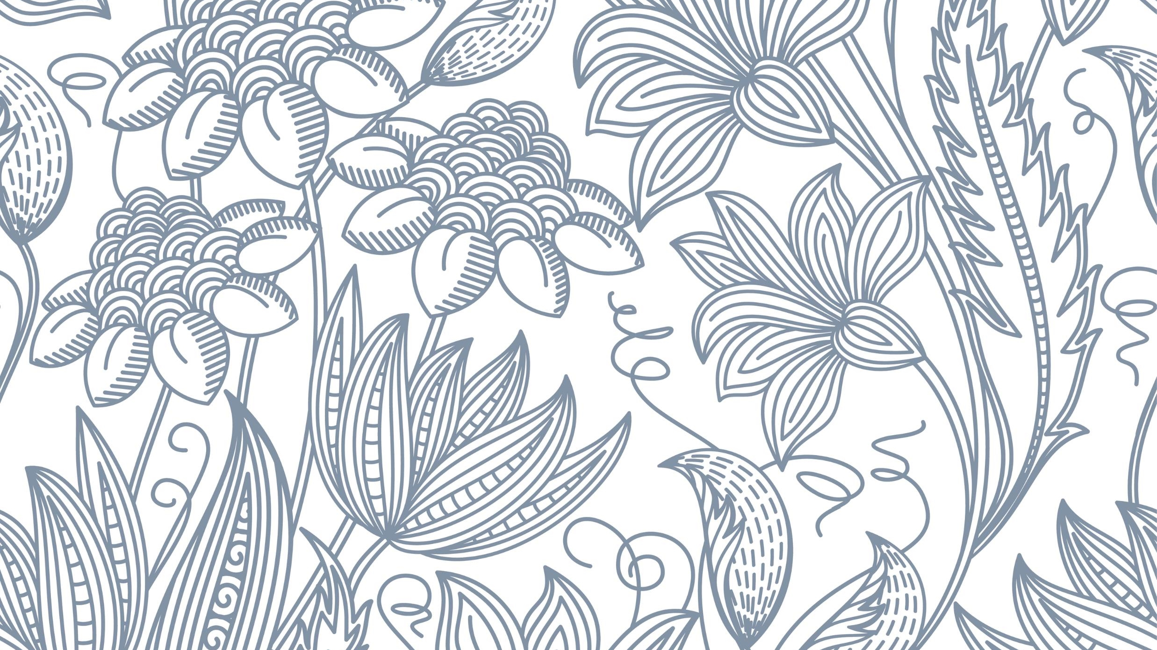
Art and Disability: What are beauty and wholeness
Jenny Jiang
CDS 2022
Professor Kristin Lindgren

Slide 2
Introduction
Art-various forms, static or moving, immortal or evanescent, accidental or planned. All are ways to record the past, inform the present, and inspire the future.
Disability-physical, mental, psychological. Art as adaptive coping strategy to express. Observe the world from a unique perspective.
Subtopics: how preserved art reflect mindsets of our ancestors; how current artists exhibit their disability as important parts of their identities.
Time limited, curated pieces are parochial. Feel free to draw connection from your memory and your favorite art

Slide 3
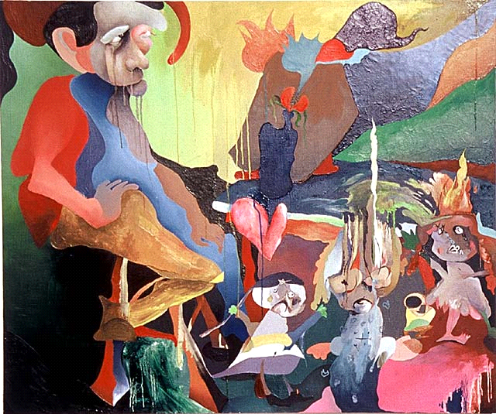
When Art and Disability intersects
Disability could be an artist’s major/minor identity
Disability restricts one’s ability to create art, but also enhances one’s urge to express.
Art as adaptive outlet, to fulfill life’s meaning.

Slide 4
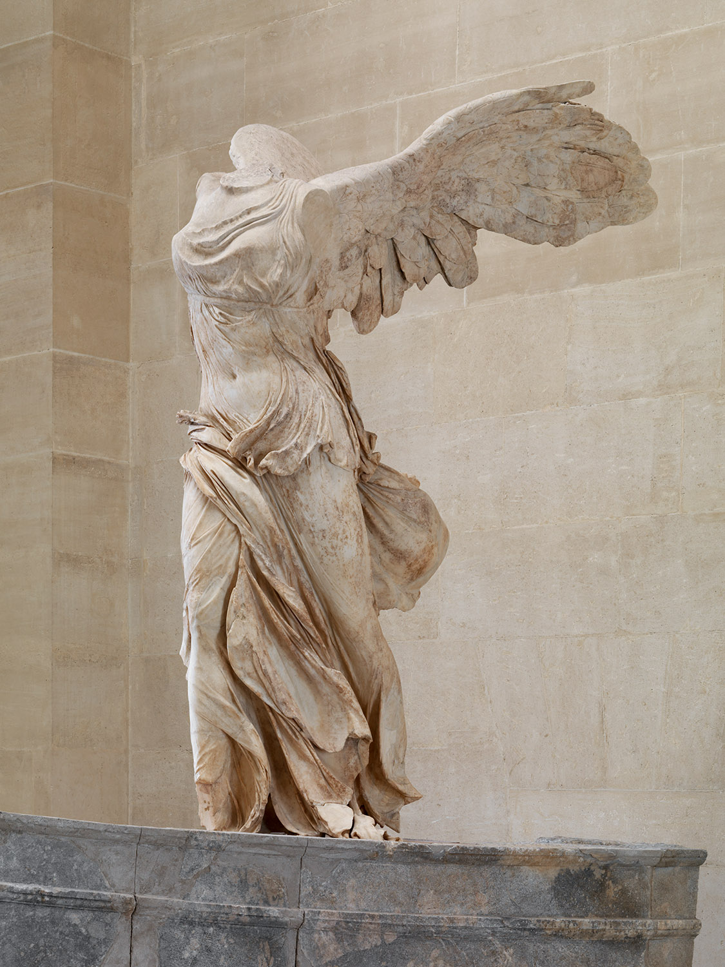
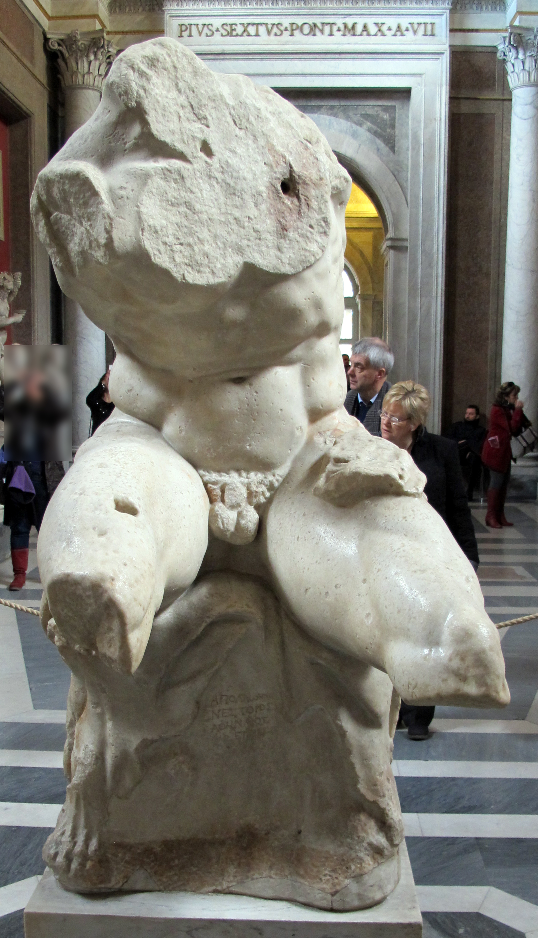
Sculptures in antiquity, wholeness from fractured pieces
Imagination of the spectator fills the blank automatically
Missing pieces adds mystic charisma
Sculpted as able-bodied figure, abide by the aesthetics of the time
Focus on what is left, instead of what went missing
Reflect features of the era with male/female dynamics
Narrated wholeness, subjective
Autonomy at the eyes of the beholder

Slide 5
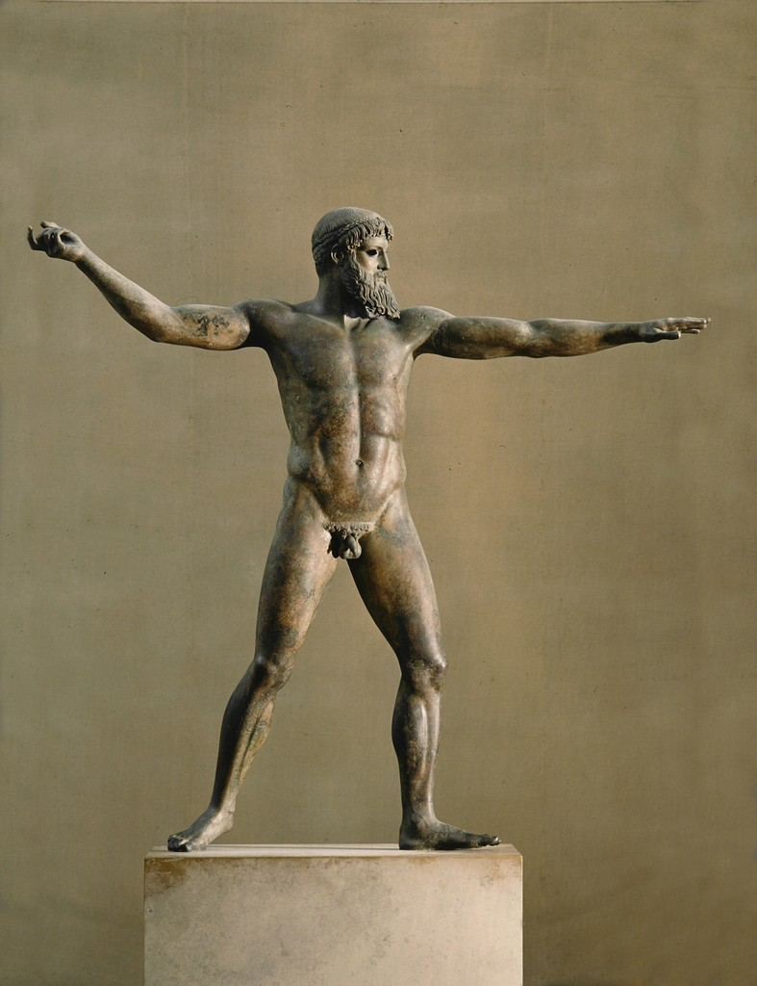
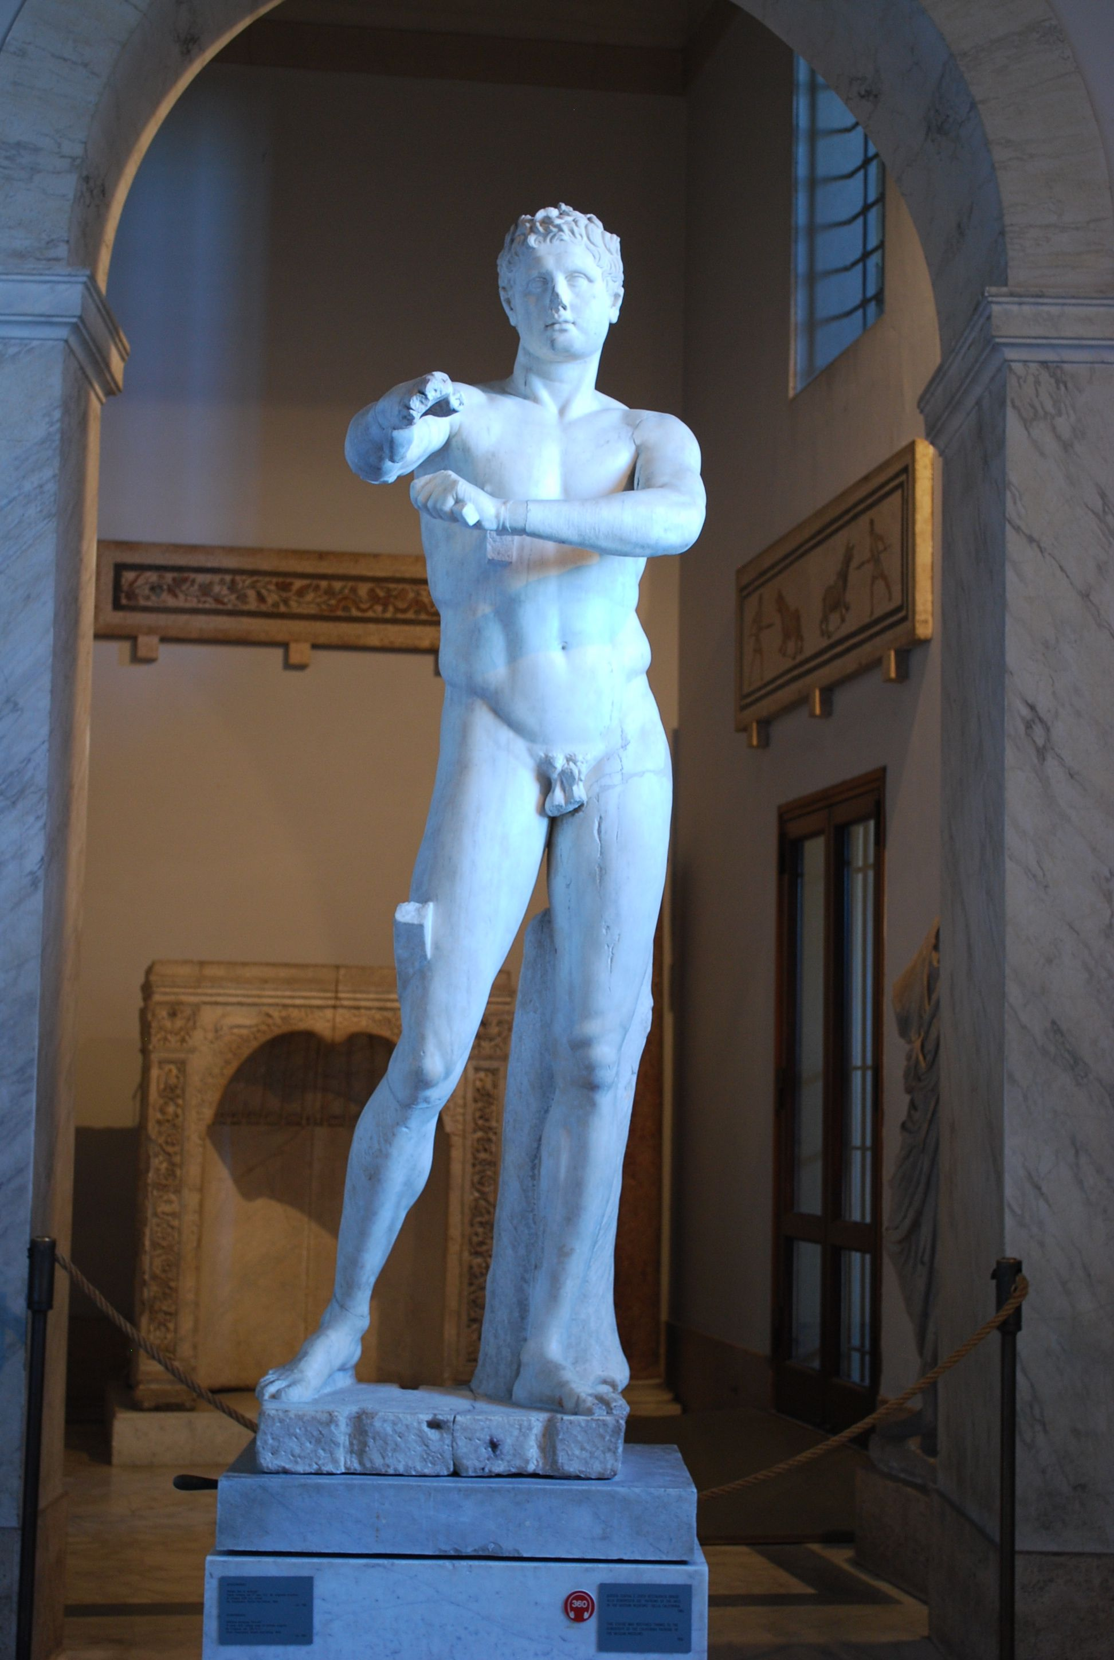
Promotion of the “perfect” body, how aesthetics are curated
Classical ideal in Greek Art, Gods in form of male nudes
Olympia and athletics, associate body strength with capability.
Glory of ancient Greek immense, tendency to follow their path
Stereotype enhanced, fixated. Revolution hard to arise
Disability rarely associated with strength in antiquity, less protected
Disability in ancient time mostly occur in battle scenes, forced upon injury, instead of innate

Slide 6
Contrast of deified sculpture and the shattered reality
Sculpture-biased medium, patrons either with ample money or resources.
Artists requested to beautify the subject, despite unwillingness. Sculpture as restrained art form
Disabled people in the past neglected, despised. Unlikely have their portraits preserved through sculpture
Past, art served the elites, disabled artists not entitled to create art.
Audience of art expanded after renaissance, shift from religion to humanism.

Slide 7
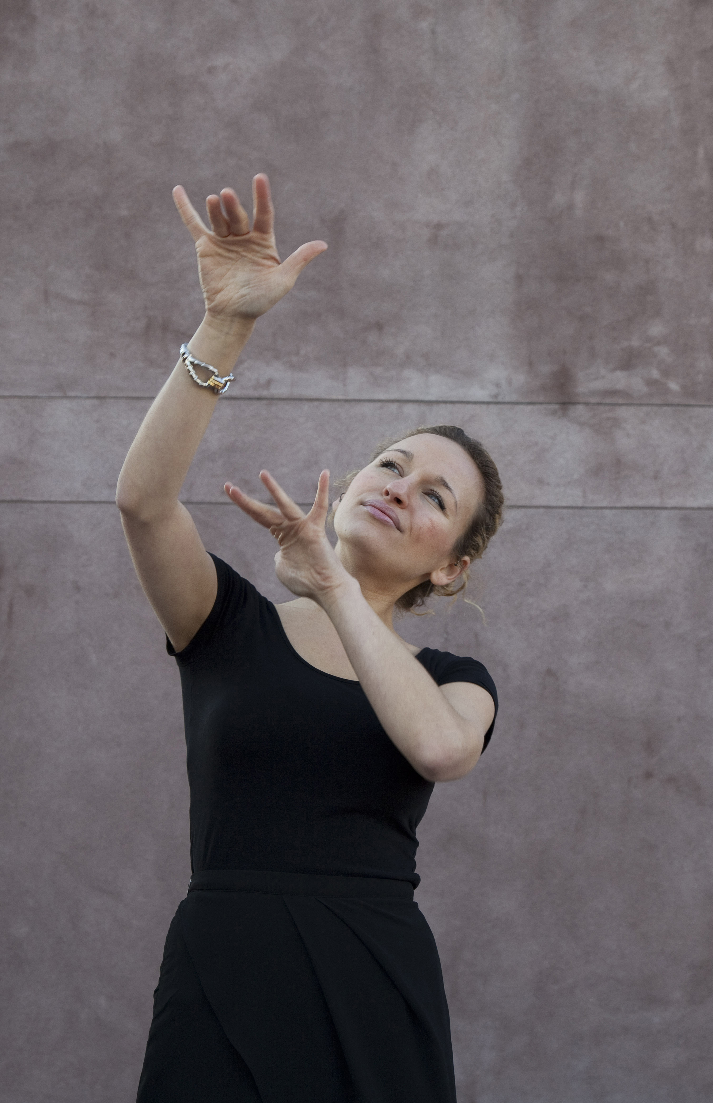
Message from movement: ASL poetry
Essence of poetry: complex thoughts/themes condensed into verses
Language not the sole information outlet
Movement, facial expression, symbolism. Maximum use of sensory media
ASL under spotlight, no longer as sideline
Breakdown communication boundary
Propel the public to interpret and listen with their eyes and hearts

Slide 8
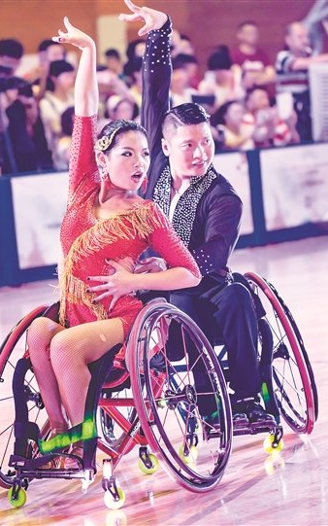
Message from movement: Wheelchair dance choreography
Wheelchair not as hindrance, but comrade, assistance to show inner strength
Competition, entertainment. How identity shines
Technology help, training, staging, collaboration of various sources
Rigid symbolism of wheelchair transformed into agility via choreography.
Why important: process of imagination into execution. Tear down stereotypes

Slide 9
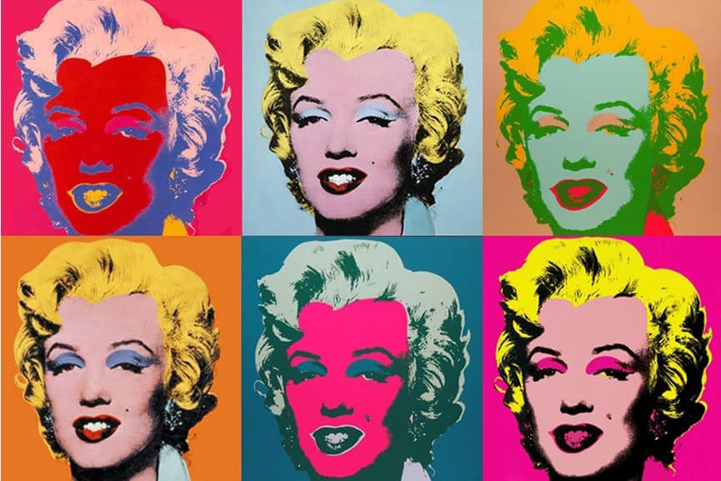
Art and pathology, when paintings become witness of disorder-case study of Andy Warhol
Late years, combination of color goes morbid, out of mind
How art could help with diagnosis
Besides from aesthetics, art with pathological significance
Inspired by talk with an adult friend in Pittsburgh, her family story
Potential revision to DSM and ICD (International classification of diseases).

Slide 10
Art as escape: case study of Yayoi Kusama
Famous artist with her trademark of dots
Soothing power from repetitive movements
Art to empower her identity as women, break free from traditional role of housewives.
Transfer visual and hearing hallucinations onto canvases.

Slide 11
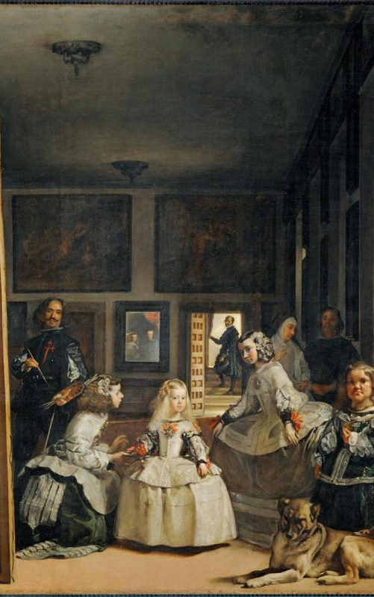
Disability and paintings, case study of Habsburg dynasty
Art to peek at historical turbulences
Disability both at center and marginalized
Aristocracy, normalize disability. How economic and political stanzas lift the pressure of exclusion
1656, mirror image of past and present

Slide 12
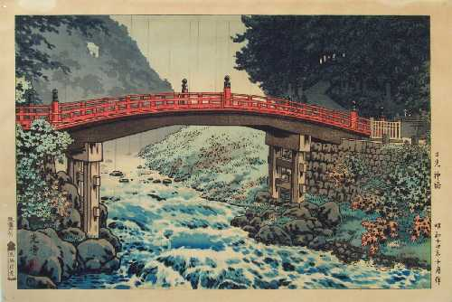
Futural application: art as bridge to empower and connect
Across ages, art as forceful medium to convey knowledge, call for civil movements, to record anecdotes and to carry religious obligations
From focus of lord to focus of self, art shifts its focus
Art condenses one’s feelings into pulpable forms
Through appreciating art pieces, we give respect to the creator. Indirect connection
Where should the water flow from now on?

Slide 13
Q&A, time to reflect. And take-home messages
Antiquity, perfect body deified to worship gods, distant and idealized presentation of body.
Through creation, able to leave culturally bond roles and relieve hallucinations, establish one’s trademark
Abnormal use of color might indicate certain disorders, art used as diagnosing tools
When aristocratic status collides with disability, shall one represent earnestly or shun away.
What other forms of art pops up in your mind at its intersection with disability? Are they different from the ones mentioned in this slideshow or similar?
Imagine yourself at these artists’ standpoint, what kind of art would you create and what theme to advocate?

Slide 14
References
Andy Warhol: The pop art King, https://musartboutique.com/andy-warhol-the-pop-art-king/
Koitsu -- "Sacred Bridge at Nikko“ http://www.ukiyoe-gallery.com/detail-fw06.html
Las Meninas, Diego Velázquez, c. 1656 https://www.britannica.com/biography/Diego-Velazquez
Yayoi Kusama, All the eternal Love I have for the pumpkins, https://icamiami.org/exhibition/yayoi-kusama/
Deaf Jam official website, https://judylieff.com/Deaf-Jam
Art and Disability: Intersecting Identities among Young Artists with Disabilities https://dsq-sds.org/article/view/3034/3065
Winged Victory of Samthrace, https://www.ancientworldmagazine.com/articles/winged-victory-nike-samothrace/
The Torso of Apollo, https://www.feuilletonfrankfurt.de/2010/03/18/torso/
The Artemision Bronze, https://en.wikipedia.org/wiki/Artemision_Bronze
Sculpture of a Greek athlete, https://www.pinterest.jp/pin/613967361669853549/

