Slide 1
The Culture of Politeness
By Princess Jefferson

Slide 2
Mission and Purpose
There is a culture here that some people choose to acknowledge and others do not. I call it the culture of civility and/or politeness.
At the start of this project I felt that this culture was more harmful than good, because this culture In my opinion sugar coats a lot of things and builds a space that is exclusive of the truth and problem solving skills.
I decided to do a 6 weeks project on this, after attending sessions of thrive and watching the people around me.

Slide 3
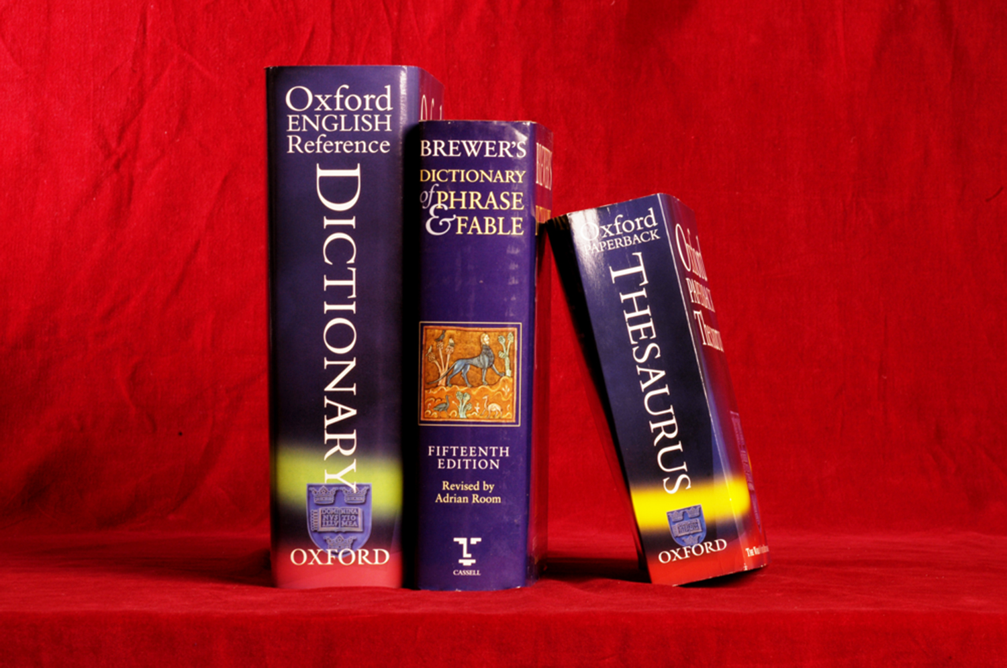
Definitions
Civility arrived in the late 14c. “Status of a citizen”, from old French civilite (14c), from Latin Civiltatean, (nominative civitas) The act of governing; courteousness. Etc.
Etymonline.com/index.php?allowed_in_fram=0ASsearch-civility
Polite- late 14c. Polished or burnished. From Latin politus,”refined, elegant, accomplished.
The point of this exercise was to see if Bryn Mawr’s culture fit any of these definitions and/or qualifications.
I define Bryn Mawr’s culture of Politeness as a refined atmosphere where communication among people on campus is formally courteous and socially correct, and because of this is very restricted.

Slide 4
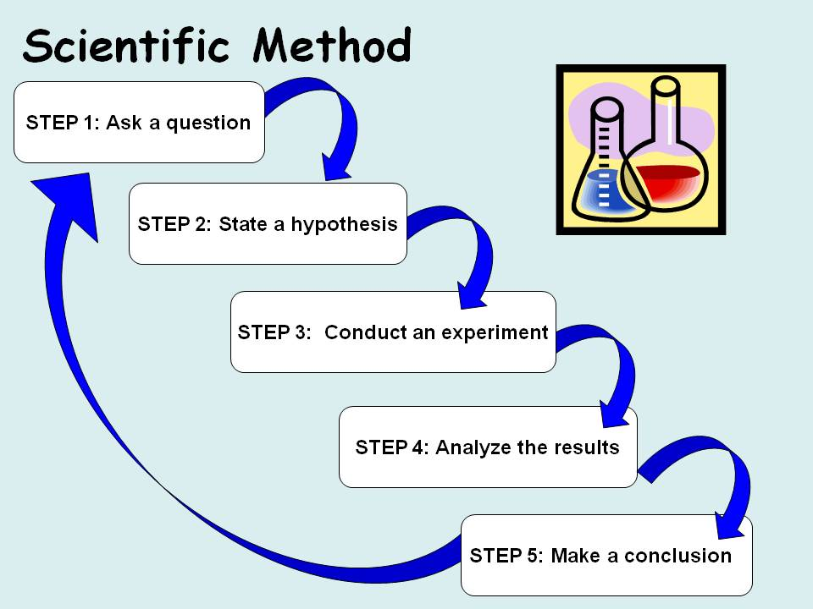
The Scientific Method
I wanted to conduct my research in the form of the scientific method, to get the best results possible.

Slide 5
Following the Steps
Define the problem: I believe that Bryn Mawrs culture of civility does more harm than good to both students and faculty.
Hypothesis: If everyone shares the same beliefs or values then the culture of Politeness exist, but if you do not it falls.
Research: for the research part of this I decided to conduct 30 interviews; ten faculty members, ten upper classmen, and ten freshman.
Research: questions
1)How do you define civility and/or politeness?
2)Based on your definition do you belief that Bryn Mawr fits this definition? How or How not?
3) How might the way that BMC chooses to handle certiain situations be beneficial or non- beneficial?
4) What is the best form of Communication?
5) Do you think there’s a time when civility and/or politeness should paused?
6)Is there a story that you would like to tell about a time when you felt that civility was expressed In a good or bad way?
7) If there was anything that you could change about Bryn Mawr what would it be?
8) For faculty only- When did the BMC culture of politeness begin?

Slide 6
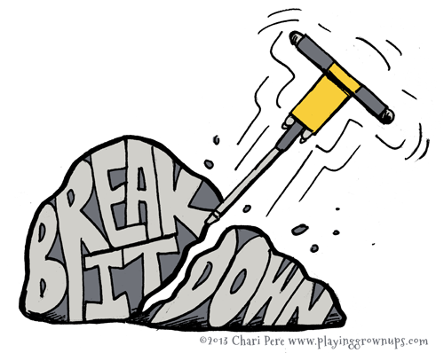
Dissecting the Questions
These question were created randomly, but of these two are general which are questions one and four, while the rest pertain to Bryn Mawr.
During the interviews anything that wanted to be expressed could be, and to make the person that I was interviewing feel more comfortable I gave the option o being anonymous.

Slide 7

Collecting the data/ Experiment
I conducted these interviews in 15 minutes intervals and the experiment was finding out how many people felt that this culture was beneficial or non- beneficial.
A lot of people chose to be anonymous for these interviews; but the overall message was the same through out: The intent of the culture of politeness is good, but the actual affect is not.
Interestingly the international students were among the largest percentage of those who felt that the atmosphere here was beneficial

Slide 8

Conclusion
It was clear after conducting these interviews that not only was my hypothesis proven correctly, my problem was definitely validated.
It appeared that the negatives did outweigh the positives, but based on the responses, I now believe that maybe there is a balance, as to why this culture has lasted for so long.
What causes damage is also allowing our school to be one the best among civility, yet voices are silenced, so is this culture really worth it, if the very people you strive to protect and/or make a priority are really just a part of a business?

