Slide 1
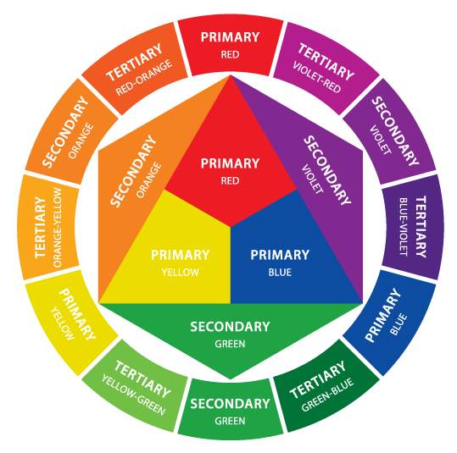

Slide 2
What’s your writing style?

Slide 4
Prompt
What does activism mean to you now. In asking this question we are inviting as wide a spectrum of possibilities as you can imagine. Drawing on at least one of the texts we have studied together, focus in particular on your role at the praxis site.
What questions do you have now on activism. What questions do you have and how might you approach addressing them.

Slide 5
Examples:
Suzan Lori-Parks = orange gradient: Parks’ writing inspires me to continue fighting to see those who are seemingly unseen. Her work challenges me to see beyond deeper into history, guiding me through a sliding scale of comfort. I have chosen the gradient to allow myself space to agree and disagree with Parks.

