Slide 1
Beyond Race and Ethnicity: Incorporation of the Culture of Disability into Cultural Competence Education
Xiwen Jia

Slide 2
Cultural Competence
Definition: “a set of congruent behaviors, attitudes, and policies that come together in a system, agency, or among professionals, and enable that system, agency, or those professions to work effectively in cross-cultural situations.” (Cross et al)
Intention: eliminate health disparities, which involve differences in the presence of disease, health outcomes or access to care that are specific to a given population (Carter-Pokras et al)
Notes:
Health disparity: Carter-Pokras O, Baquet C. What is a “health disparity”?. Public Health Rep. 2002;117(5):426-434. [Google Scholar]

Slide 3
Why care?
Prevalence of health disparities among the disabled community
Relative rareness of doctors with disabilities → generally low level of understanding within the medical profession:
  Social context of disability
  Non-medical factors affect the health of people with disabilities
Under HealthCare Settings, culture is often defined only as a product of race and ethnicity

Slide 4
Goals
Cultural competence extends beyond understanding those values, beliefs, and needs that are associated with age/gender/racial/ethnicity/religion
More inclusive definition of culture in Healthcare Professions (e.g. Medical School Curricula)

Slide 5
My interests/Project Scope
Recall ‘Cultural Competence’ learned in my past health studies senior capstone class
Draw the link between health studies and critical disabilities studies
How to address the culture of disabilities in cultural competency initiatives in medical education
  Find literatures on applying the model of cultural competence to the culture of disability
  Analyze them from critical disabilities perspectives

Slide 6
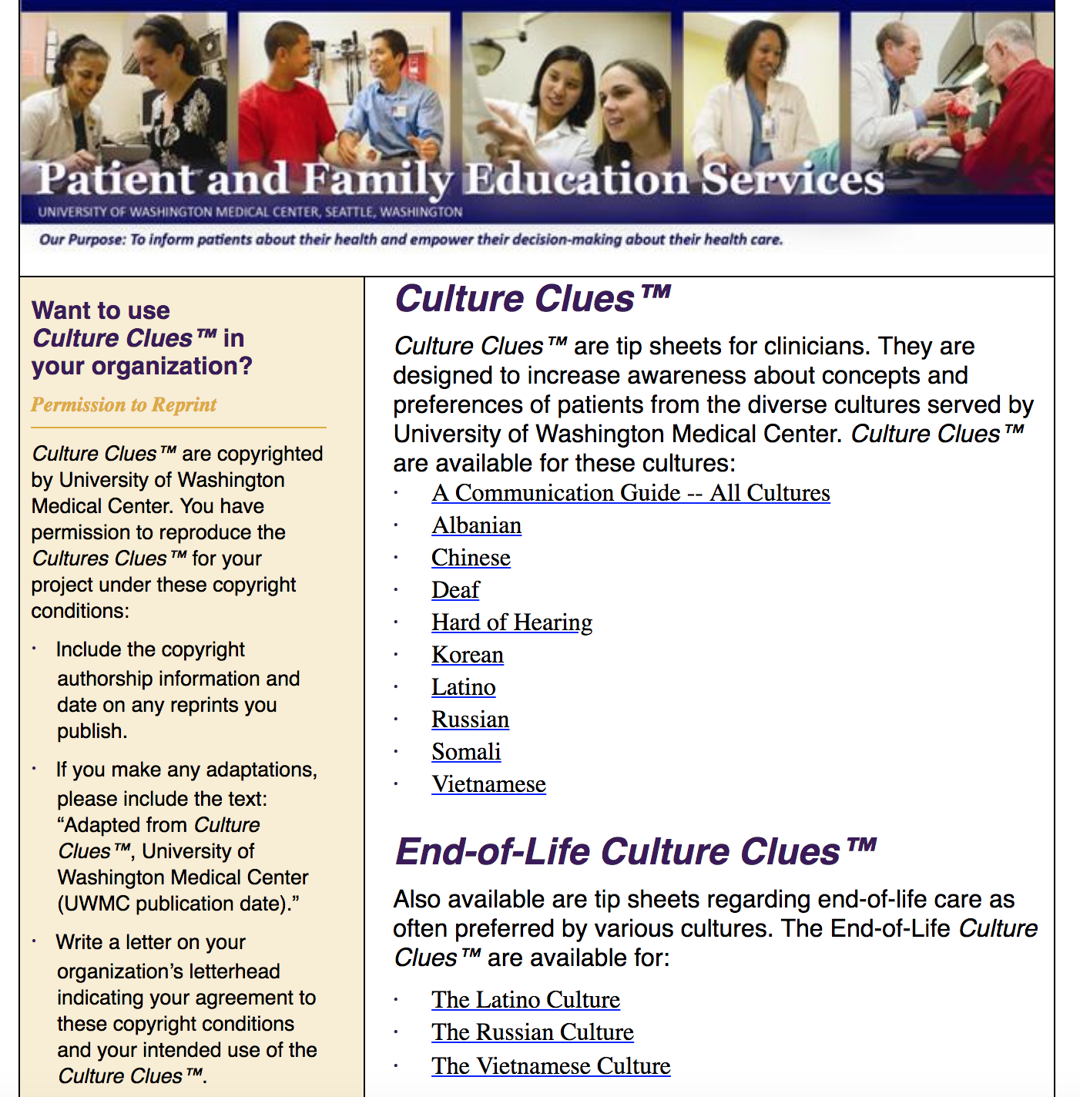
‘Culture Clues’
Source: University of Washington Medical Center (https://depts.washington.edu/pfes/CultureClues.htm)
Purpose: ‘to inform patients about their health and empower their decision-making about health care’
Cultures Clues:
  Mostly different ethnicity
  Limited on disability culture
Oftentime: cultural differences == sociopolitical or ‘minority group’ model
Condescending tone
Notes:
https://depts.washington.edu/pfes/CultureClues.htm

Slide 7
Incorporating the disability culture into Flores’ 5 Elements of Cultural Competence
Language Issues
Patients/Parents’ Beliefs
Folk Illness and Remedies
Provider Practices
Normative Cultural Values
Eddey, Gary E. et al

Slide 8
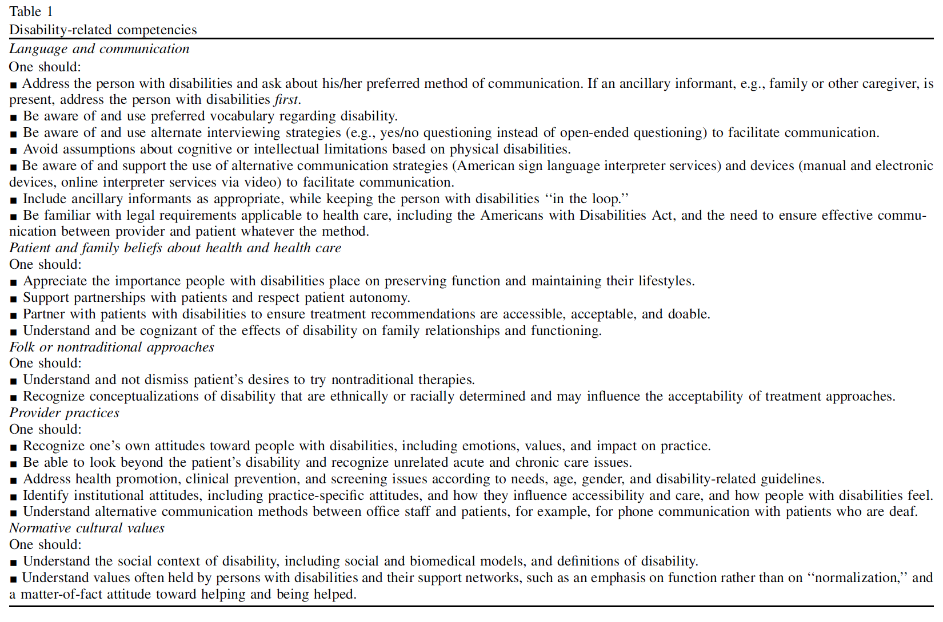
General Overview
K.L. Robey et al.

Slide 9
Language Issues
For patients with cognitive impairment: adjusting complexity of speech to be understandable
  Cognitively Accessible Language (Why we should care)
An inability to speak ≠ cognitive deficit
Do not foreclose individual as a potential key source of clinical information
Avoid condescending tones / “infantilizing manner’
  ‘Inspiration Porn’ (Stella Young, I'm not your inspiration, thank you very much, TED Talk)
Basic familiarity with assistive and augmentative communication devices

Slide 10
Patients/Parents’ Belief
Be aware of their belief that they know their conditions more than the physicians
Advocacy roles of parents → help accomplishing treatment goals

Slide 11
Folk Illness and Remedies
Targets of seller of folk remedies→ potential harm and uncertainty → educate the family about the relative risks and benefits of these alternatives

Slide 12
Provider Practices
Avoid ‘infantilizing speech’
  May discount or ignore the inputs of patients with disability
Lack of ‘age-specific competence’: continuation of care into adulthood
Home visits
  Environmental
  Familial
  Social
Conscious of complex medical symptoms → multidimensional treatment approach

Slide 13
Normative Cultural Values
Acceptance of human differences
  Temporality of able-bodiedness: “Any of us who identify as ‘nondisabled’ must know that our self-designation is inevitably temporary, and that a car crash, a virus, a degenerative genetic disease or a precedent-setting legal decision could change our status in ways over which we have no control whatsoever.” --- Linton, Simi., Claiming Disability, Foreword, page 3
Interdependence v.s. Dependence (interdependence is valued more in disability culture)
  The play -- ‘A Fierce Kind of Love’
Understanding of different needs depending on different levels of dependence

Slide 14
Thoughts/take-away
Importance of ‘revolutionizing’ cultural competence using critical disability studies
  Especially in medical school curricula
Need for more research on incorporating culture of disability into cultural competence

Slide 15
References
Cross, T., Bazron, B., Dennis, K., & Isaacs, M. (1989). Towards a culturally competent system of care: Volume I. Washington, DC: Georgetown University Child Development Center, CASSP Technical Assistance Center
Carter-Pokras, Olivia, and Claudia Baquet. “What Is a ‘Health Disparity’?” Public Health Reports, vol. 117, no. 5, 2002, pp. 426–434., doi:10.1016/s0033-3549(04)50182-6.
Eddey, Gary E., and Kenneth L. Robey. “Considering the Culture of Disability in Cultural Competence Education.” Academic Medicine, vol. 80, no. 7, 2005, pp. 706–712., doi:10.1097/00001888-200507000-00019.
“Cognitively Accessible Language (Why We Should Care).” The Feminist Wire, 22 Nov. 2013, thefeministwire.com/2013/11/cognitively-accessible-language-why-we-should-care/.
“I'm Not Your Inspiration, Thank You Very Much.” Performance by Stella Young, YouTube, YouTube, 9 June 2014
“A Fierce Kind of Love | Part of High Pressure Fire Service.” FringeArts, fringearts.com/event/fierce-kind-love/2019-03-01/.

Slide 16
References
Linton, Simi. Claiming Disability: Knowledge and Identity. New York University Press, 2010.
Robey, Kenneth L., et al. “Teaching Health Care Students about Disability within a Cultural Competency Context.” Disability and Health Journal, vol. 6, no. 4, 2013, pp. 271–279., doi:10.1016/j.dhjo.2013.05.002.

