Slide 1
Culturally Relevant Pedagogy -A Proposal
By Natalie J, Sam K, Sidra S, Mary B, and Jules A.

Slide 2

Proposal
We are proposing several alternative strategies from which teachers may draw to develop a more culturally inclusive and accessible curriculum.
We hope to provide some helpful building blocks for current and future teachers to incorporate into their own pedagogy.

Slide 3
Autonomy Based Learning
Established and encouraged
Changing perceptions of “classroom management”
  Move away from emphasis on control
Active student engagement in the classroom
  Personal experiences
Create an open relationship between teacher and students
  Exchange ideas
  Impact on class structure and content
(Bondy, Ross, Gallingane, & Hambacher, 2007)

Slide 4
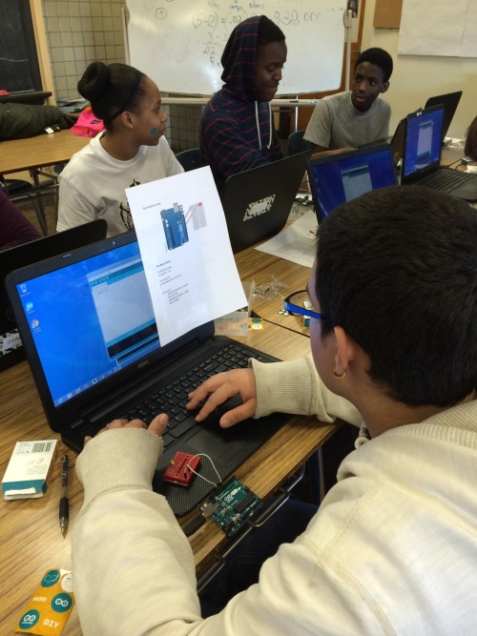
The Impact
“Self-regulation”
  Greater time management in class
Improved learning
  Language
  Writing skills
(Nguyen & Gu, 2013)
(http://greenstemnetwork.org/tag/science-leadership-academy/)
Notes:
Benefits

Slide 5
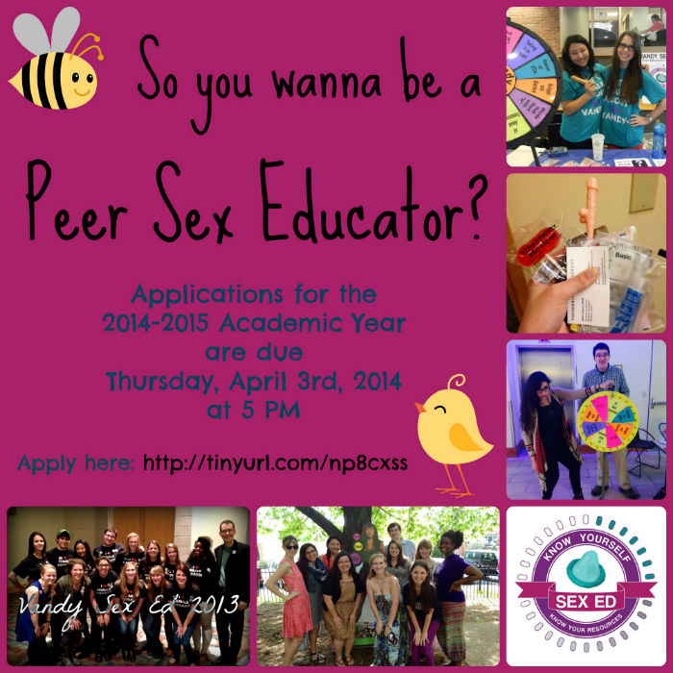

Students as Educators
“Peer Education” vs. “Peer Learning”
Motivations:
  Financial
  Broader course offerings
  Better suited to some learners Improving communication
(Boud, Cohen, and Sampson, 2006)
Notes:
Is sex not a serious topic??

Slide 6
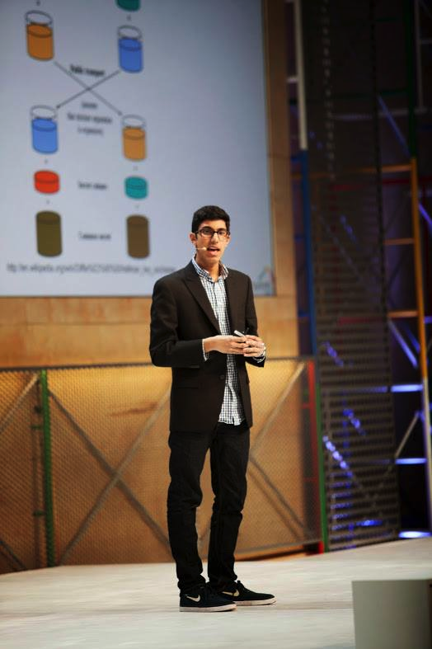
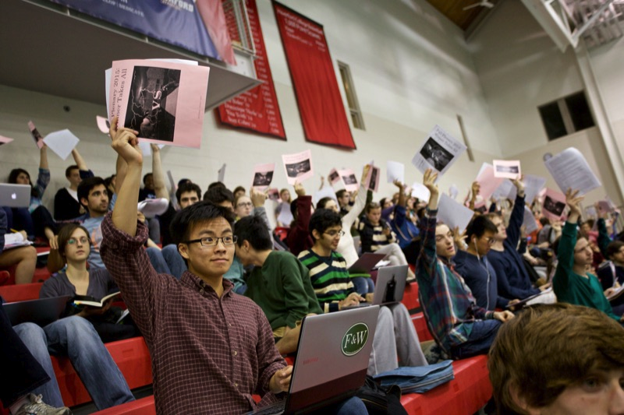
Who is a “Peer” Educator?
Pitfalls:
  High variability in quality, style, effectiveness, pairing, etc.
  Elevate natural leaders
  Undermine teachers’ authority
  Students can’t know everything - otherwise they would be teachers
Where is the line between “Peer Educator” and “Teacher”?
(Badura Brack, 2010)

Slide 7
Shaping Culturally Relevant Pedagogy
Warren 2014
  “Transformational change, especially in situations of power inequalities and oppressive structures, requires a social movement. By social movement in this context, I mean collective action by oppressed or marginalized people to build power to win changes in government policy and public attitudes that advance the cause of social justice” (p 8)
  “Social movements create shifts in cultural attitudes and public discourse and so are necessary to combat the stereotypes and low expectations facing children of color in education, on the streets, and in the media” (p 8)
  “Community and youth organizing is foundational to the emergence of a movement because it is through this process that local people with the most at stake in educational equity and justice—parents and students—build relationships and gain the support and courage to take action to make change.” (p 9)
  “In addition, a successful educational justice movement will need to win the support if not active embrace of teachers because they will be the ones to implement new policies and to treat and teach low-income students of color in more equitable, effective, and empowering ways.” (p 10)

Slide 8
Shaping Culturally Relevant Pedagogy
Milner 2011
  “Having good intentions is important, but teachers must transform and enact those good intentions into thinking (that is, mindsets) and practices that allow all their students, including their culturally diverse students, to (1) find meaning in the classroom, (2) feel a sense of belonging in the space, and (3) build knowledge and skills for academic success” (p 56)
  “Success, rewards, and sustainability can be couched in a student’s ability to understand, negotiate, and navigate through the culture of power, and it is teachers’ responsibility to assist students in these processes while simultaneously building their own knowledge about what it means to have power in the space” (p 67)
  “It is imperative that teachers realize that differences that are inevitable between themselves and their students do not have to halt success in the classroom as long as teachers are willing to exert the necessary energy and work to build their knowledge and skill to address, challenge, and work through conflicts” (p 70)

Slide 9
Concerns and Limitations
Teacher Background
  “Classrooms are becoming more diverse, but the people leading them remain predominantly white” (Deruy)
Tokenization
Discomfort/Controversy
  “Ultimately, the students’ resistance reminds us that students are not (nor should they be) passive receptacles for teachers’ knowledge. It also reminds us that discourses of recognition are not necessarily progressive and can even be mobilized to support inequality” (Lee & Walsh 61)
Standardized Testing
Predetermined Curricula
Lack of Structure
Notes:
Standardized tests are just part of the system and are put on by administration

Slide 10
Shaping Syllabi and Curriculum
“For students to experience academic success, their learning must be relevant to their lives and experiences”-Ladson-Billings

Slide 11
Framework
Ladson-Billings identified three principles of culturally relevant teaching.
students must experience academic success and intellectual growth by engaging in activities that require them to pose and solve higher-order problems.
students must develop cultural competence as a vehicle for learning, and see their identities and cultures as strengths.
students must develop socio- political and critical consciousness that allows them to critique the cultural norms, values and institutions that produce and maintain social inequities.
-Ladson-Billings points give provides an outline that teacher can incorporate into their curriculum and teaching methods.
-These principles s help students be more culturally aware in other settings outside school, and overall teach them better ways to approach diversity and culture
(Ladson-Billings ,1995)

Slide 12


Implications
Culturally relevant pedagogy builds on the understanding of “how people are expected to go about learning may differ across cultures, and in order to maximise learning opportunities, teachers must gain knowledge of the cultures represented in their classrooms, then translate this knowledge into instructional practice”
This model is crucial in the topic of Cultural Competence because it brings diversity and culture into educational settings
(Ann E, Lopez, 2011)

Slide 13
Works Cited
Bondy, E., Ross, D. D., Gallingane, C., & Hambacher, E. (2007). Creating Environments of Success and Resilience: Culturally
Responsive Classroom Management and More. Urban Education, 42(4), 326–348. https://doi.org/10.1177/0042085907303406
Boud, David., Ruth Cohen, & Jane Sampson. “Peer Learning and Assessment.” Assessment & Evaluation in Higher Education, Vol. 24, No. 4, (1999), pp. 413-426: https://pes.concordia.ca/docs/peer_learning_and_assessment.pdf.
Brack, Amy Badura PhD. “Are Peer Educators Really peers?” Journal of American College Health, pp. 566-568. http://www.tandfonline.com/doi/citedby/10.3200/JACH.56.5.566-568?scroll=top&needAccess=true.
Klepp, K.-I., Halper, A. and Perry, C. L. (1986), The Efficacy of Peer Leaders in Drug Abuse Prevention. Journal of School Health, 56: 407-411. doi: 10.1111/j.1746-1561.1986.tb05783.x.
Milner, H. R. (2011). But good intentions are not enough: Doing what's necessary to teach for diversity. In J. G. Landsman & C. W. Lewis (Eds.), White teachers / diverse classrooms: Creating inclusive schools, building on students' diversity, and providing true educational equity (pp. 56-74). Sterling, VA: Stylus Publishing.
Monkman, K. "Social and Cultural Capital in an Urban Latino School Community." Urban Education 40.1 (2005): 4-33. Web.
Nguyen, L. T. C., & Gu, Y. (2013). Strategy-based instruction: A learner-focused approach to developing learner autonomy. Language
Teaching Research; London, 17(1), 9–30. https://doi.org/http://dx.doi.org/10.1177/1362168812457528
Lopez, Ann E. "Culturally relevant pedagogy and critical literacy in diverse English classrooms: A case study of a secondary English teacher’s activism and agency." English Teaching: Practice and Critique (2011): 75-93. Web.
Ladson-Billings, G. (1995). Toward a Theory of Culturally Relevant Pedagogy . 465-491.

