Slide 1
Urban Outfitters
By Bre Genaro

Slide 2
Background Info
Company created in 1970
College student oriented
Urban company includes Free People, Urban Outfitters, Anthropologie, Terrain
CEO: Richard Hayne
Bohemian/hipster
Companies goal is “to offer a product assortment and an environment so compelling and distinctive that the customer feels an empathetic connection to the brand and is persuaded to buy.”

Slide 3
Company Profile
Stocks climbing until 2014
In midst of several controversies
  Clothing designs
  Plagiarism
  Labor ethics
  What they support

Slide 4
Merchandise Designs
Urban prides itself on being “edgy”
When edgy turns into offensive
  Tee-shirt designs
  Prescription Drug parephenalia
  Board games

Slide 5

Tee-Shirt designs

Slide 6
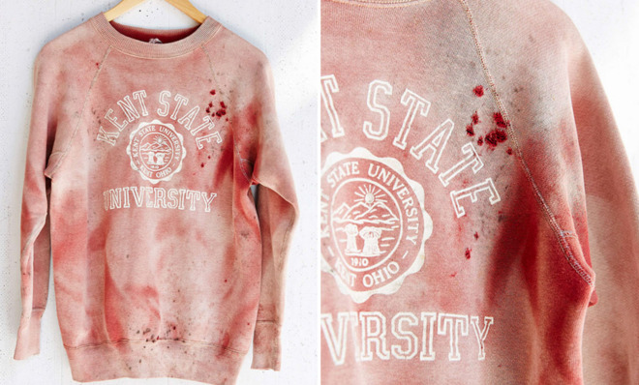
Cont.

Slide 7
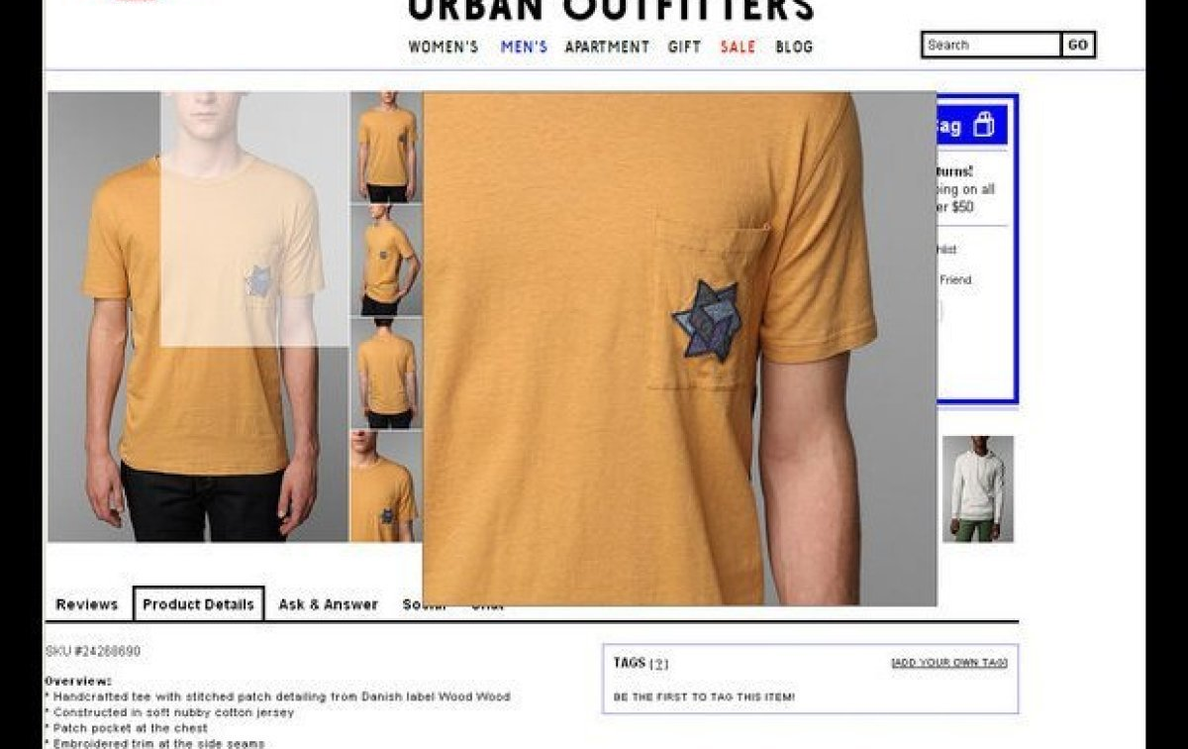
Cont.

Slide 8

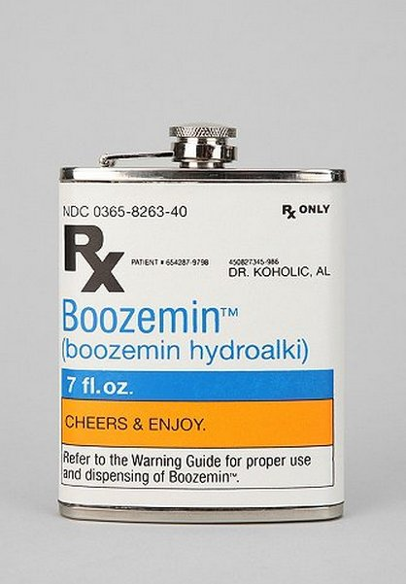

Prescription Drug

Slide 9
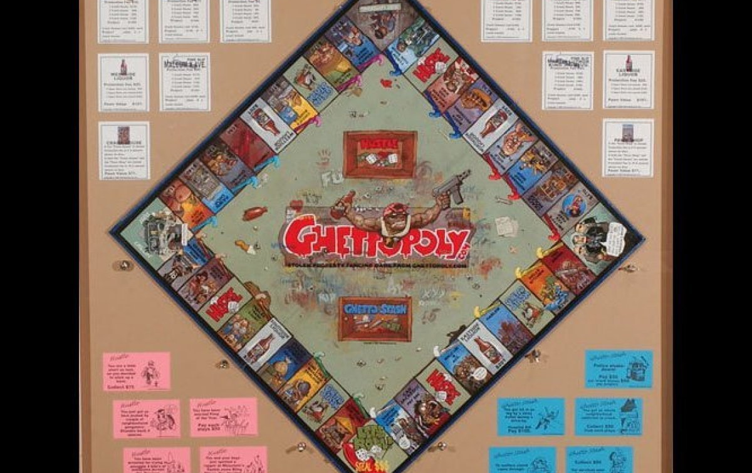
Racist board game

Slide 10
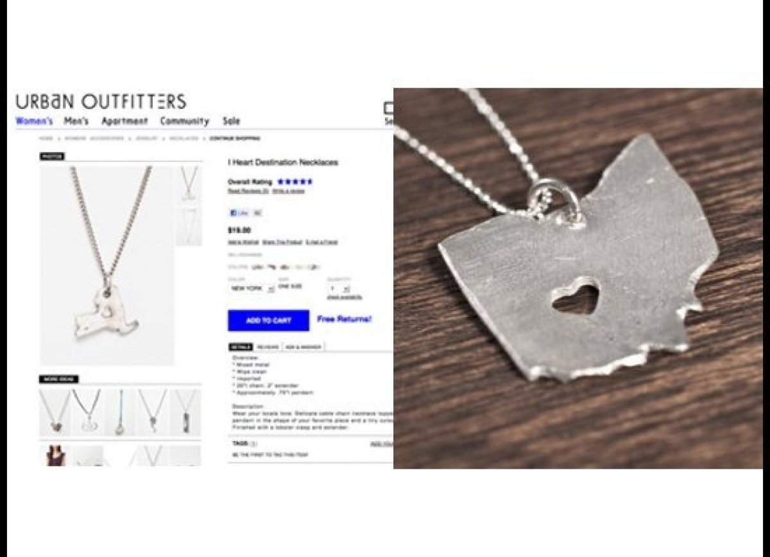
Plagiarism
Stealing a necklace design from an independent designer
Stealing a design from an artist on Society6
  Site Urban has done business with before

Slide 11
Labor
Sweatshop-like labor violations
  Paying less than minimum wage
    Less than $6.50 on average
    Paid per piece they sewed
  Not paying overtime
  Falsifying and failing to keep records
  High clothing prices and poor quality

Slide 12
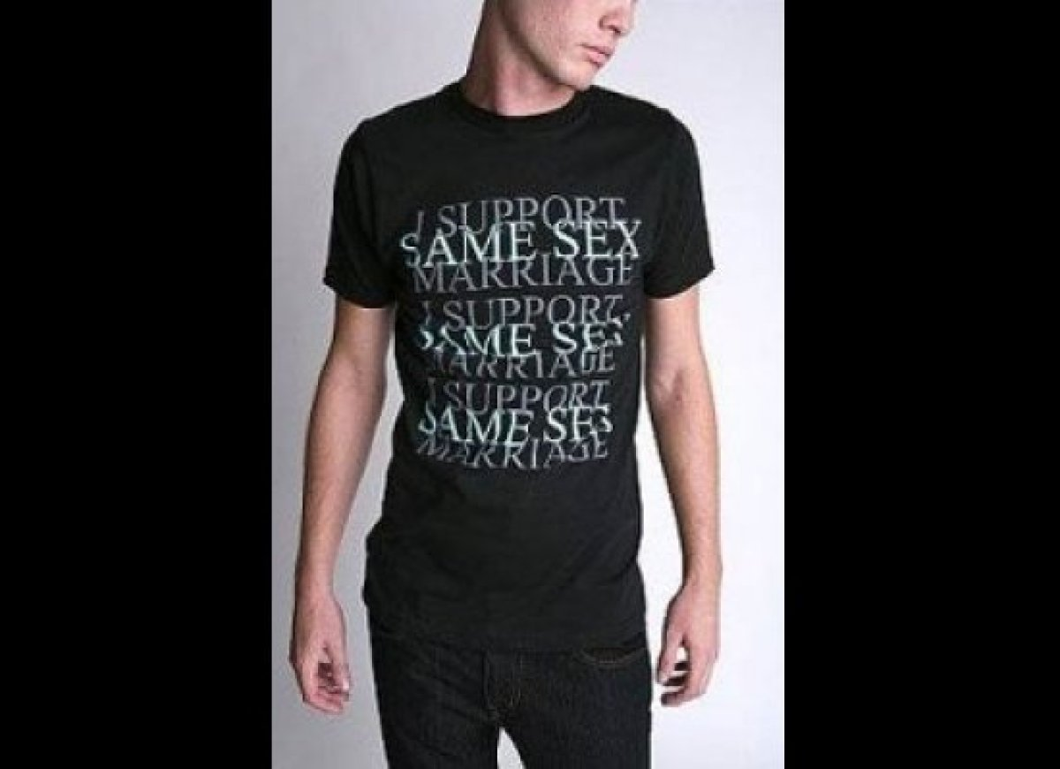
Where does the money go?
Co-founder and chairman supports anti-gay rights politicians
  Rick Santorum
  Took gay pride tee shirt off the racks

Slide 13
Contact Zone
Questions to ask myself:
  What statement does the merchandise make?
  How does the company’s quality and prices say about my values?
  By shopping here, who am I really supporting?
  Is this company aware of modern society? Who are they supporting?
By purchasing these products, and wearing them, I am entering many contact zones centered on equality, mental illness, addiction, race, and human rights

Slide 14
Works Cited
http://www.groundswell.org/why-im-breaking-up-with-urban-outfitters-and-4-questions-to-ask-yourself-before-you-shop/
http://www.ecouterre.com/urban-outfitters-among-fashion-brands-using-l-a-sweatshop-labor/
http://www.huffingtonpost.com/2012/12/14/sweatshop-la-fashion-urban-outfitters-aldo-forever-21_n_2302493.html
http://jezebel.com/5875181/whats-wrong-with-urban-outfitters
http://theweek.com/article/index/220370/racist-navajo-attire-and-7-other-urban-outfitters-controversies

