Slide 1
Urban Outfitters
By Bre Genaro

Slide 2
Background Info
Company created in 1970
College student oriented
Urban company includes Free People, Urban Outfitters, Anthropologie, Terrain
CEO: Richard Hayne
Bohemian/hipster
Companies goal is “to offer a product assortment and an environment so compelling and distinctive that the customer feels an empathetic connection to the brand and is persuaded to buy.”

Slide 3
Company Profile
Stocks climbing until 2014
In midst of several controversies
  Clothing designs
  Plagiarism
  Labor ethics
  What they support

Slide 4
Merchandise Designs
Urban prides itself on being “edgy”
When edgy turns into offensive
  Tee-shirt designs
  Prescription Drug parephenalia
  Board games

Slide 5

Tee-Shirt designs

Slide 6
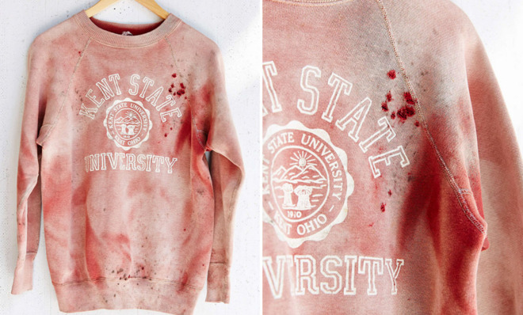
Cont.

Slide 7
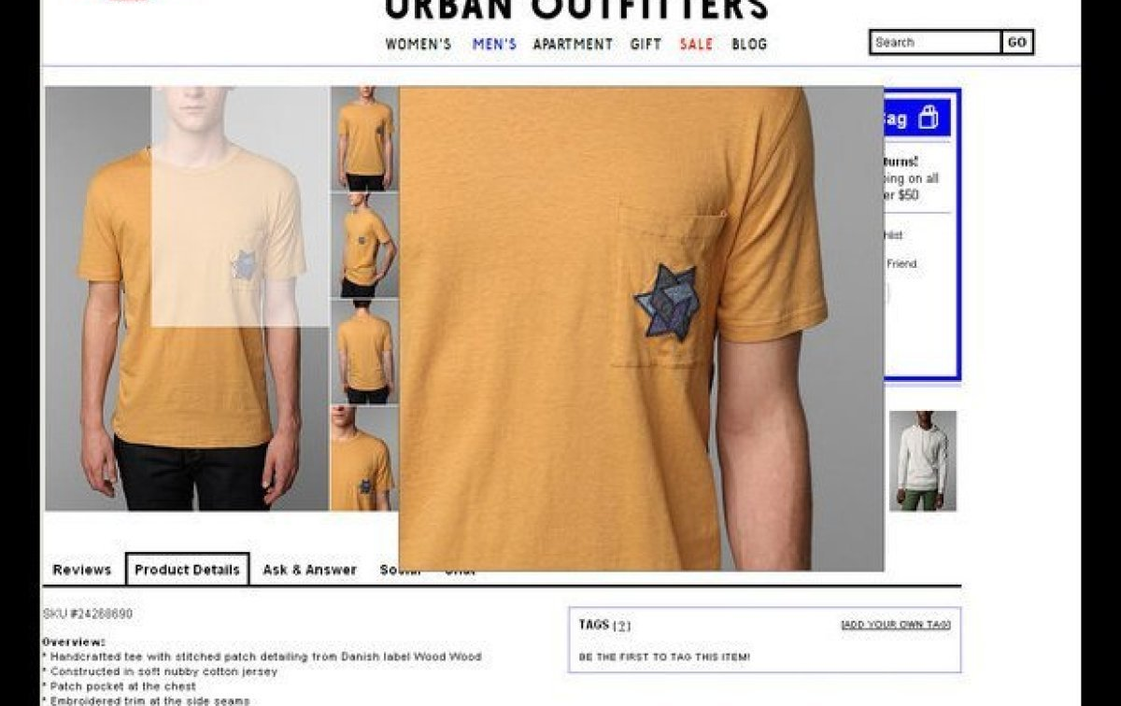
Cont.

Slide 8

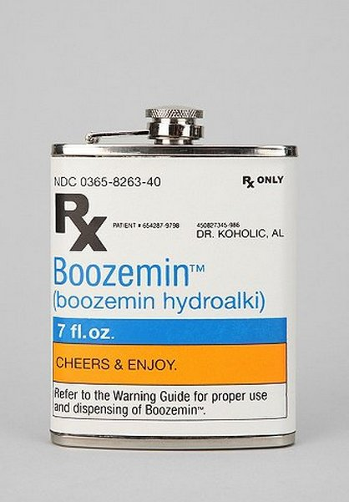

Prescription Drug

Slide 9

Racist board game

Slide 10
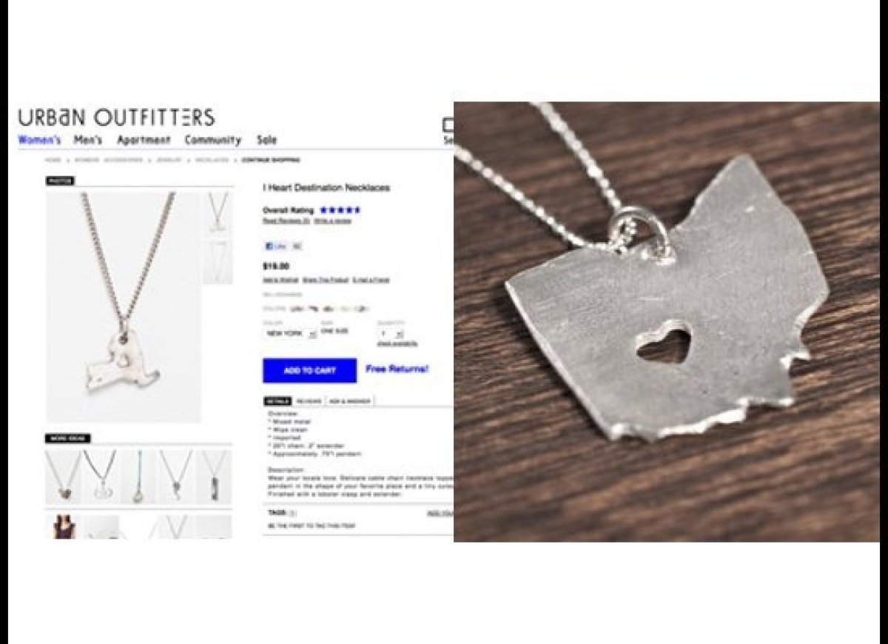
Plagiarism
Stealing a necklace design from an independent designer
Stealing a design from an artist on Society6
  Site Urban has done business with before

Slide 11
Labor
Sweatshop-like labor violations
  Paying less than minimum wage
    Less than $6.50 on average
    Paid per piece they sewed
  Not paying overtime
  Falsifying and failing to keep records
  High clothing prices and poor quality

Slide 12
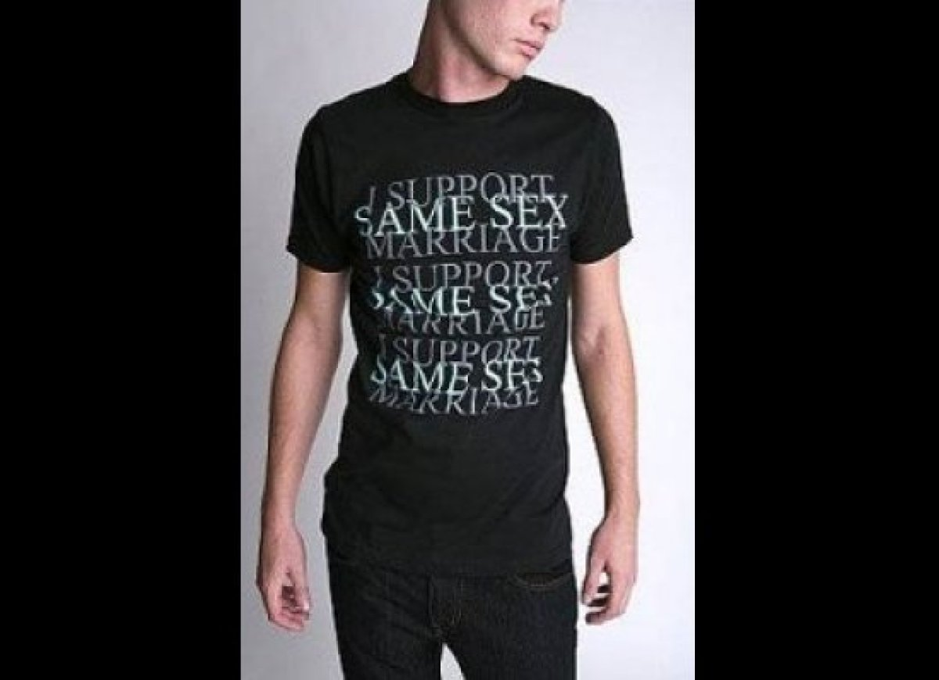
Where does the money go?
Co-founder and chairman supports anti-gay rights politicians
  Rick Santorum
  Took gay pride tee shirt off the racks

Slide 13
Contact Zone
Questions to ask before consuming:
  What statement does the merchandise make?
  What does the company’s quality and prices say about my values?
  By shopping here, who am I really supporting?
By purchasing these products, and wearing them, I am entering many contact zones revolving around equality, mental illness, addiction, race, and human rights

Slide 14
What Can Be Done?
More consumer knowledge
Active and alert consumers
Greater advertisement of wrongdoings
Public Protest
  Company can only run with consumer support

Slide 15
Works Cited
http://www.groundswell.org/why-im-breaking-up-with-urban-outfitters-and-4-questions-to-ask-yourself-before-you-shop/
http://www.ecouterre.com/urban-outfitters-among-fashion-brands-using-l-a-sweatshop-labor/
http://www.huffingtonpost.com/2012/12/14/sweatshop-la-fashion-urban-outfitters-aldo-forever-21_n_2302493.html
http://jezebel.com/5875181/whats-wrong-with-urban-outfitters
http://theweek.com/article/index/220370/racist-navajo-attire-and-7-other-urban-outfitters-controversies

