Slide 1
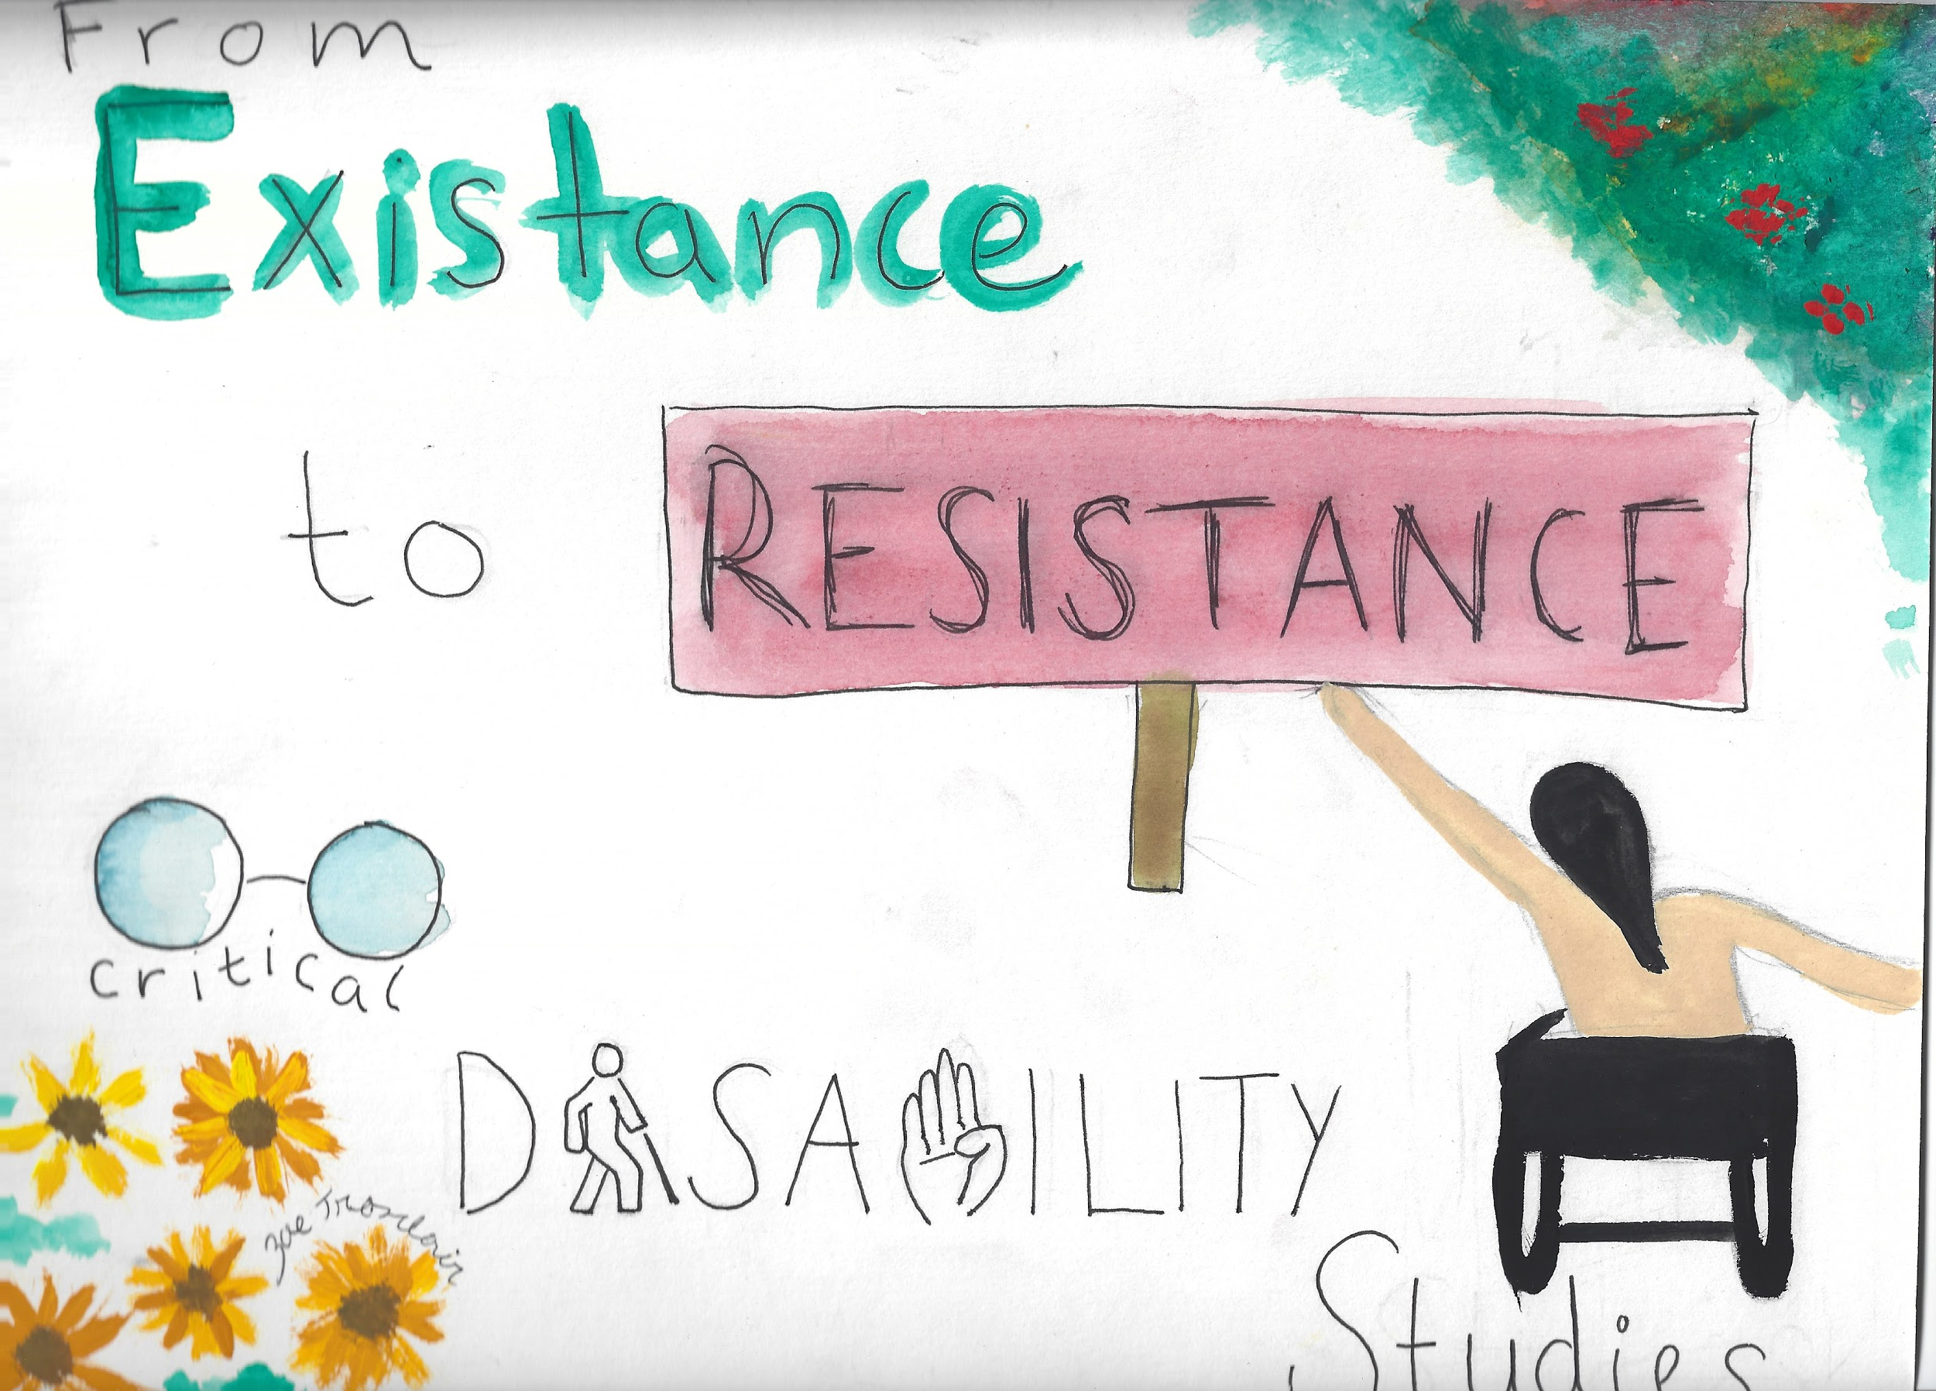
e

Slide 2
From Existence To Resistance
A note from the author
What does it mean to create a world where different minds and bodies can exist in harmony and community? To find and build connection? To rethink what capitalism has defined as valuable? This is Critical Disability Studies. In the pages of this book, I put myself in dialogue with disabled writers, activists, and scholars to explore disability as a social construct, a political identity, and a personal reality. My work is influenced by both by what I’ve learned in the classroom to my experience as an educator, caretaker, and Unitarian Universalist. Recognizing that our capitalist society values some voices more than others, some labor more than others, and some times of scholarship more than others, I resist by engaging creatively with these ideas. I abandon the comfort of a structured academic paper for the risk and freedom of an art project. I hope this book will embody the principles of Universal Design for Learning that call for multiple means of representation, engagement, and expression. Hope you enjoy :)

Slide 3
Table of Contents
A note from the author
Voice and Self Advocacy
Social Model of Disability
Community
Rethinking Independence
Access Intimacy
Changing Language
Resistance

Slide 4
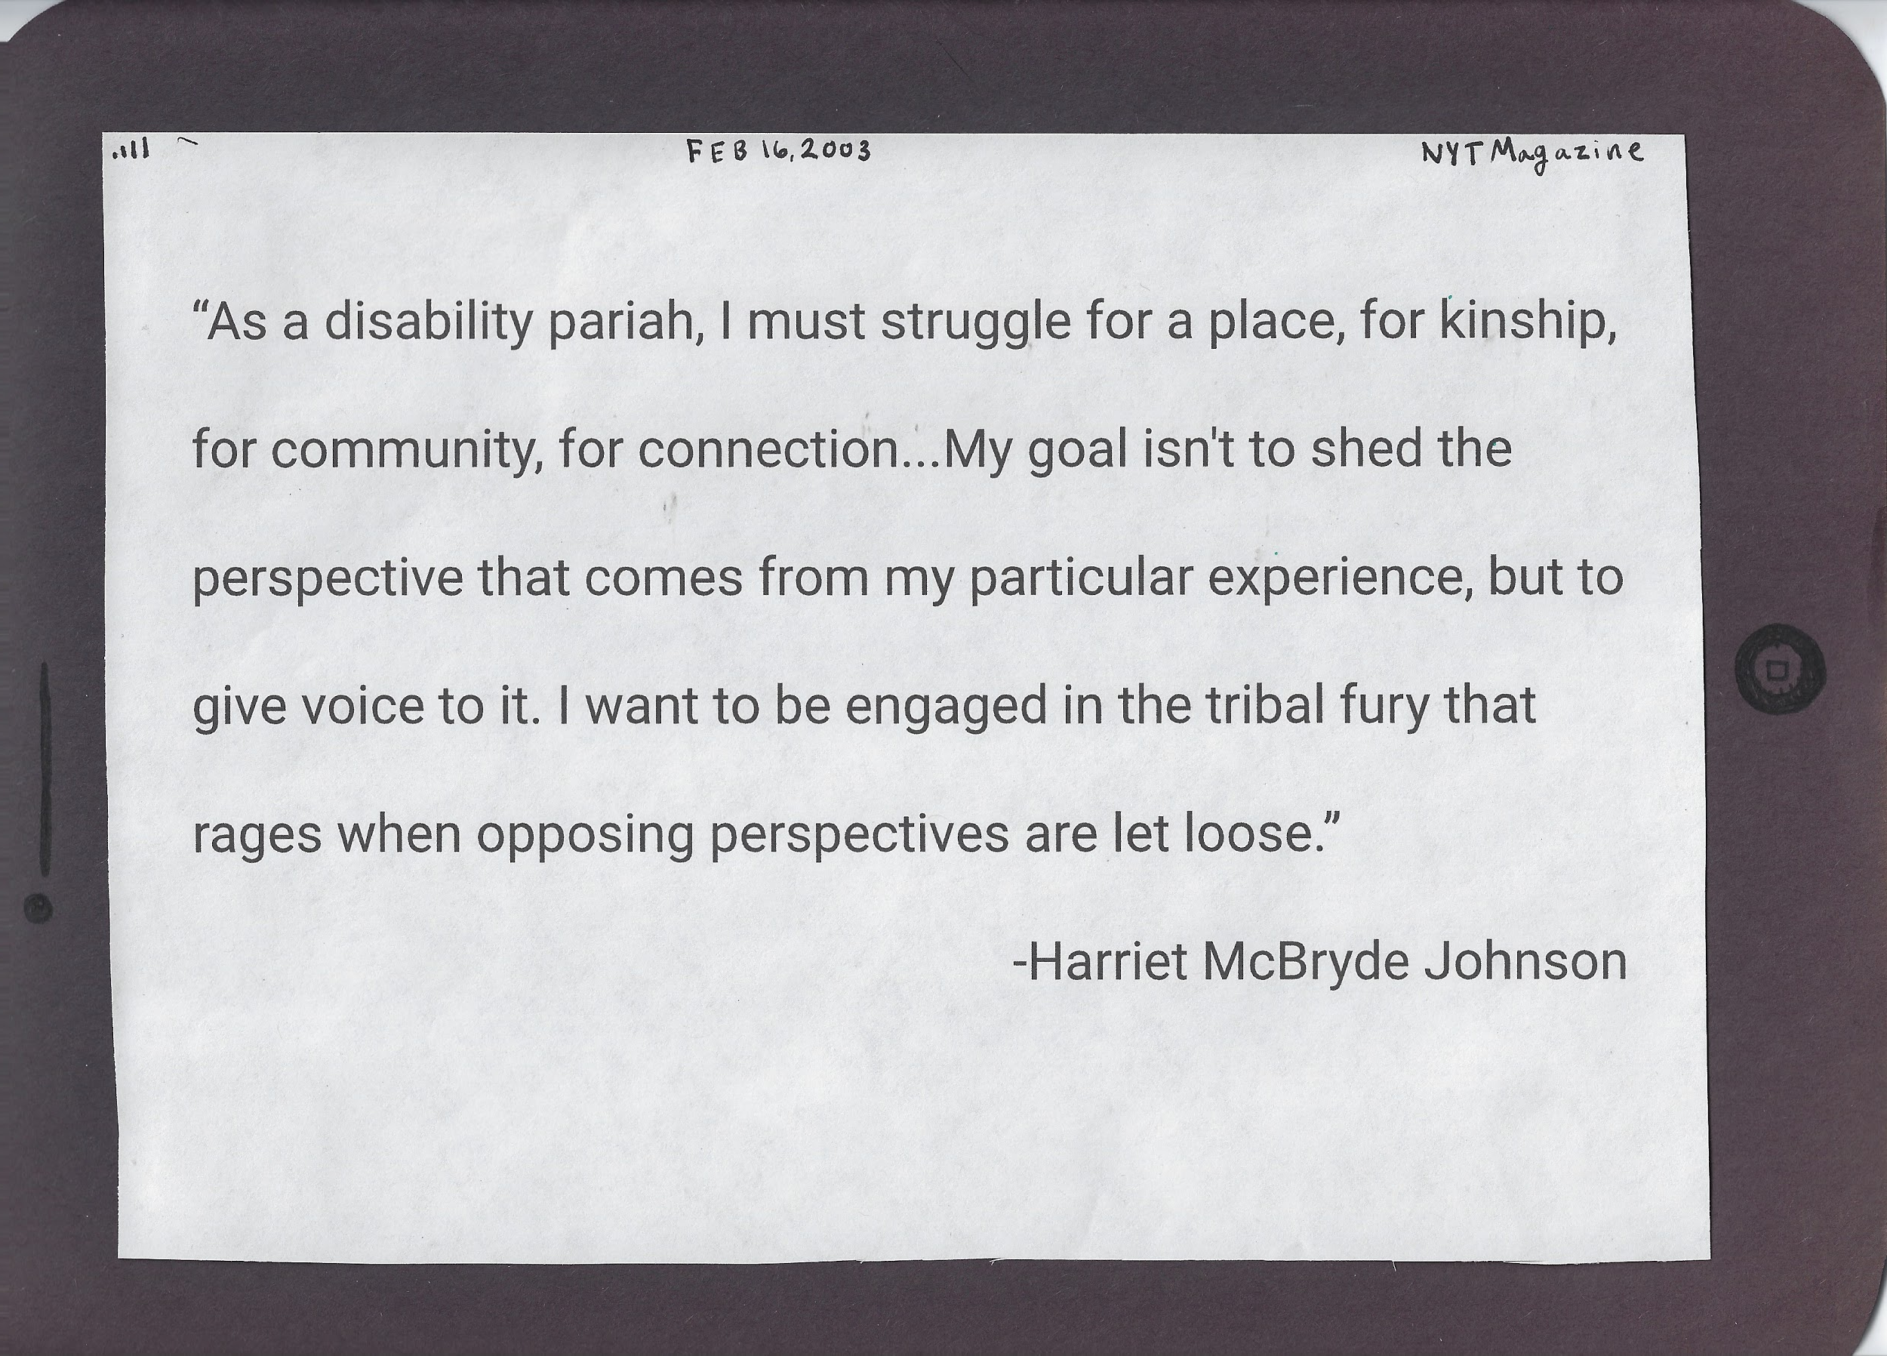
Notes:
Voice and self advoacy picture

Slide 5
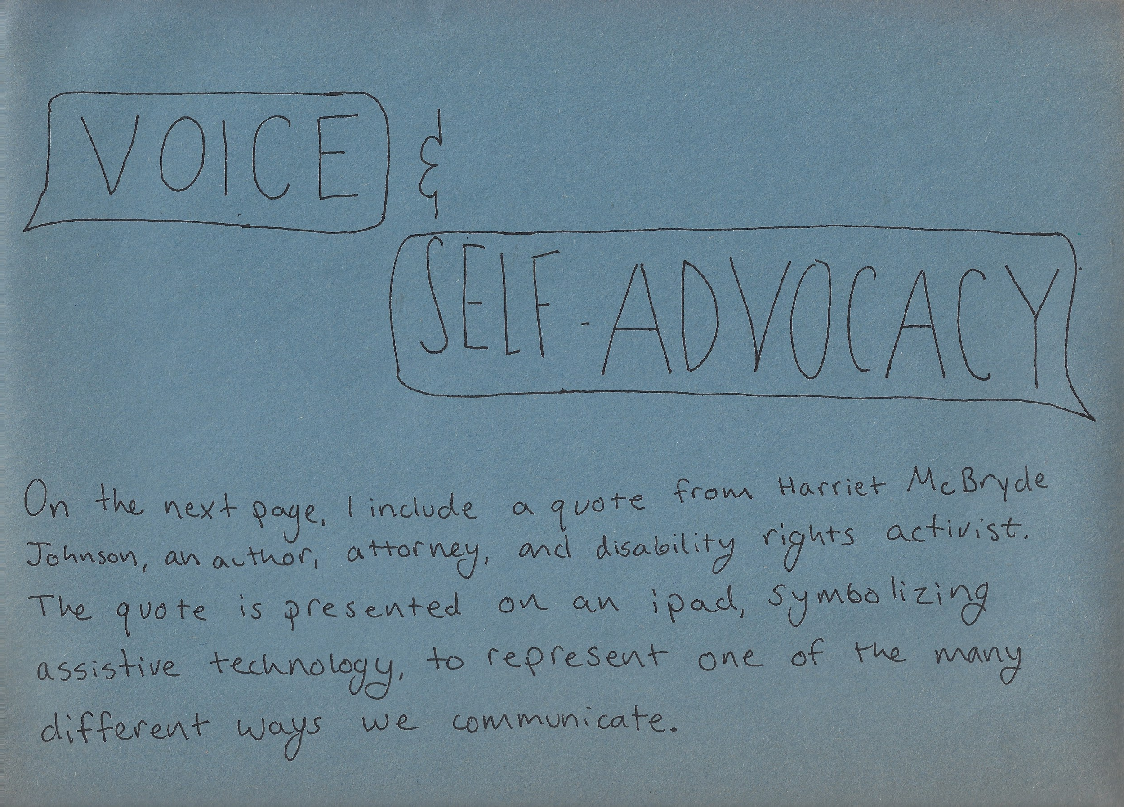
Notes:
Voice and self advoacy pciture

Slide 6
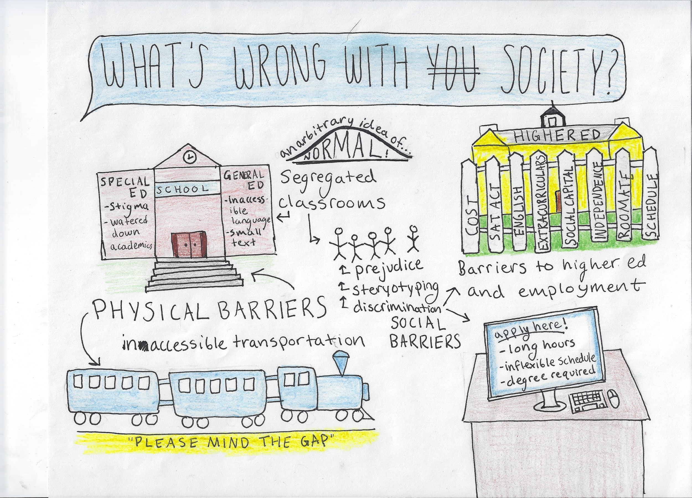
Notes:
Social Model of disability picture

Slide 7
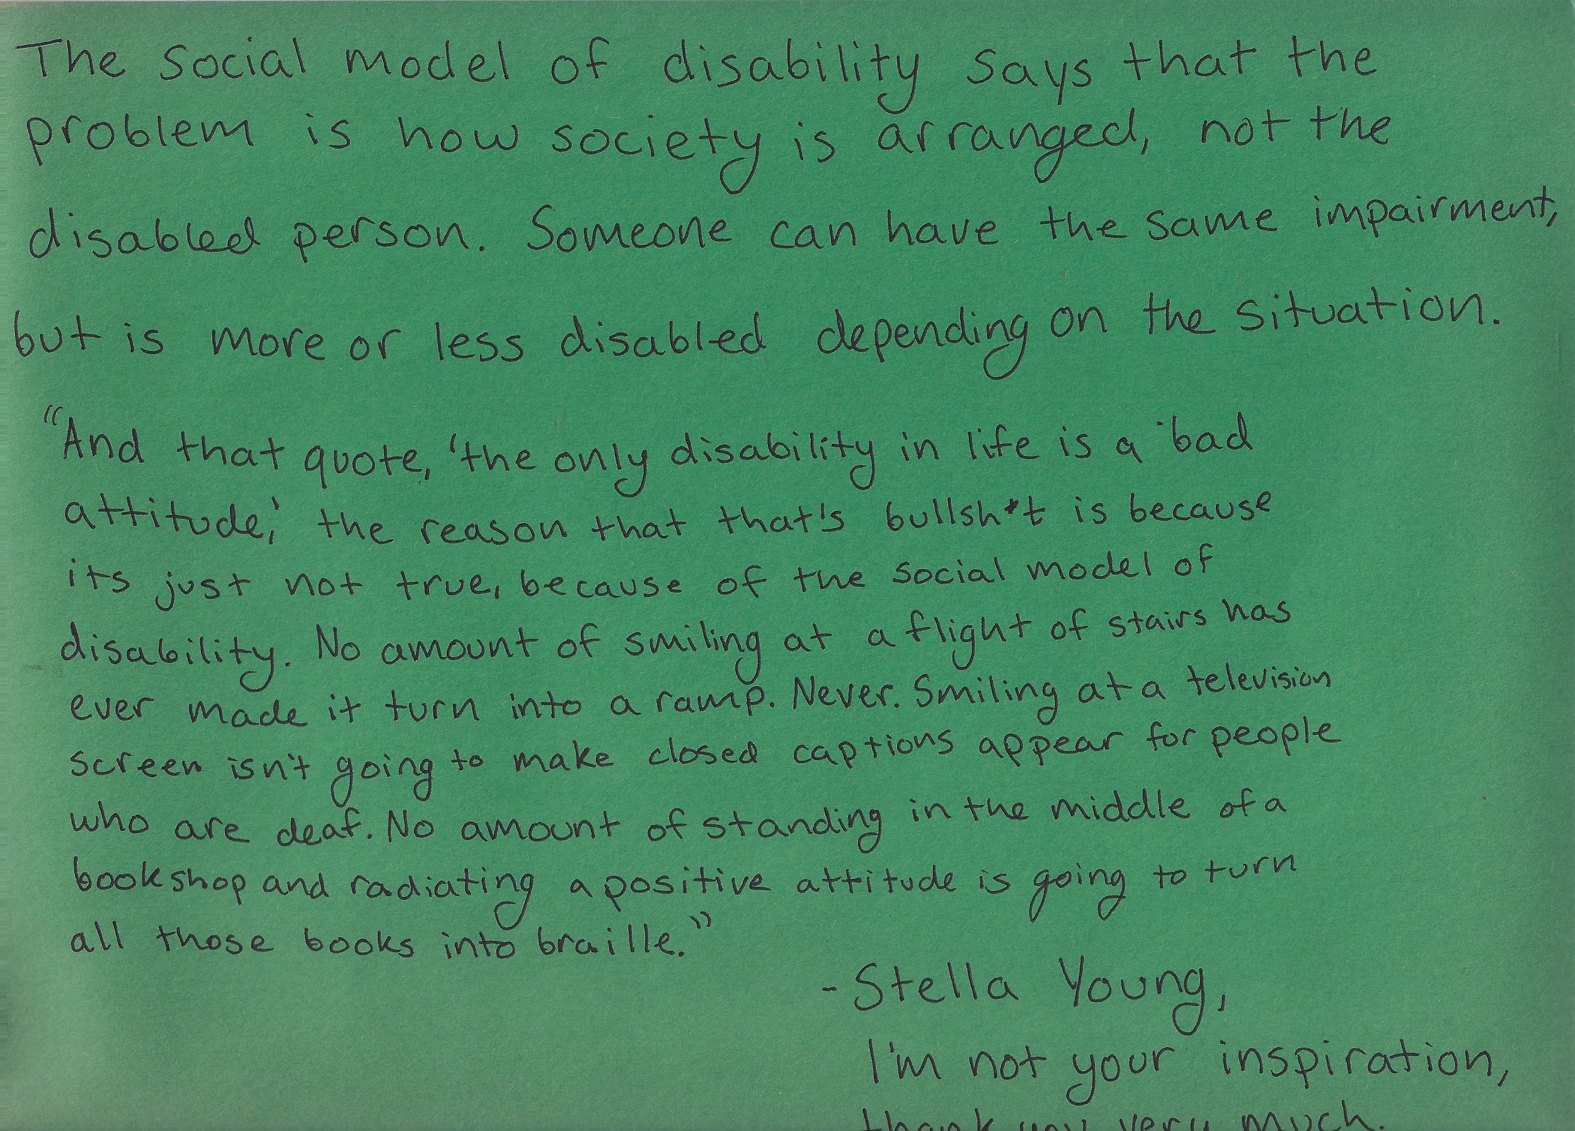
Notes:
Social model of disability text

Slide 8
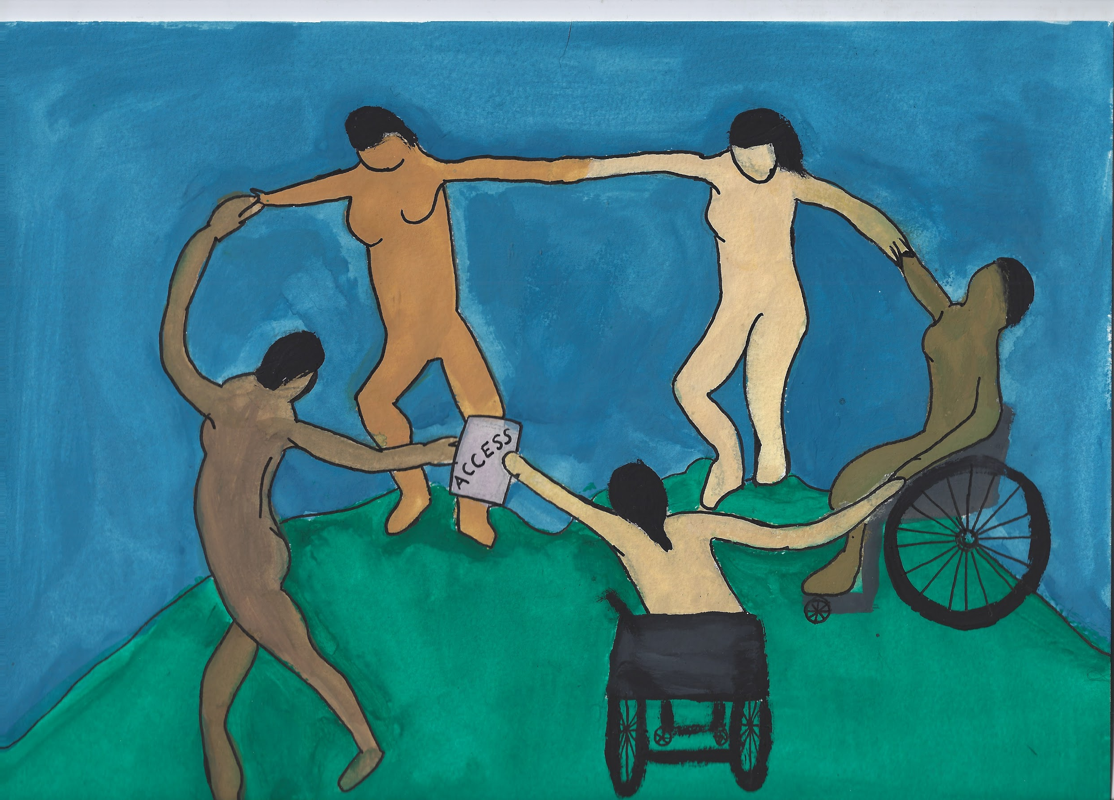
Notes:
Community picture

Slide 9
Notes:
Community text

Slide 10
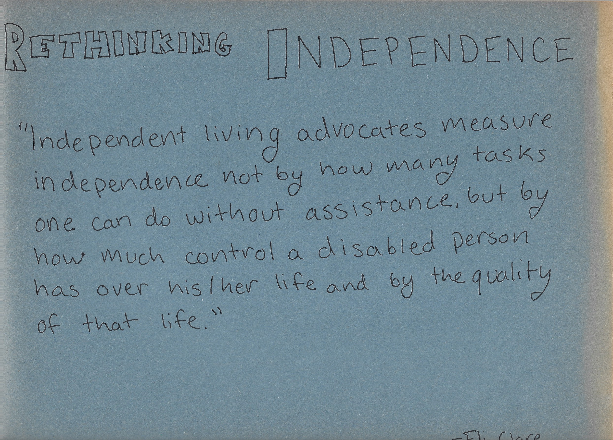
Notes:
Rethinking independence text

Slide 11
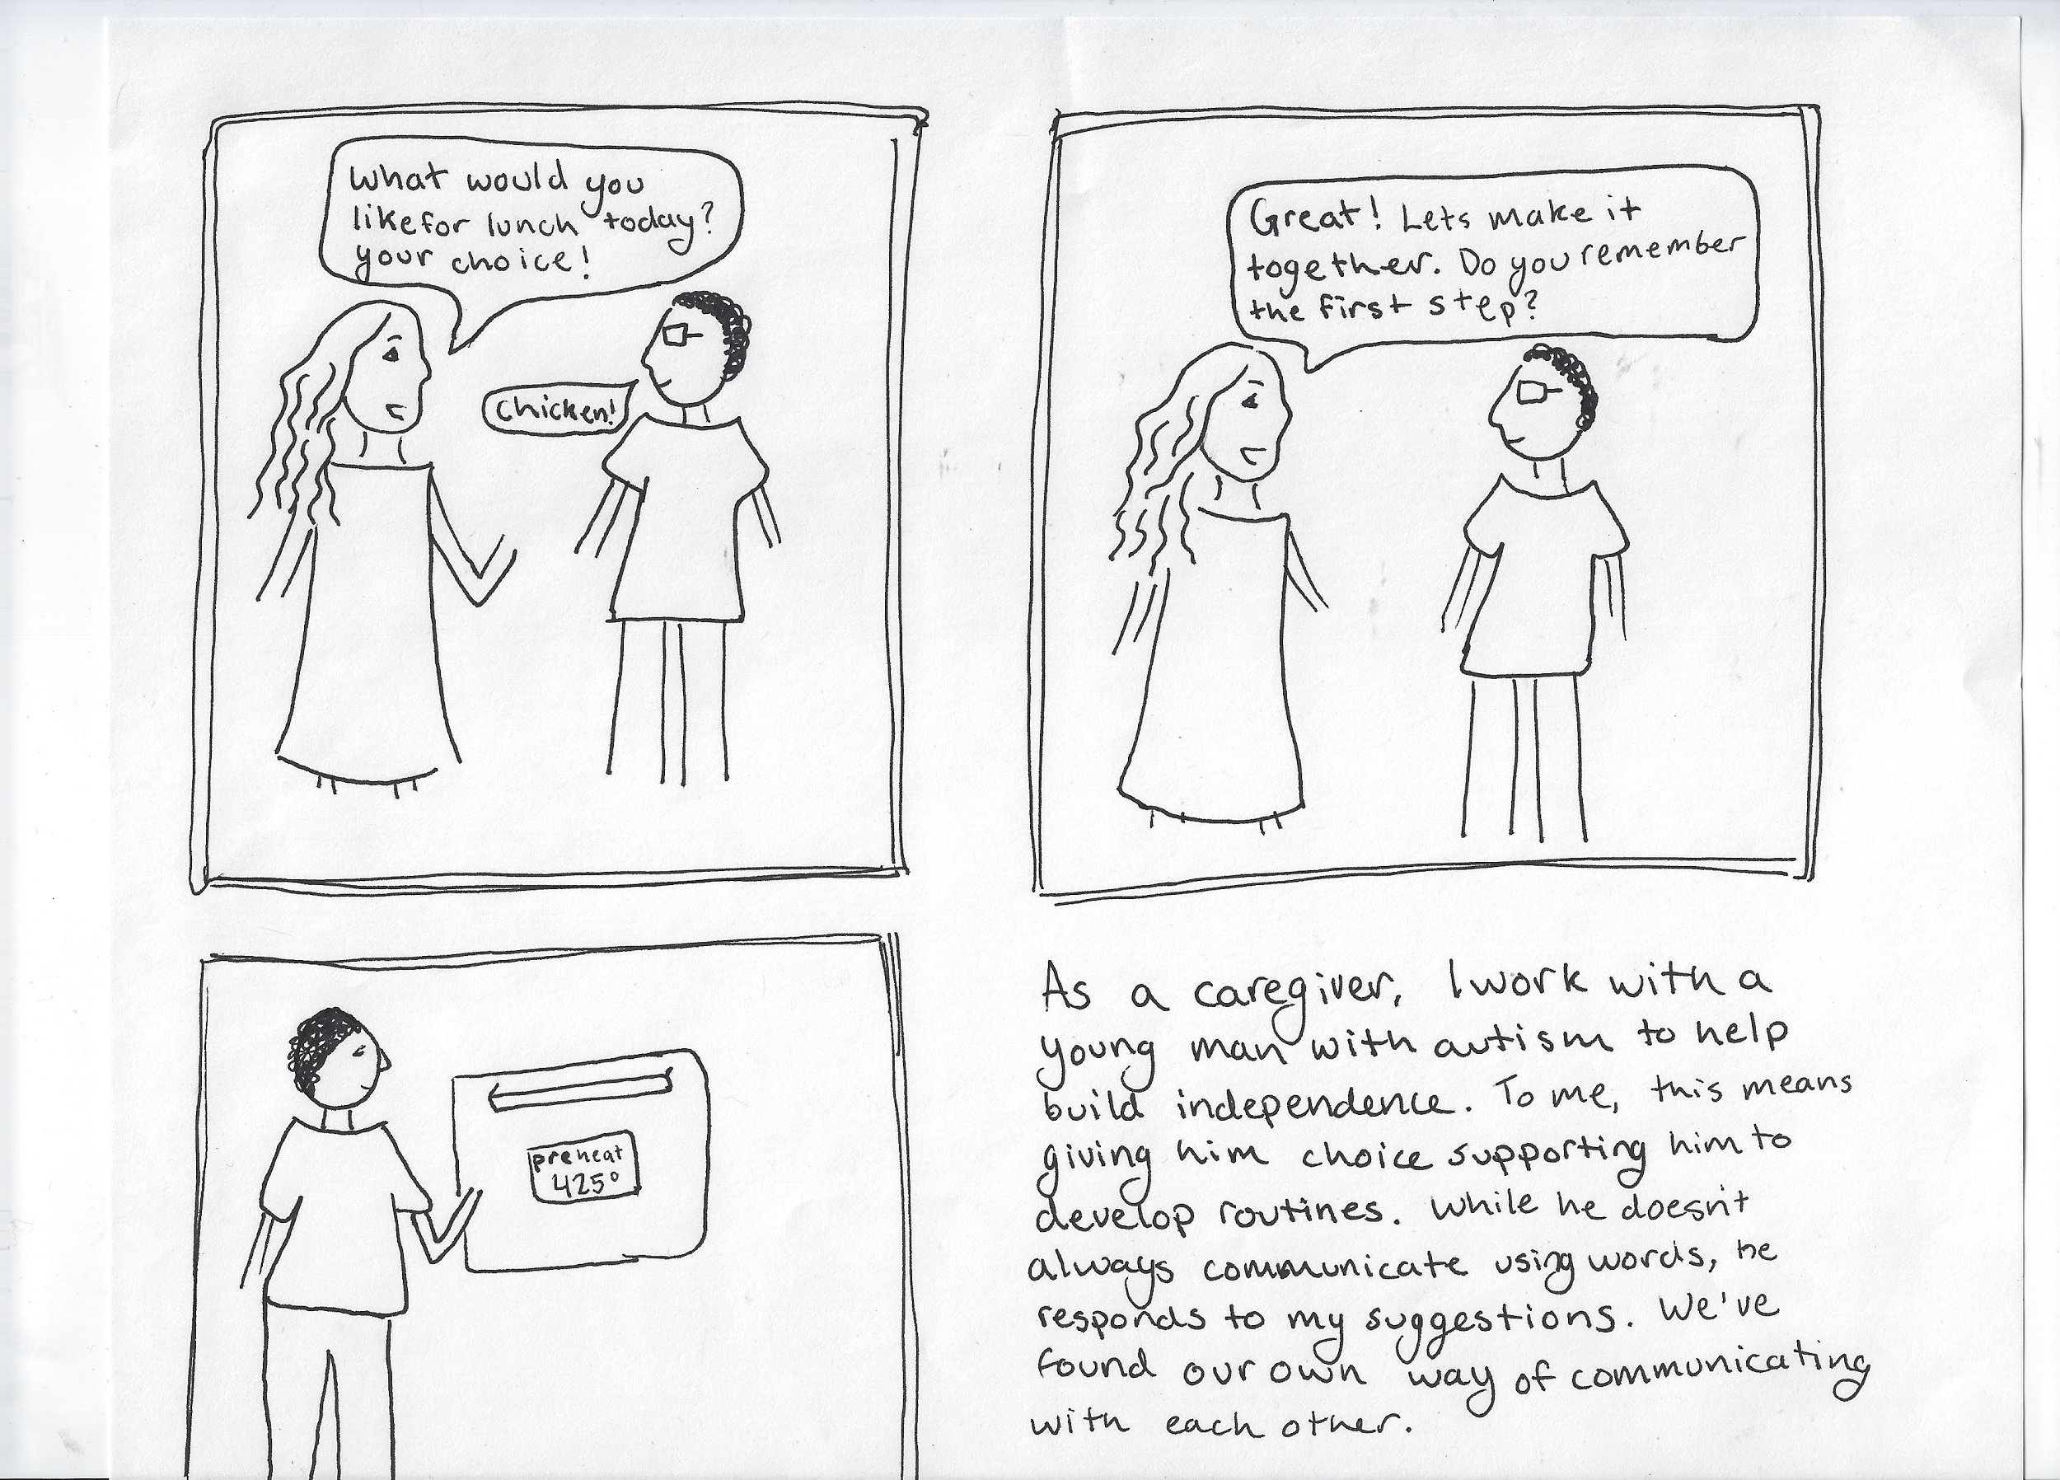
Notes:
Rethinking indep pic

Slide 12
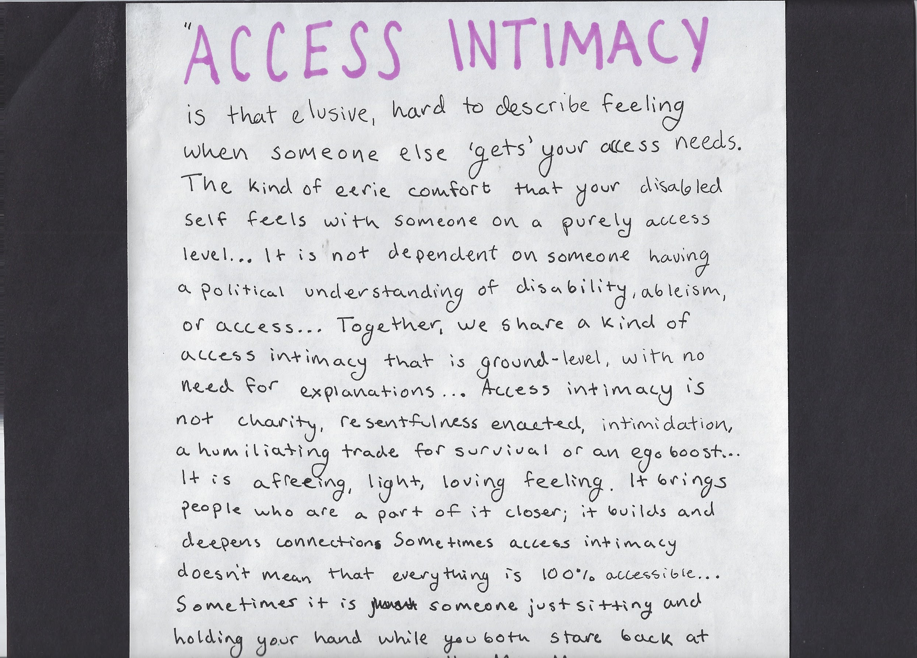
Notes:
Access intimacy text

Slide 13
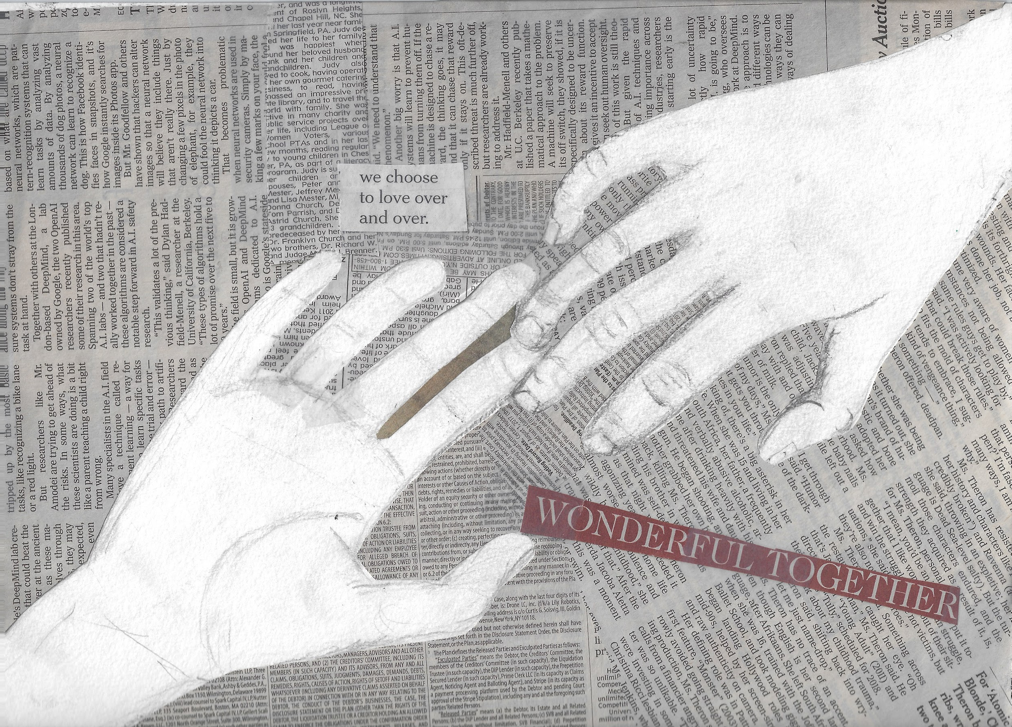
Notes:
Access intimacy picture

Slide 14
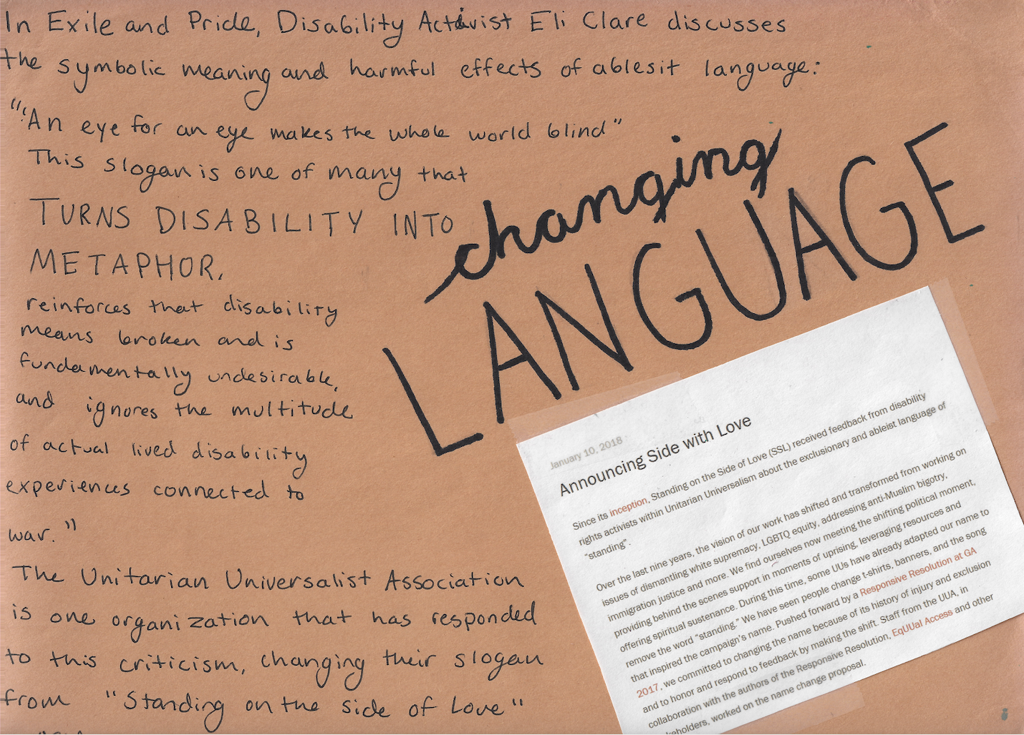
Notes:
Changing language text

Slide 15
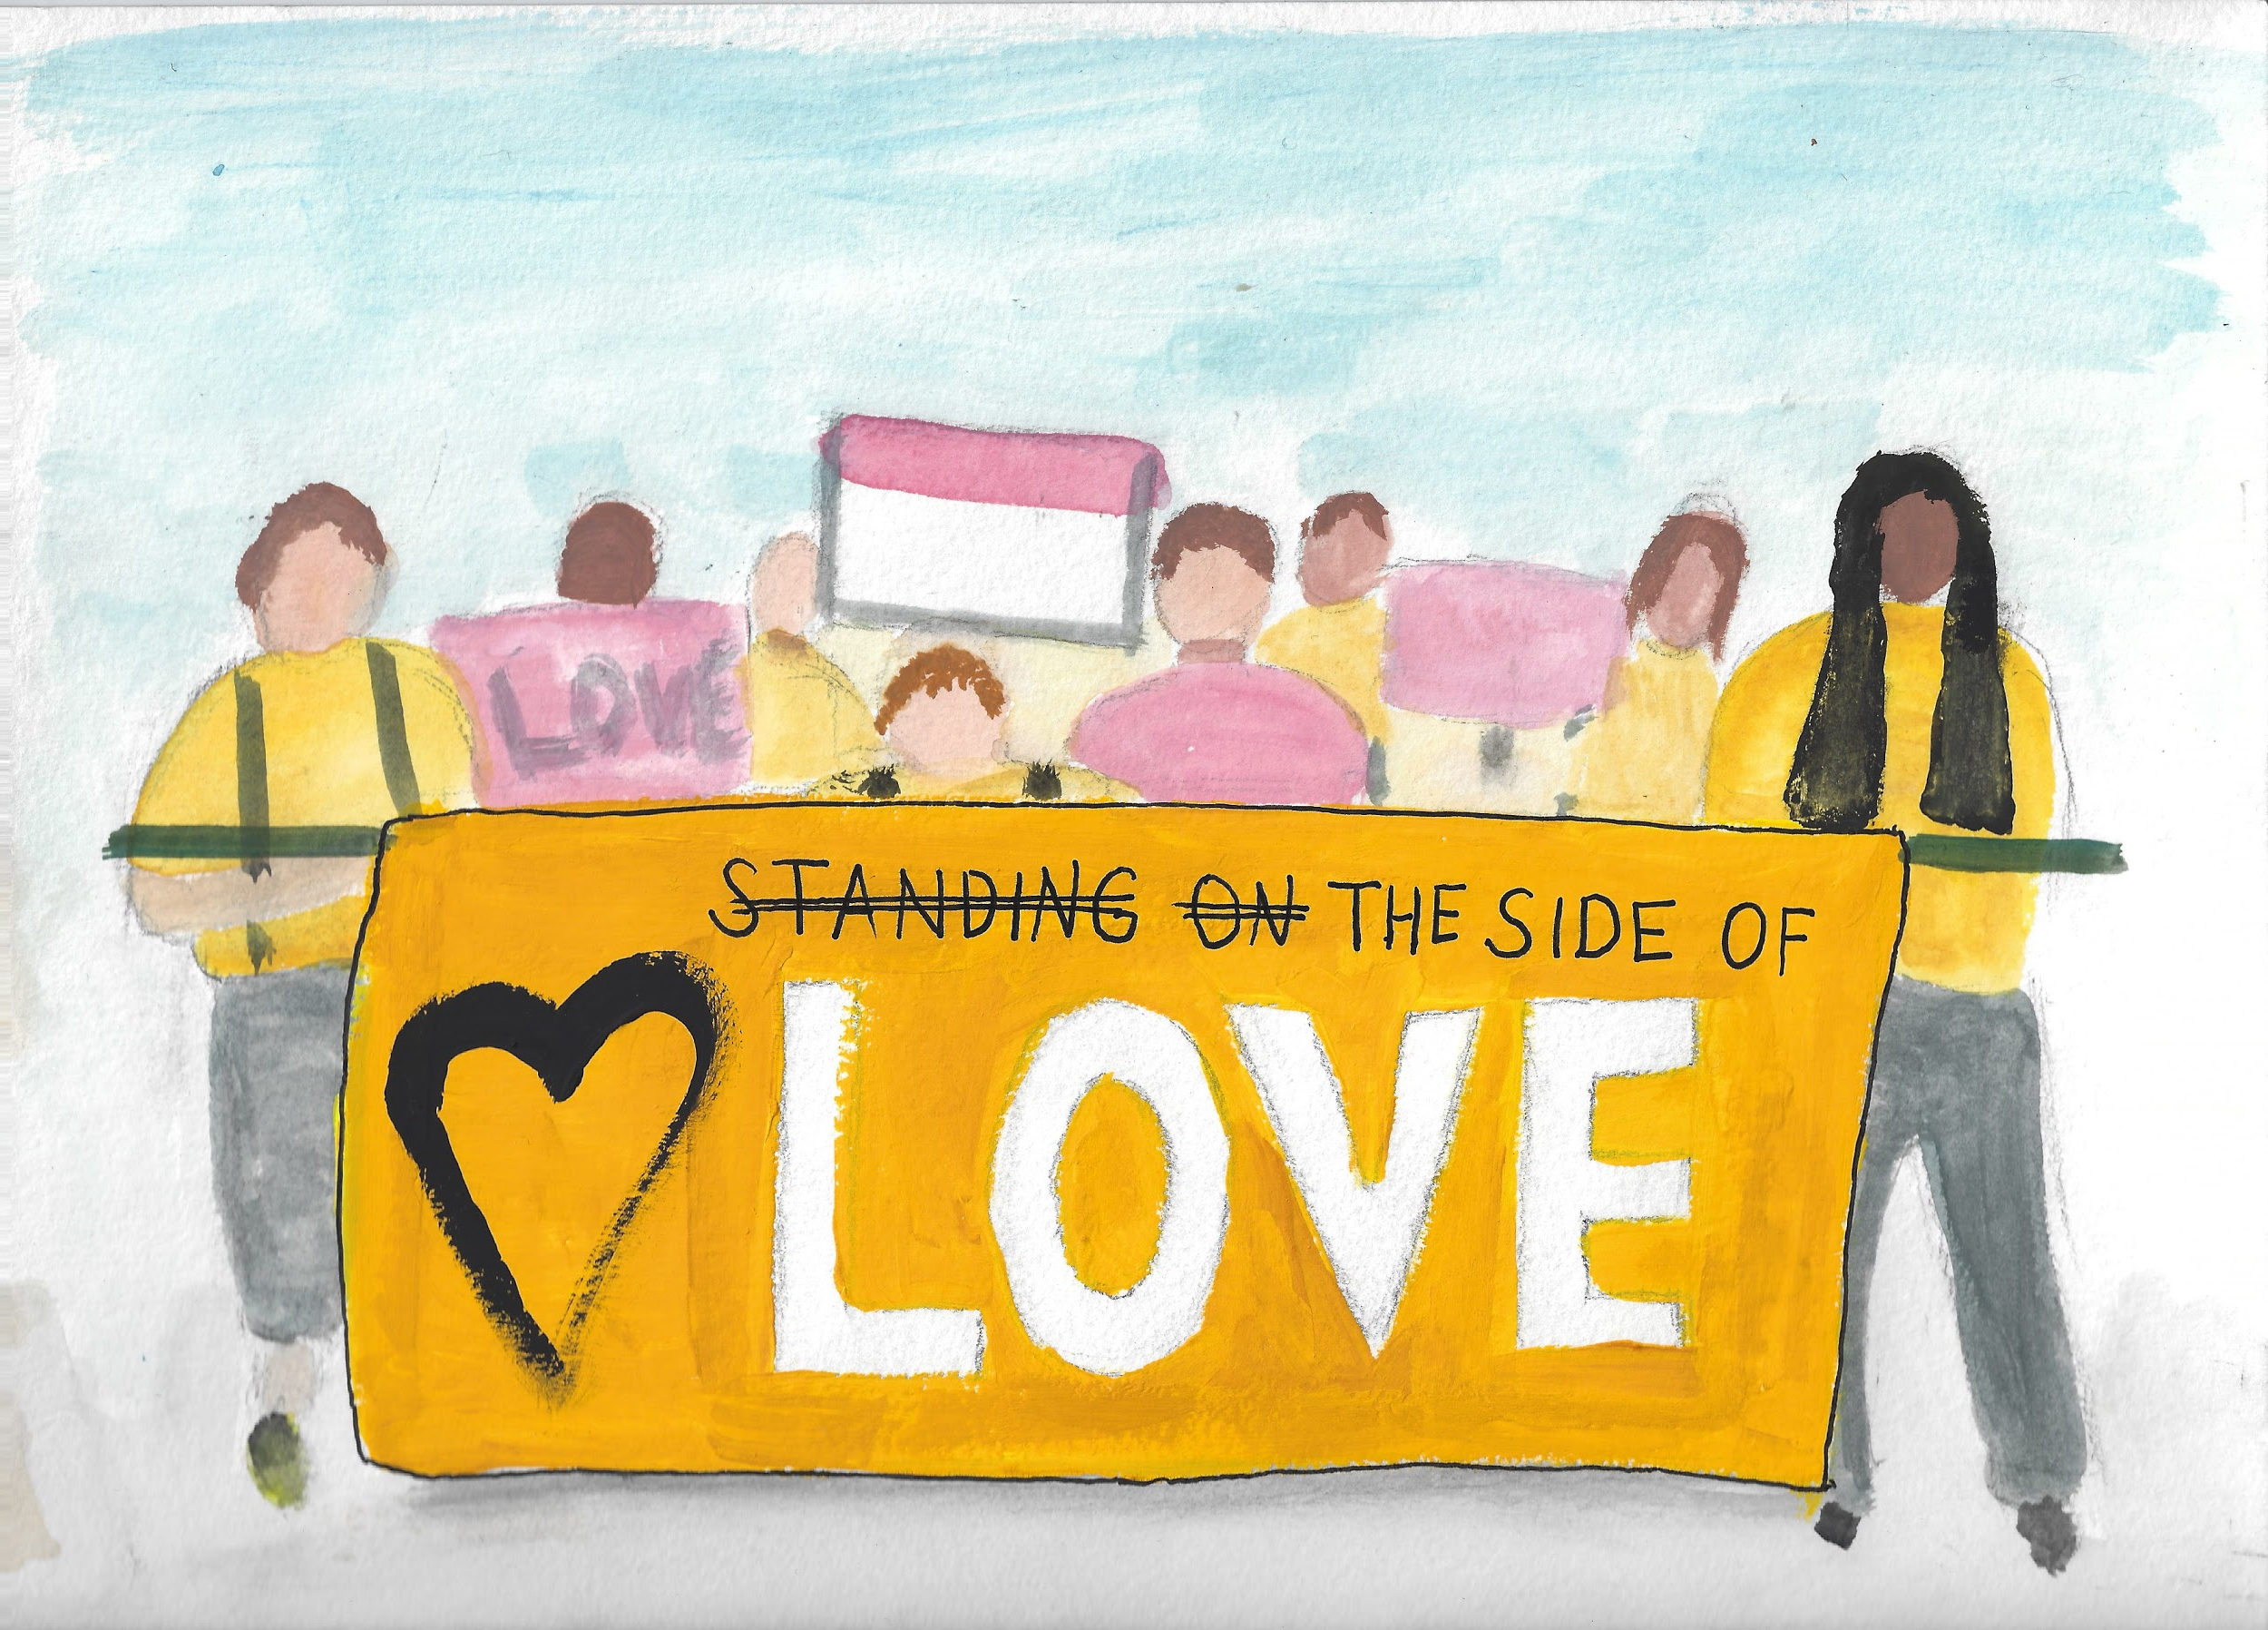
Notes:
Changing langaage picture

Slide 16
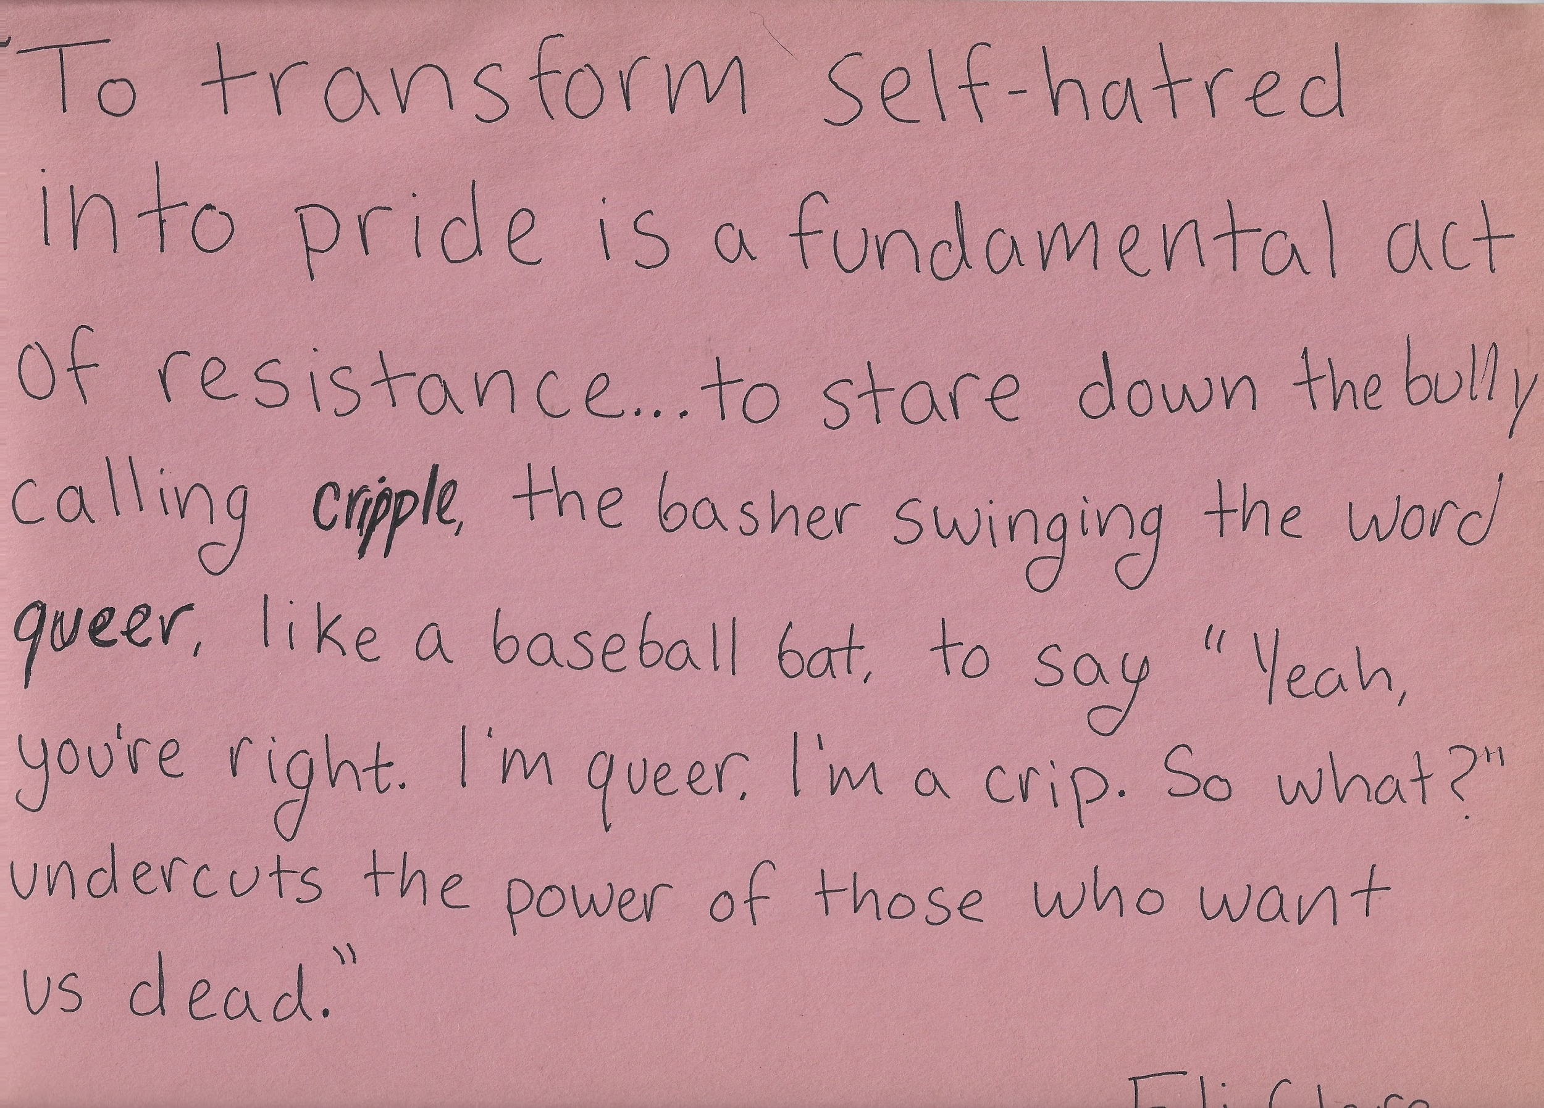
Notes:
Resistance text

Slide 17
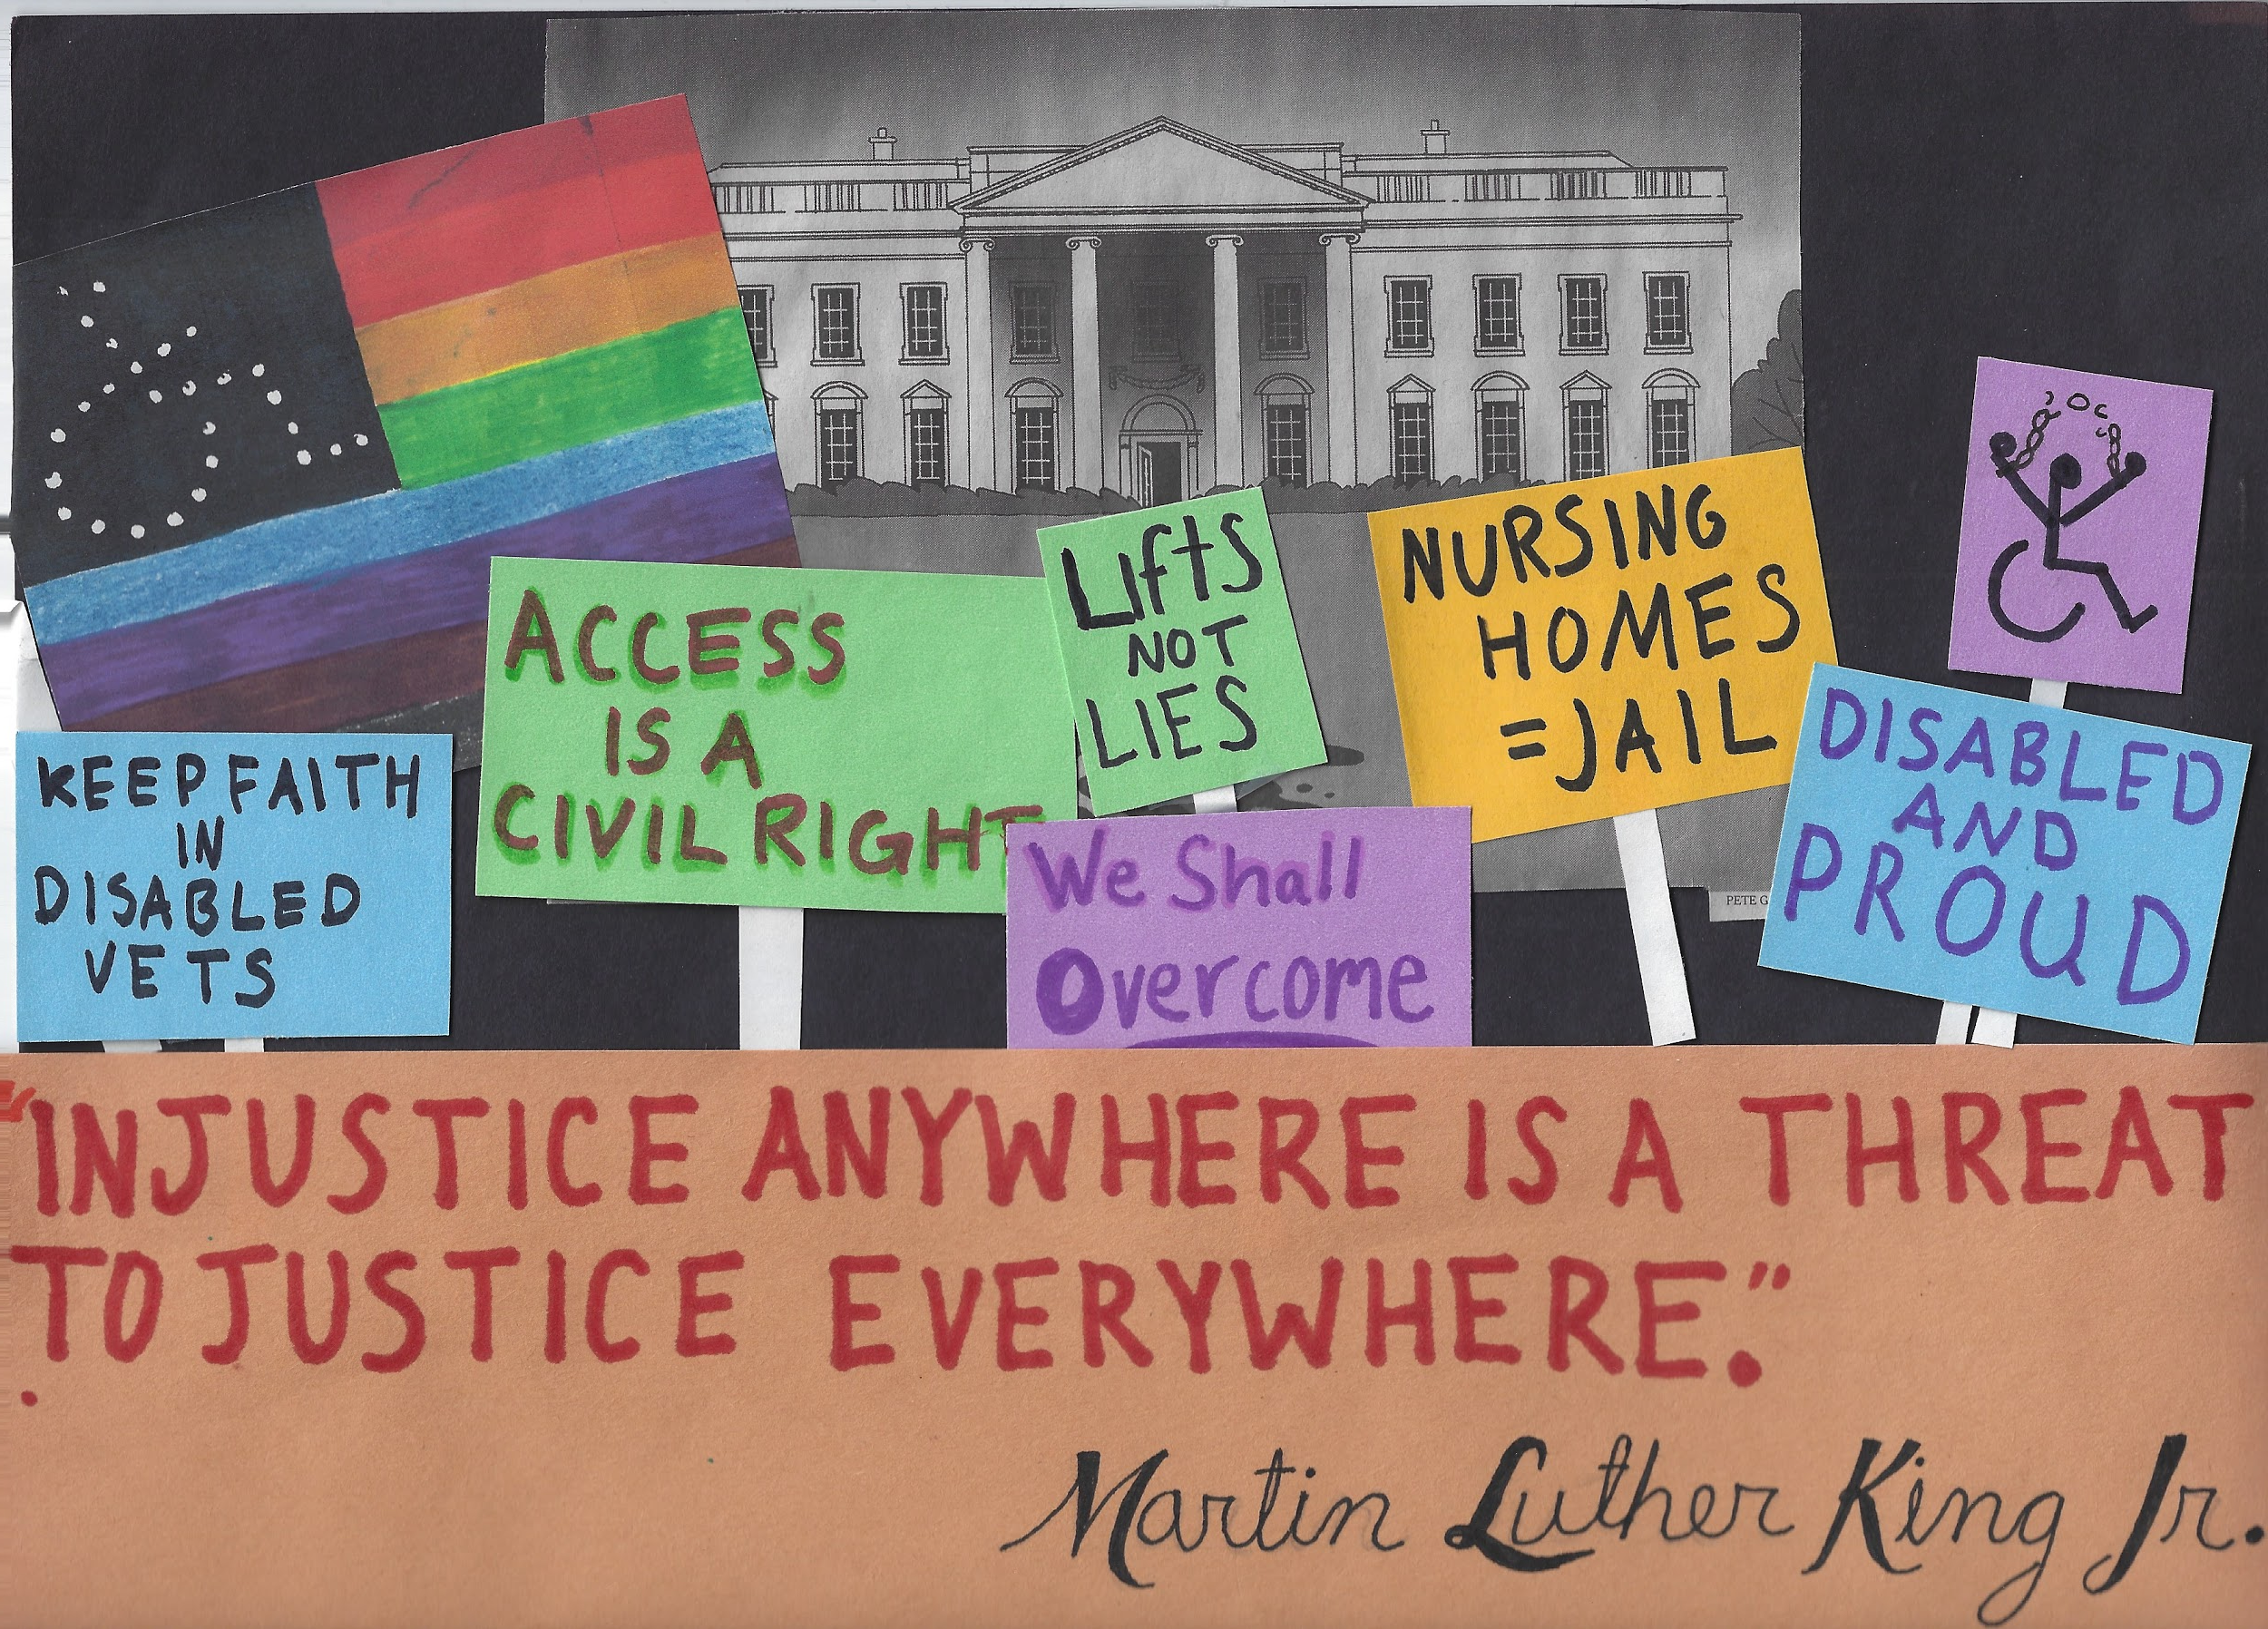
Notes:
Resistance picture

Slide 18
Citations
McBryde Johnson, Harriet. 2003. "Unspeakable Conversations." New York Times Magazine. The New York Times Company.
Young, Stella. “I’m not your inspiration, thank you very much.” TEDxSydney.
Rosemarie Garland-Thomson. 2016. “Becoming Disabled.” The New York TimesL New York.
Matisse, Henri. 1901. Dance I. Paris, Boulevard des Invalides. On display at MOMA.
Clare, Eli. 2009. Exile and Pride. Duke University Press. United States of America.
Mingus, Mia. 2011. “Access Intimacy: The Missing Link.” Leaving Evidence: a blog by Mia Mingus.

