Slide 1

My experiment
Nathalia Santos

Slide 2
Weeks 1 – 5 = What is this project about?
After feeling a little bit lost, we decided to talk about clothing. We thought it would be a great chance to evaluate daily contact zones we are unaware of. At first it sounded like a great idea, since I buy a lot of clothes. I decided to delay my start a little bit (damn Brazilian Way), since we were very focused on what to talk about. I imagined it wouldn’t take a long time…

Slide 3
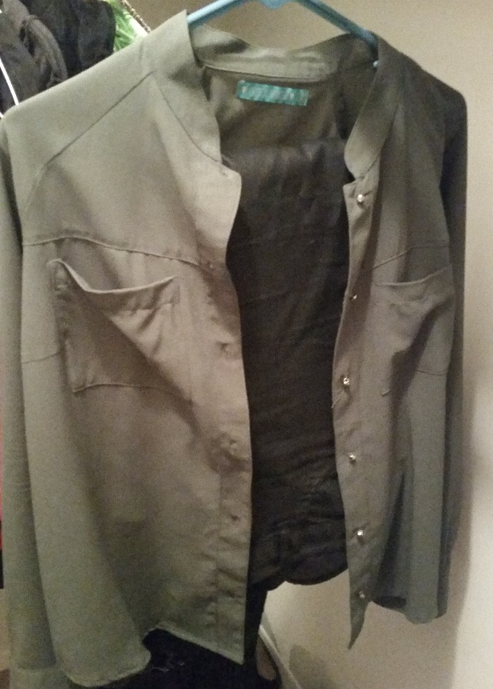
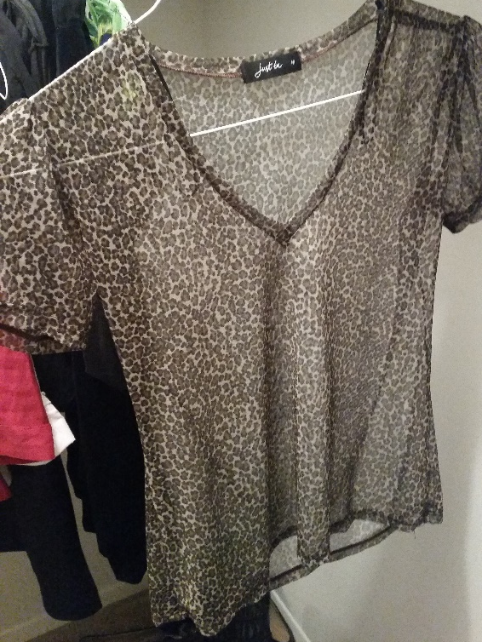
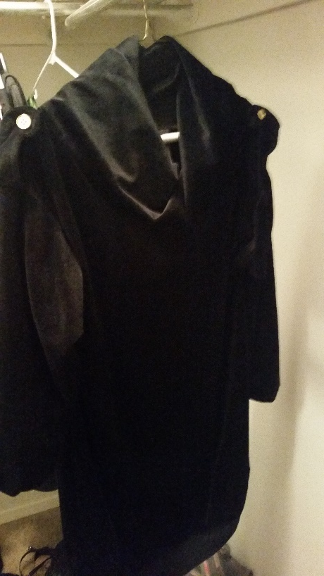
Week 6 = Choosing an Outfit/Brand
My closet is packed. Picking up 3 favorite outfits is a daily struggle, but I managed to do it. The three of them are from Renner, a Brazilian store.
Military Look:
Leather Pants
+
Army Shirt
Black Dress
Wildcat Shirt

Slide 4
Week 7 = Findings
After exhaustingly research, I found out the company was fined in 1 million dollars for slavery. But such information is not easy to find. The fact Renner is vegan, cruelty-free, no animal testing is plain to see in every website, but finding labor conditions on Brazilian companies is practically impossible, because that doesn’t cause enough empathy.

Slide 5
Week 8 = The week I figured I am heartless
I started analyzing how that would affect the way I purchase things. It made me feel bad towards my way to purchase, but it did not affected me that much. It is not a problem that consumed my mind or made me feel guilty for buying the clothes I did.

Slide 6
Week 9 = Never too late to change plans
I found some data on Renner, but I still felt like the research topic did not interested me that much. Contact Zones should be something that gets you thinking from time to time, so I decided change my research topic to Services Offered, since I am constantly asking for delivery, getting cabs or eating out.

Slide 7
Week 10 = The research continues
Most people don’t even pay attention on the guy who delivers food, the Taco Bell attender, the waiter. I’ve always done. And since I am a foreigner, anyone I meet here, unless Brazilian, has huge chances of being a foreigner to me. During week 10 I decided to write down a brief report on people that I met. I will owe you guys pictures, cause I did not feel like asking them for it, so they did not felt like I was only talking to them cause I wanted to do school work.

Slide 8
Profiles
Omar
Peter
Wingerz delivery guy;
Turkish 23 years old;
Graduated in graphic design in home country;
Came to America to study Arts and make more money;
Delivers to afford college;
Pizza Hut delivery guy
American, late 20s;
Dropped college to find a job because he got his girlfriend pregnant;
Couldn’t find a better job with no experience;
Currently likes his job, but regrets dropping college;
Melissa is 5 years-old and ADORABLE, parents divorced.

Slide 9
Profiles
Jean
Rebecca
Airport Shuttle Driver;
Haitian mid-sixties;
Graduated in Spanish in home country;
Fluent in Portuguese, French, English and Spanish;
Love his job, because he meets people;
Waitress at Applebee’s
American, mid-twenties;
Works in another restaurant to make more money;
Loves her job, because that’s how she has the opportunity of meeting people and having a social life;

Slide 10
Week 10 = What I learned
Some people love doing what they do, it doesn’t matter what it is, I picture their jobs as something temporary, but some of them see it as their careers. Some of them even gave up their former careers. I learned that through Services I get my major contact zone, even though I don’t even realize it. This will affect more and more my “purchase” as every time I ask for a service I make more effort to get to know the person behind it.

