Slide 1
Representing Ability
Super and Dis Abilities in Television

Slide 2
Representations of Deviations on TV
Superheros, Metahumans, Mutans, ‘Powers’
Disability as a power/skill-enhancer or motivation
  Power as a cure
  Disability as a Power
Disabled, ‘Less Than’, Sub-human

Slide 3
Super-people
Heroes Alphas
Heroes Reborn Tomorrow People
Smallville Flash
SHIELD X-Men
Believe Avengers
No ordinary family
Misfits
Teen Wolf
The struggle of having powers and
being ‘Enhanced’

Slide 4
(Em) Powered
powers begin to reveal themselves→ Searching for answers→ Finds mentor/purpose
Learns what their power is → Denial→ Marginalization→ Find More Friends →
‘training montage”→Identify Villain→ Save World

Slide 5
Disability and ‘Power’
Teen Wolf-- Epilepsy
Touch--Autism (?)
Sherlock Holmes--ASD (?)
Daredevil--Blind (?)
Professor X--Paraplegic
Gary Bell--Alphas
Power as a cure, Disability as a power

Slide 6
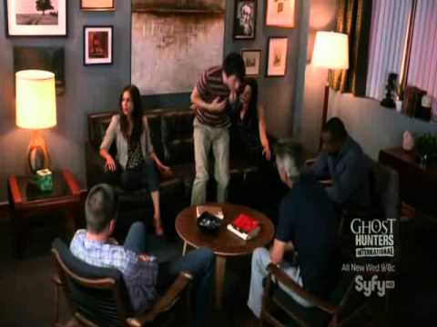
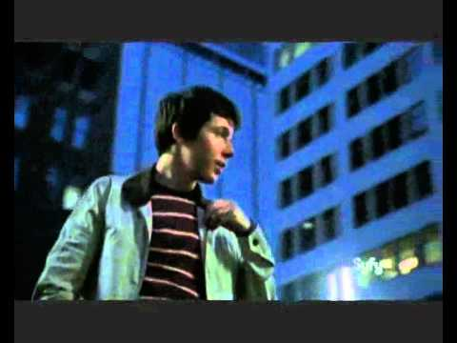
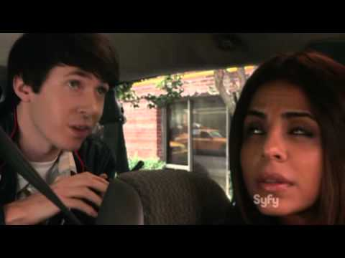
Gary in
Alphas
Disability ‘quirks’
or tendencies
assist in solving
crim
‘High Functioning Autistic’,

Slide 7
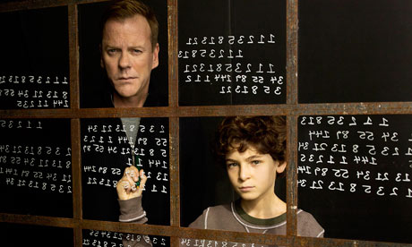
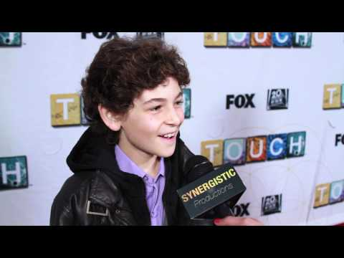
Misdiagnosed
Jake in Touch identifies out of autism
Is it better to say that his character is not
autistic and is actually something better?

Slide 8

“What if I told you, all of this could go away?”
Disability as weakness
Disability as a problem
Biological enhancement
as the cure

Slide 9
Examples of disability in TV (no ‘super ability’):
Open ASD: Parenthood- Max Braverman
Closed ASD: Sherlock-Sherlock

Slide 10
The Autistic Pony: Open or Closed ASD
Open ASD: Professor X,
Character has the disability
storyline
Likeable? Obstacle? Variety? How will it end?
Will that character be better off?
Are they just their disability?
When did it happen? Addressed?
Closed ASD: Sherlock
Character could have the disability
Does it matter?
Personality traits
No need to identify as the disability
They are more than a disability

Slide 11
Closed ASD
When a character could have a disability, great controversy arises:
The actor could be ‘playing’ the character with
no disability in mind or only a disability in mind
People could be offended with the inference that a character has a disability
It forces some stereotyping, ‘labeling’, or universalizing disability
If the actor chooses to identify ‘out’ of a disability, those that once related to the character feel marginalized
If the actor identifies ‘in’ the nondisabled masses may feel uncomfortable and find the character less relatable

Slide 12

Sherlock: Identifying out of disability
In this clip, it is confirmed that Sherlock has
asperger’s, but the actor who plays Sherlock
still says that he doesn’t see the character
that way

Slide 13
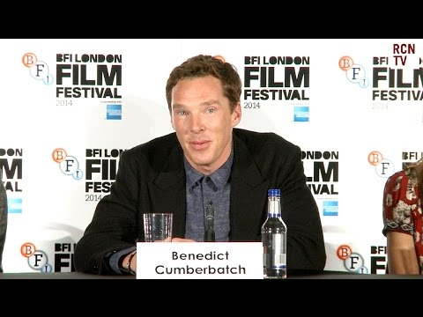
However, Cumberbatch does not see Alan Turing in The Imitation Game or Sherlock on the autism spectrum
He is actively identifying out of ASD

Slide 14
Identifying Out of Autism
Hurtful/Offensive: Open Letter to Benedict Cumberbatch about Alan Turing and Sherlock from The Caffeinated Autistic
“I wish you would have embraced your ignorance of this topic, instead of discussing how “lazy” it is to interpret Alan Turing as autistic, despite there being loads of evidence that he was.”
“You spoke recently about The Imitation Game, and you said that it “celebrates outsiders; it celebrates anybody who’s ever felt different and ostracized and ever suffered prejudice”. I felt so very happy when I read those words, thinking, “this is someone who understands the person who he’s playing”. It was just a day or two later that my hopes were dashed as you denied Turing’s neurodivergence, and I wondered if perhaps I was the wrong sort of “different” for you – is it okay if I’m queer, but I’m the wrong sort of different if I’m autistic? Is there something shameful about being autistic, because your manner of speaking about us seems to indicate that is so.”

Slide 15
Out
Why identify out of autism or as autistic?
Relatable
Create awareness for people
Give a pop culture icon for someone to look
up to who has ASD
Make people see how human people with
autism are
"As far as the known similarity that he's socially awkward, what you see is a whole evolution in him. It's humanising and that happens, I suppose, in some aspects of what we do with Sherlock.
-Cumberbatch
" It's a great honour to be asked to play somebody like him so the last thing I want to do is go, 'well, he's a bit like Sherlock, isn't he?' Because he's not and you can't begin to fathom what an individual is when you start calculating the similarities
Cumberbatch
As

Slide 16
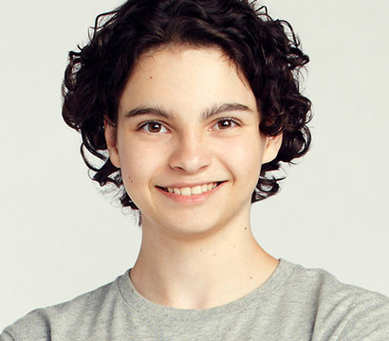
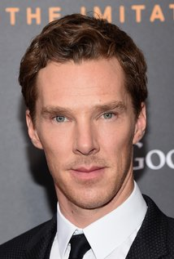
“Crip Drag”- Feminists with Disabilities
When an actor plays a character who has a disability when they themselves do not have that disability

Slide 17
Open ASD
How can you represent a whole community of people who are on the autism spectrum if you don’t know that experience personally?
What if the show dramatizes or misrepresents ASD?
How will the show handle diagnosis/ familial reactions?
Will the character have any other characteristics or storylines that are not about their ASD?
What will the ‘resolution’ be?

Slide 18
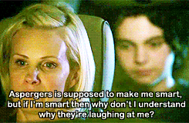
Max Braverman
“I didn’t know that we could do it because there weren’t any shows or movies that told the story of a kid with Asperger’s. I was worried.
Would it just be a point of people turning away from the show? And would we be able to do a good job telling the story, representing in some way what the experience is really like for a family dealing with this? And I didn’t know the answer to that.”-Showrunner
Parenthood
This character has Asperger's and the showrunner has a child on the spectrum

Slide 19
Authority
For parenthood, the showrunner had personal experience with the disorder
Interestingly, the actor that plays Max came to the same conclusion as Cumberbatch did:
“And what’s made Burkholder’s Max earn the favor of the largely underrepresented autism community, in addition to his standout performance, is the actor’s approach to the character, as being someone who’s more than his disorder. “Once I got the general idea of what Asperger’s is down, I sort of stopped thinking of Max so much as a kid with Asperger’s, rather more as just the character himself,” Burkholder said” -Buzzfeed
How does an actor gain the authority to represent disability?
How can you fight the stigma of ‘crip drag’?

Slide 20
Disability
Symptoms begin to surface→ searching for answers→find doctor→ diagnosis
denial/grief→ Marginalization→ Little victories/setbacks→ Learns about self → eventually finds place where they can be themselves

Slide 21
Misdiagnosed as disability
Pity
Represents real people
Desireable
Disability as a power
Marginalization
Disability
right kind of different
Superability
searching for ‘diagnosis’
‘crip drag’
Not desireable
No ambiguity
Identify with them and
their struggle
journey toward self-acceptance
Ambiguity
(Closed or
open ASD)
out cast
underdog
Saves the world
wrong kind of different
All fantasy→ not representative
of real people

Slide 22
Why, then are disabilities so undesirable?
With all that disability and superability have in common with regards to their representations, why are the reactions of audiences so different?
We see superheroes as above us. We want to be like them, seek their help in times of need, and we root for them. Even more, we root for their self-acceptance of being different
However, we pity the disabled. We ‘other’ them, feel bad for their families for having to deal with them, and seek cures for their disability.
No one would pity a superhero or try and ‘cure’ them. We preach self-acceptance, but only when that person has desireable traits. Even more, we root for people who are not real, but cannot connect to characters who are modeled after real people. How, then, can we represent disability better?

Slide 23
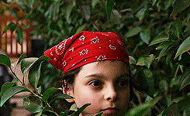
OPEN ASD!
Max is an underdog, but we root for him. The way the show presented him
made him relatable. He has likes, dislikes, he laughs and loves. He
is a person, not just a disability. But, his disability is a part of him. Furthermore, the actor who plays him never identified out of autism. In this sense, we were able to achieve what Cumberbatch wants; seeing a
character as a compilation of all of their quirks and personality traits
without putting them in a box. However, Parenthood presented us with the box of Asperger’s in season 1 and allowed us years to get to know Max outside of and inside of this box. In fact, Max permeates the boundaries
of the box.
In my opinion, Max Braverman of Parenthood is the closest to real representation of someone on the autism spectrum. The actor got to a point where he saw Max with Asperger’s being a part of his identity but not all of it. That is unlike Benedict Cumberbatch who refused to even admit that his characters were on the autism spectrum. Parenthood never shied away from the reality of it.

Slide 24
Final
Reflections
Superability seems more relatable than disability because it is more desireable and people like to imagine themselves as ‘super’.
However, anyone at any time can become disabled so the key to representing disability is to show that disable people are still human.
So, characters that are disabled will be flawed because everyone is. Their disability is a part of them but does not have to define all of their plot lines. Furthermore, the people behind the show like the actors and showrunners need to be on the same page so no one tries to identify out of a disability. Open ASD could television and in film may lead to greater social understanding, but closed ASD cannot. We can make ‘crip drag’ less offensive and more informative or realistic by making sure actors speak to people with these disabilities, not just organizations that try to ‘cure’ them. Also, more actors that have disabilities could be hired to avoid the crip drag problem altogether.
Superheros will always be the more desireable end of the ‘normal’ bell curve, but if we begin to see disability as human and relatable through accurate and real tv representations, then maybe the curve won’t be so steep.

