Slide 1
Hello!
nĭ hao
olá
annyeonghaseyo
Helló
Hej
Kon’nichiwa

Slide 2


Can we talk about something kind of weird?
Notes:
http://www.clipartbest.com/clipart-niEXkkn6T

Slide 3

Have you ever eaten fried crickets???
Notes:
Cricket: http://cliparts101.com/files/737/9D772A04F84704498D191C1B0065DBFA/Cricket.png

Slide 4

Have you ever wondered where we can from?
Notes:
Question Mark: https://cdn4.iconfinder.com/data/icons/defaulticon/icons/png/256x256/help.png

Slide 5
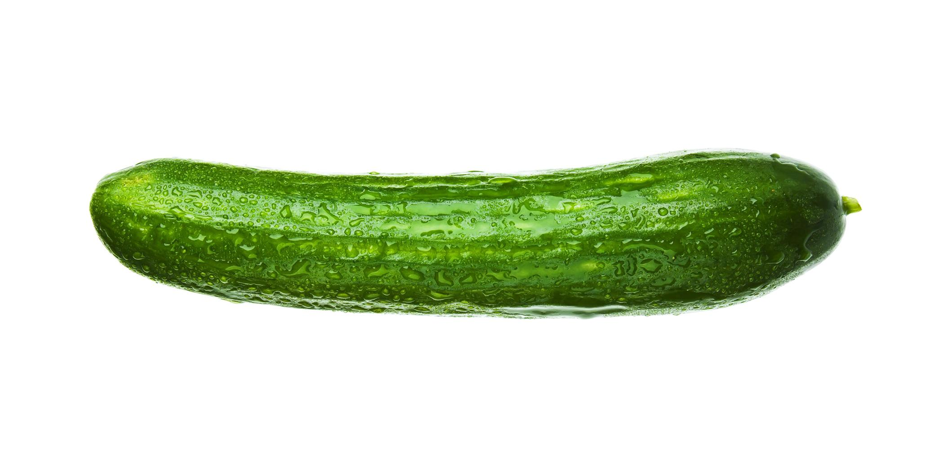

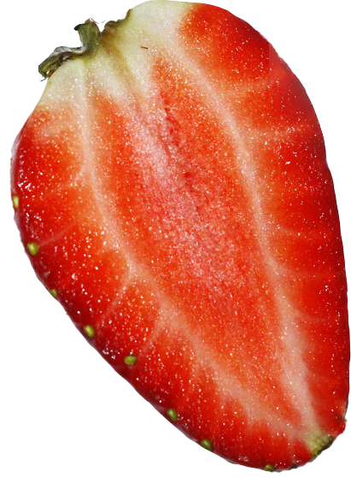
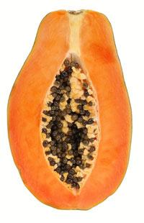
Can we talk about sex?
Notes:
banana: http://globe-views.com/dcim/dreams/bananas/bananas-03.jpg
Papaya: http://static.naturallycurly.com/images/articles/2011/05/papaya.jpg
Strawberry: http://upload.wikimedia.org/wikipedia/commons/5/5e/Half_a_strawberry.jpg
Cucumber http://www.publicdomainpictures.net/view-image.php?image=6219

Slide 6


I know it is a weird topic, but did you know that a lot of people around the world learn about sex?
Notes:
World: http://www.clker.com/cliparts/8/z/A/w/r/R/new-world-hi.png
light bulb: http://images.clipartpanda.com/light-bulb-clip-art-BULB02.png

Slide 7


So how about you and I take a global trip through sex education?
Notes:
Ship: http://4vector.com/i/free-vector-sailing-ship-clip-art_105573_Sailing_Ship_clip_art_hight.png
Arrow: http://www.clipartbest.com/cliparts/9iR/REB/9iRREBRLT.png

Slide 8
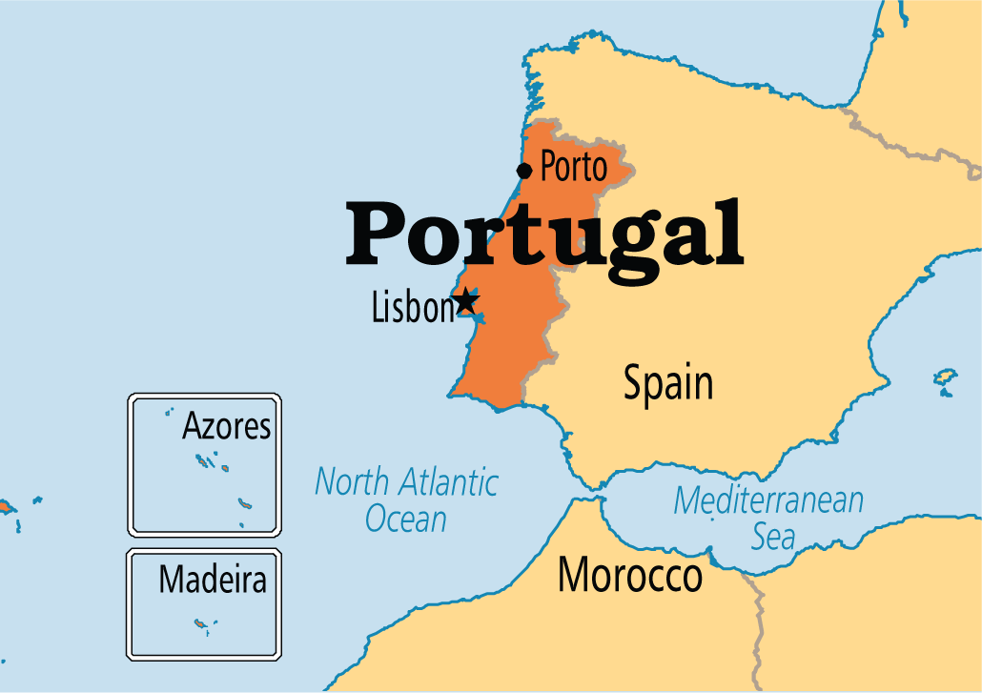
Our first stop is in Portugal, in it’s capital, Lisbon.
Notes:
Portugal: http://www.operationworld.org/files/ow/maps/lgmap/port-MMAP-md.png

Slide 9
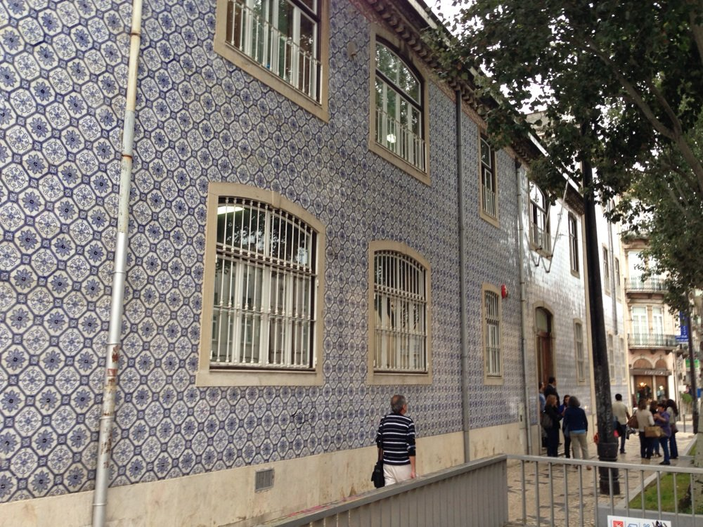

This is Daniela. She’s 7 years old and goes to APISAL Elementary School in Lisbon.
Hi Daniela!
Olá!!
Notes:
School: http://www.yelp.com/biz_photos/apisal-lisboa?select=TWgnagMXf7WH37TjUcD1uA#TWgnagMXf7WH37TjUcD1uA
Girl: http://cache3.asset-cache.net/gc/84782638-girl-in-classroom-gettyimages.jpg?v=1&c=IWSAsset&k=2&d=vqkNb4%2FRK4xFvHOyQEKVWbffs2ne0OmZZZ99pEfSUJU%3D

Slide 10
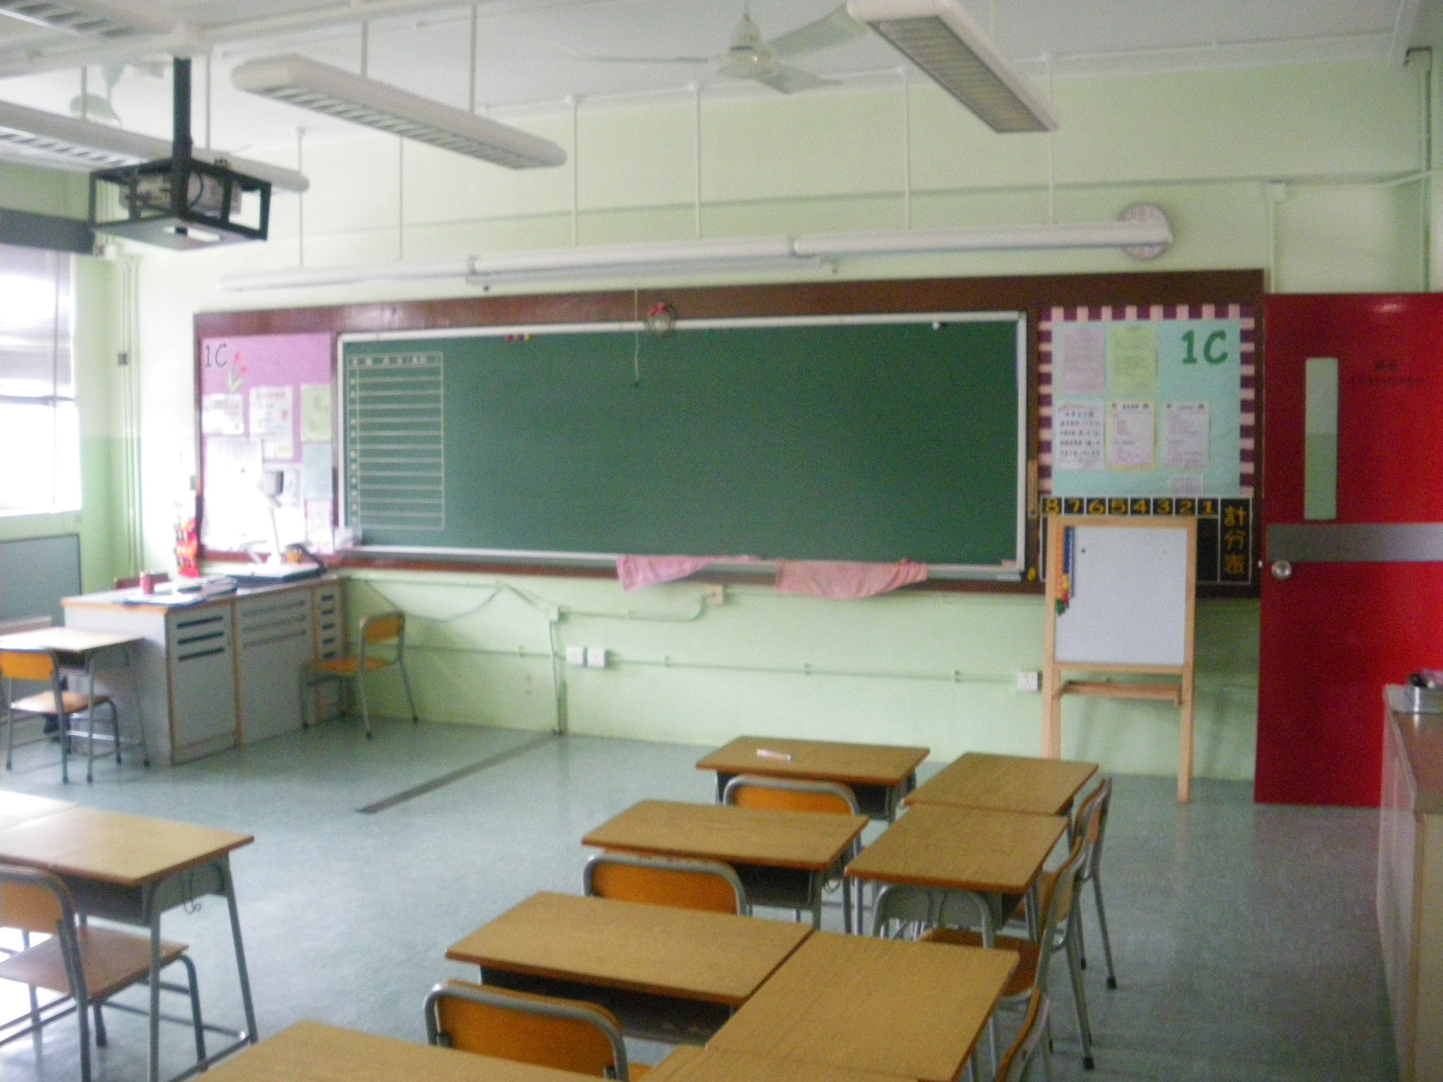

Daniela, can you tell us what you learned in school today?
Yes! Follow me!
Notes:
Classroom: http://dontstopliving.net/wp-content/uploads/2013/05/IMGP30791.jpg
Arrow: http://images.clipartpanda.com/purple-cross-clipart-Arrow-clip-art-15.png

Slide 11
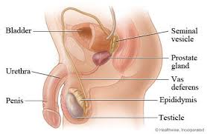
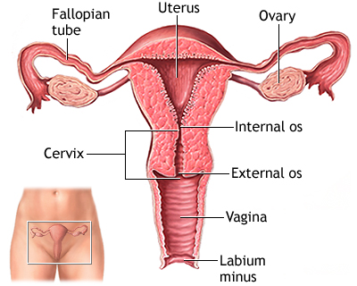
Today I learned about the differences between boys and girls
There are generally two types of people in the world:
Humans who have penises
and humans who have vaginas.
Humans who have penises are generally labeled boys
Humans who have vaginas are generally labeled girls
However, even though somebody may be born with a penis or a vagina, it does not mean that he/she is a boy or a girl. But don’t worry about that right now; we’ll get that that later!!!
Notes:
Penis: https://s3.amazonaws.com/healthtap-public/ht-staging/user_answer/avatars/403601/large/open-uri20120915-24612-ajvs54.jpeg?1347684416
Vagina: http://s1305.photobucket.com/user/nutmeg911/media/76780EEA-5E77-49B8-852B-06F3E7B41D99_zpsp6duijmd.jpg.html

Slide 12
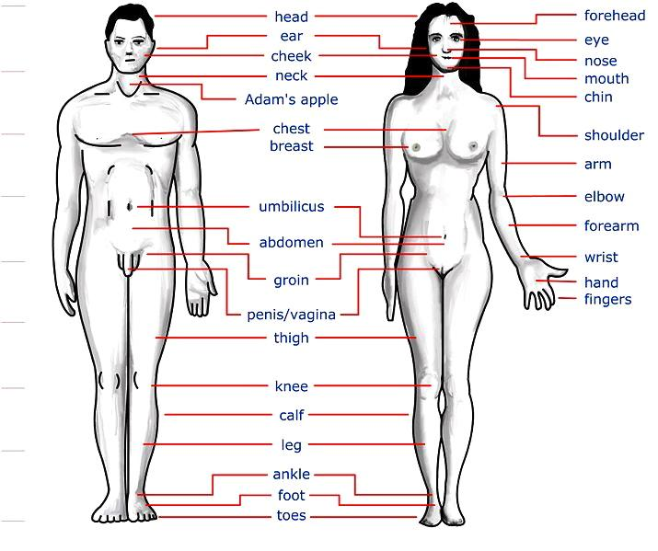
We learned that boys and girls look different on the outside.
Both boys and girls have two arms, legs, hands feet, eyes, and ears, and they also have one head and nose. However, biological girls have more developed breasts. These are used to store milk to feed their babies.
Notes:
Anatomy: https://arnoldzwicky.files.wordpress.com/2011/11/body-parts-3.jpg

Slide 13


We also learned that boys can be attracted to both boys and girls, and girls can be attracted to both boys and girls.
That’s right! People who are attracted to the opposite sex from themselves are heterosexual (het-er-o-sec-shoo-uh-l). People who are attracted to the same sex as themselves are homosexual (home-o-sec-shoo-uh-l). People who are attracted to both can be bisexual (bi-sec-shoo-uh-l)
Notes:
Man and woman: http://www.dailyembroidery.com/wp-content/uploads/2012/09/WomanMan.jpg

Slide 14

Thanks for teaching us about gender differences, Daniela!!! Do you know where we could learn about human reproduction?
No problem! You should go visit my friend Oscar in Sweden!

Slide 15
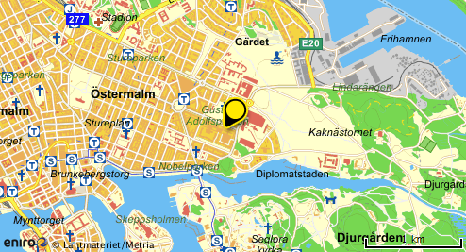

Hello! My name is Oscar and I am 12 years old. My friend Daniela told me you wanted to learn about the reproductive system! Well, it’s a good thing I just learned about that in my class today at the Banérportsskolan school in Stockholm, Sweden.
Notes:
Boy: http://shannonbrown.typepad.com/.a/6a00d83452920069e2017617779d6f970c-800wi

Slide 16
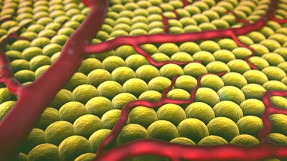
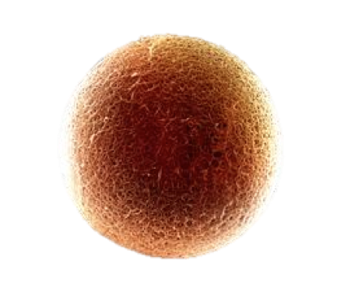
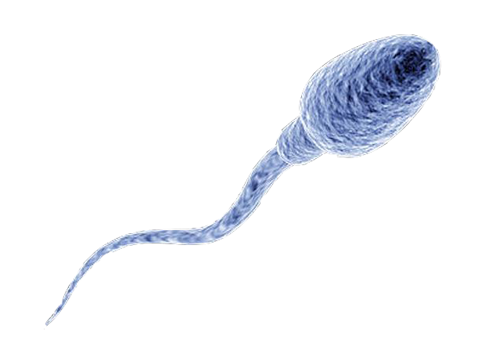
There are two things that are needed to make a baby: a sperm and an egg. The egg contains nearly everything needed to create a baby; however, it only has half the information it needs to make the baby. The other half comes from the sperm.
Notes:
Sperm: http://cbsnews1.cbsistatic.com/hub/i/r/2010/09/22/86b3c5fb-a643-11e2-a3f0-029118418759/resize/620x465/9f5987c0e770cce5ce393581bd1aac6e/sperm_1.jpg
Egg: http://www.nature.com/news/2011/110823/images/news476382a_egg.jpg
Background: http://3.bp.blogspot.com/-zxhYanb7vW0/U7jJREeLVXI/AAAAAAAAAXs/yVdhJ3xiS2s/s1600/Devious+Depths+1+%255Bwww.sulirium.com%255D.jpg

Slide 17
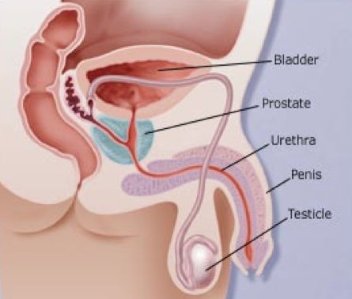
Sperm are half of what eventually makes a baby. They are created and stored in the testicles. An individual with testicles (test-ih-kuh-ls) can create sperm for zis* whole life.
*Zis here refers to gender neutral pronouns. Ze, zim, and zis are all gender neutral pronouns. Some people are more comfortable when they decide to not be a boy or a girl. Instead of using words like “his” or “her”, we can use gender neutral pronouns so that we can be inclusive of everyone.
Notes:
Diagram: http://img.webmd.com/dtmcms/live/webmd/consumer_assets/site_images/articles/health_and_medical_reference/sexual_health/male-sexual-problems-basics_malereproductivesystem.jpg

Slide 18
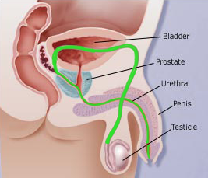
When they are ready, the sperm make their way through the bladder and prostate, into the urethra (you-ree-thra), and out of the penis. This is called ejaculation (e-jack-you-lay-shun). The average ejaculation has over 40 million sperm!
Notes:
Information: http://www.nlm.nih.gov/medlineplus/ency/article/003627.htm

Slide 19
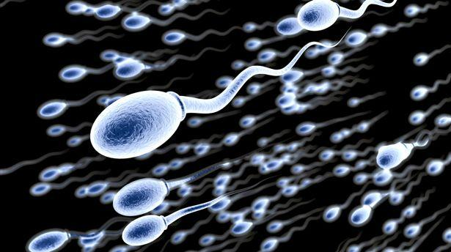
Wow!!! Look at all those sperm! They are moving really fast because they all want to get to one specific place first!!
Notes:
Sperm: http://www.thedrinksbusiness.com/wordpress/wp-content/uploads/2013/12/sperm.shutterstock.jpg

Slide 20
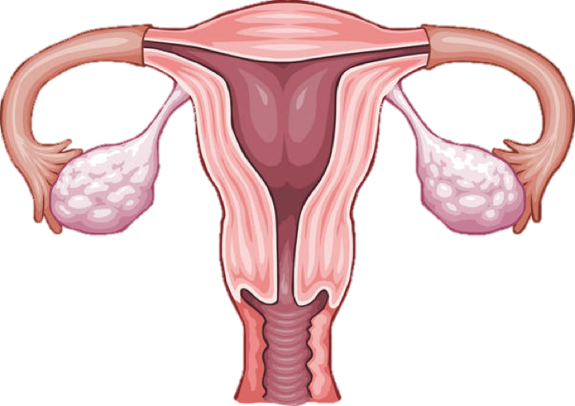
So where were all those sperm going? Well, if they are trying to make a baby, then they are heading towards a woman’s uterus (you-ter-us).
Fallopian Tubes
Uterus
Ovaries
Notes:
Uterus: https://edc2.healthtap.com/ht-staging/user_answer/reference_image/7081/large/Uterus.jpeg?1386669522

Slide 21
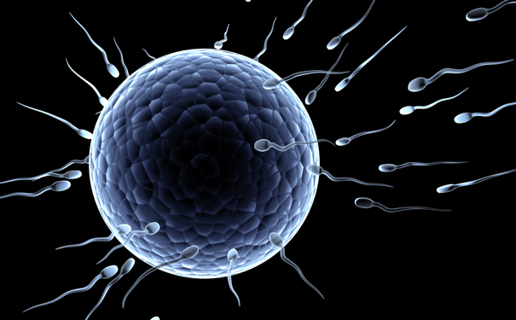
The sperm race until they reach the second half of what eventually makes a baby, the egg.. There, only the first one to reach the egg will be able to inseminate (in-sem-in-ate) it.
Notes:
Background: http://scienceillustrated.com.au/blog/wp-content/uploads/2012/09/sperm-and-egg.gif

Slide 22
Uterus
Fallopian Tubes
The egg starts in the ovaries (over-e’s), and makes its way into the fallopian (fa-lope-e-an) tubes. There it will meet the sperm and together they will travel into the Uterus. From there, they will multiply into millions of cells and eventually create a baby!
Ovaries
The egg comes from a the ovaries. Unlike testicles, ovaries only have a limited amount of eggs. When an individual reaches around 45, ze has used up all zis eggs, so there aren’t a lot of eggs to be made into babies.

Slide 23
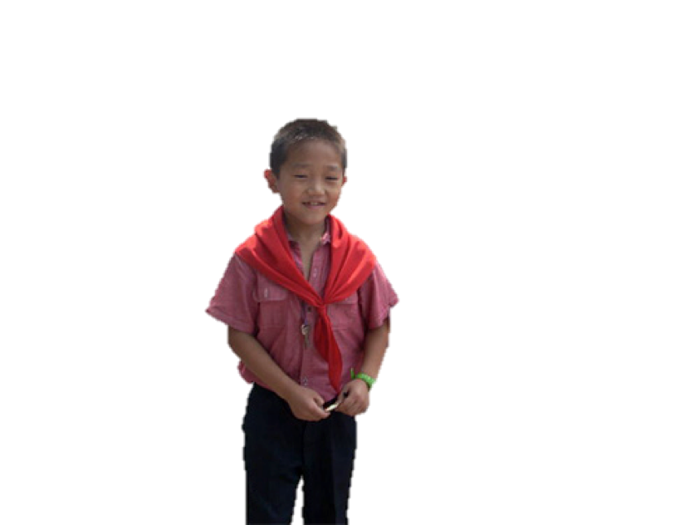
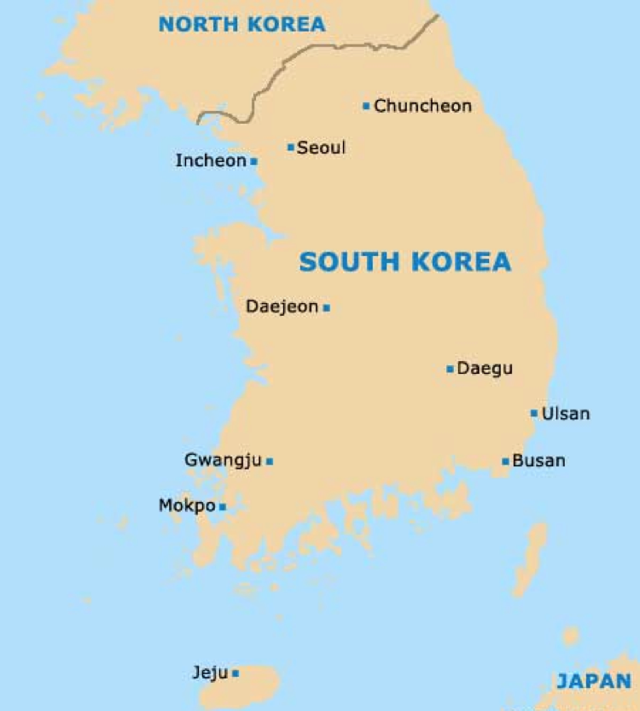
Thanks for showing us how how sperm and eggs come together, Oscar! Our next stop is in Seoul, South Korea at the Shin-Gu Middle School. This is Ji hu. He’s 10, and today he learned about how babies develop in the womb.
Yes, that’s right! Here let me show you!!
Notes:
South Korea: http://www.world-guides.com/images/south_korea/south_korea_map.jpg
Boy: http://www.kidsofcourage.com/images/spotlight/120730_nkboys.jpg

Slide 24
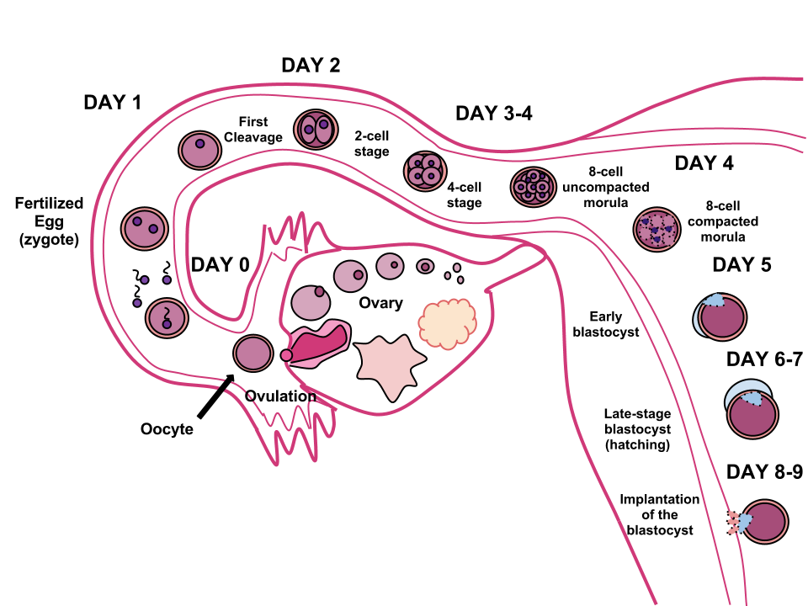
After the sperm and egg have combined, the egg moves to the uterus, also known as the womb. Here it will spend 9 months maturing (mat-ur-ing), going from a cell smaller than the naked eye can see, to a full grown baby!
Fallopian Tubes
Uterus
Sperm and
Egg Meet
Ovaries
Notes:
http://figures.boundless.com/6400/full/human-fertilization.png

Slide 25
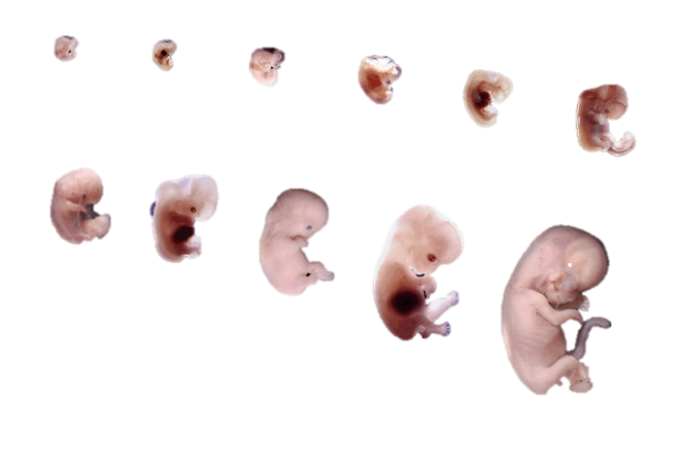
The Carnegie Stages
This is what the sperm and egg, now called an embryo (em-bree-o) look like 28 days all the way to 56 days after they combined with each other.
Notes:
Stages: http://embryo.soad.umich.edu/carnStages/allStagesButtons.gif

Slide 26
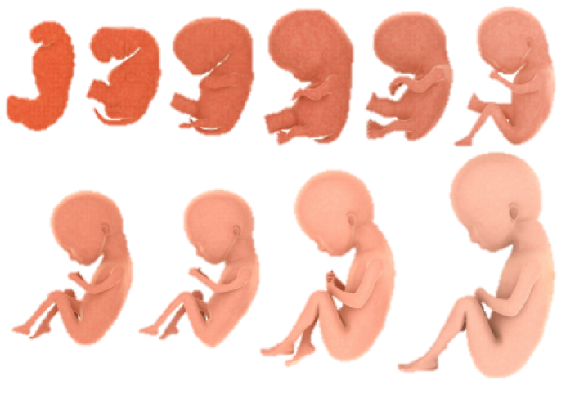
This is what the embryo looks like 56 days all the way to 350 days after they combined with each other. At this point we switch to calling it a fetus (feet-us).
Notes:
Development: http://horausa.com/images/HORA_USA_Web/Human-Embryo-Development.jpg

Slide 27
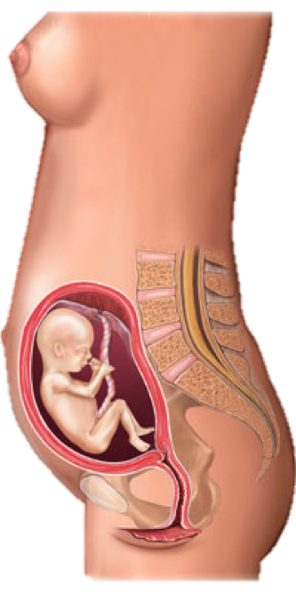
The Fetus
This is a fetus inside a human body. The fetus lives off of the human, gaining food and nutrients (new-tree-ents) from zim.
Notes:
Diagram: http://s.hswstatic.com/gif/fetus-in-uterus-pregnancy.jpg d

Slide 28
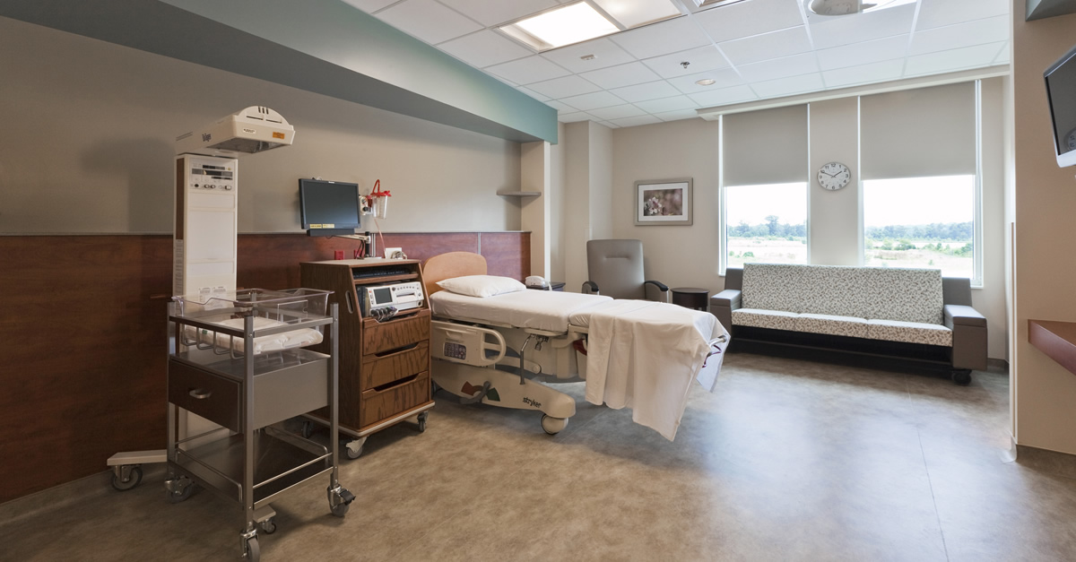
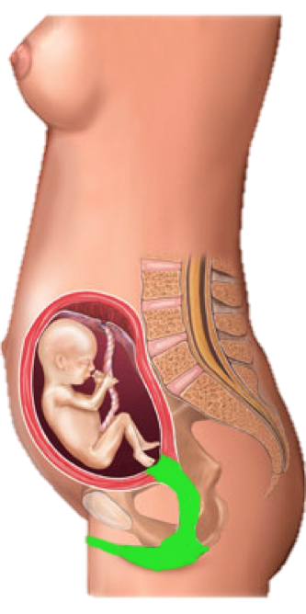

When the fetus is ready, which is 9 months after the sperm and egg first met, it will travel from the womb through the vagina and into the world as a newborn baby!
Notes:
Diagram: http://s.hswstatic.com/gif/fetus-in-uterus-pregnancy.jpg d

Slide 29
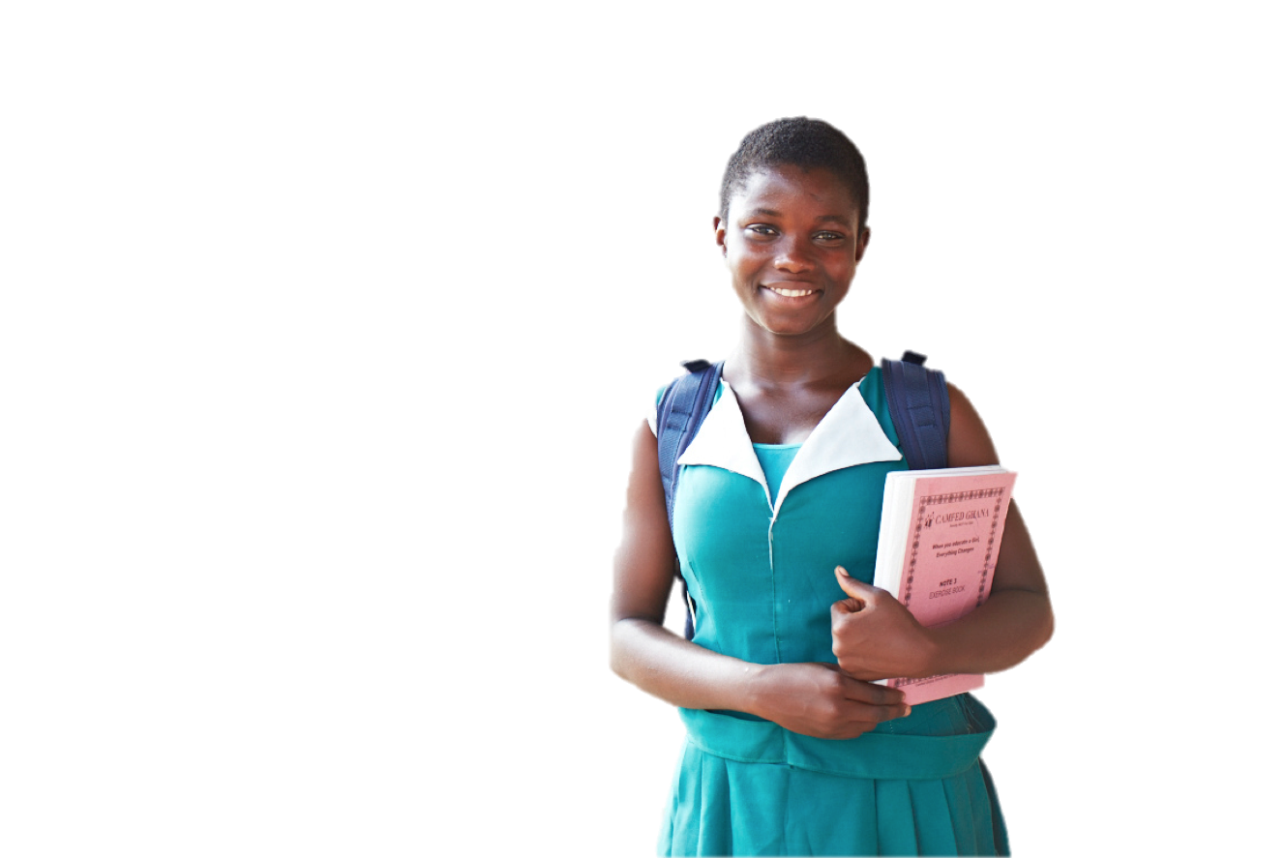

Now that we know where babies come from, can we talk about how they are made? In the traditional sense, a baby is made when a man and a woman come together and have sex. Hi Andile! This is Andile. She goes to the Avondale Primary School in Harare., Zimbabwe, our fourth stop. Do you think you could tell us a little more about sex?
Hello!
Harare
☆
Notes:
Girl: https://camfed.org/media/uploads/files/753A1539_St_Matthews_JHS_Ghana3_low_res.jpg

Slide 30
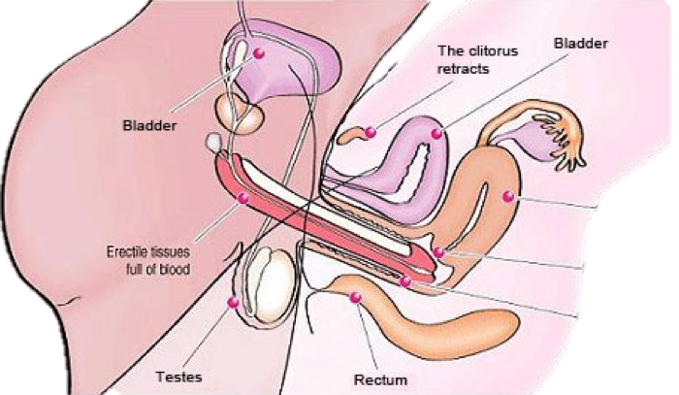
I sure can! Sex is when two (or more) individuals come together and engage in sexual activity. Traditionally this includes penetration of the vagina from the penis. However, today I just learned that sexual activity doesn’t always have to involve just a penis and a vagina. It can also be between two penises or between two vaginas.
Above is a form of sexual activity. It is done between two individuals, one with with male and one with female sexual organs. This is the most common form of sex. The penis will become hard and will be inserted into the vagina. Eventually this causes the penis to ejaculate and deposit sperm into the uterus where they will start their search for the egg. Sexually activity of any sort must be wanted by both people in order to be a pleasurable experience.. If someone tells zis partner that ze wants to engage in sexual activity, ze is giving consent. Both people should always give consent, or permission, before sex.

Slide 31
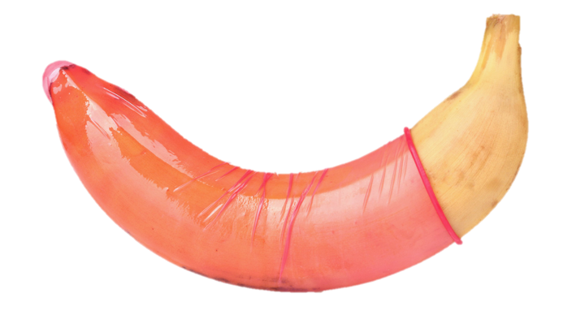
There are other forms of sexual activity including oral sex, anal sex, and masturbation. Oral and anal sex are both other ways to enjoy sexual activity with a partner, masturbation (mast-r-bay-shun) is something people do by themselves.
That’s right! I learned that masturbation does not cause any harm, and can actually feel really good. However, it should be done in private. I also learned something really important! It is always best to use a condom during sexual activity to help prevent unwanted pregnancies and special types of diseases. These are called STDs. A condom is a rubber covering that goes on the penis to catch the sperm before it can reach the uterus. This will help to make people safe.
This is a condom on a banana
Notes:
Condom: http://c.fastcompany.net/multisite_files/coexist/poster/2013/03/1681650-poster-1280-banana-condom_0.jpg

Slide 32
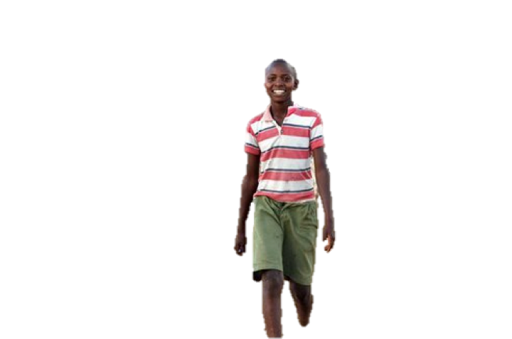
Thanks Andile!! Now lets travel to Kenya where we will meet ten-year-old Juma!
Habari!
Now, Juma, you had somebody special come to your school. Is that correct?
Tackle Africa came to my school to teach us about STDs!
That’s awesome! What did you learn?
Notes:
Boy: http://cdn.dogomedia.com/system/ckeditor_assets/pictures/508d4c9a1860e04fa300174a/content_richard-turere-young-inventor-nairobi-kenya.jpg.492x0_q85_crop-smart.jpg

Slide 33
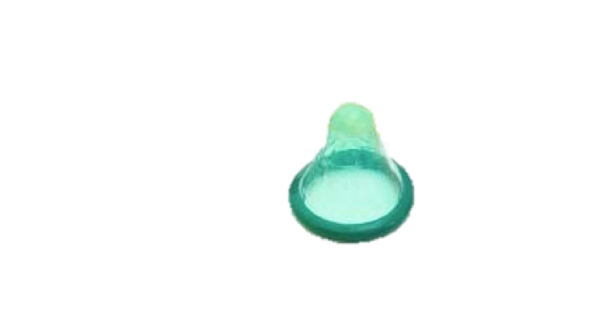

Tackle Africa is an organization that uses football (soccer) as a way to teach us about STDs and prevention. We learned about how there are diseases that can be spread through having sex, called STDs.
STDs, or sexually (sex-you-ally) transmitted disease are no fun. In Africa and South America right now many people are infected with a common STD: HIV/AIDS. STDs can only be transmitted through the exchange of bodily fluids, which is why sex is a major transmitter. The two methods of prevention against STDs are using condoms and abstinence (ab-steh-nence), or not having any sex.
Notes:
Condom: http://www.ippf.org/sites/default/files/imagecache/News_Medium_image_420_234/images/blog/2012/condoms.jpg
Condom Package: http://i.kinja-img.com/gawker-media/image/upload/s--0gVWXgu8--/189llgnztk4djjpg.jpg

Slide 34
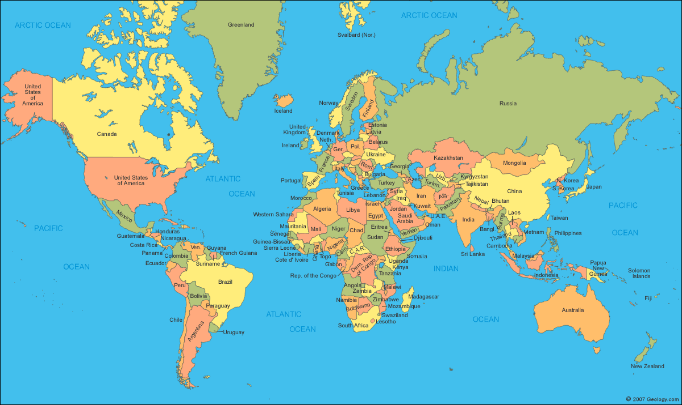
In many countries in the Middle East, Africa, South America, and parts of the United States, abstinence is taught.
Abstinence means choosing to not have sex. A lot of religions say that sex before marriage is not allowed and that young boys and girls should partake in abstinence.
An issue that has come up due to this is that many (but not all) young boys and girls are curious about sex and will have sex no matter what.
Studies have shown that abstinence only programs do not stop adolescents from having sex, and in fact discourage some from using condoms during sex
Notes:
World Map: http://geology.com/world/world-map.gif

Slide 35
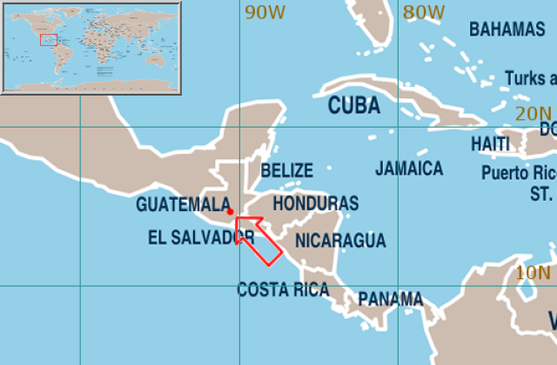
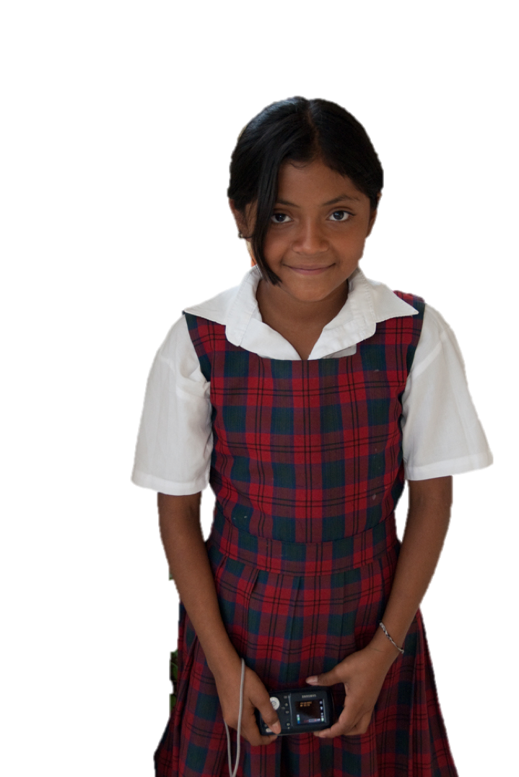
Our final stop on our journey is in Guatemala., in Guatemala city, at the Joaquin Palma School. This is Mita. She’s 11 years old. Hola, Mita! Can you tell us what you learned in school today?
Hola! I sure can!
Notes:
Map: http://www.eird.org/perfiles-paises/perfiles/images/Guatemala-map-pop.png
Girl: http://i0.wp.com/www.dicksimon.com/wp-content/uploads/2012/12/guatemala-09.jpg?resize=669%2C1000

Slide 36

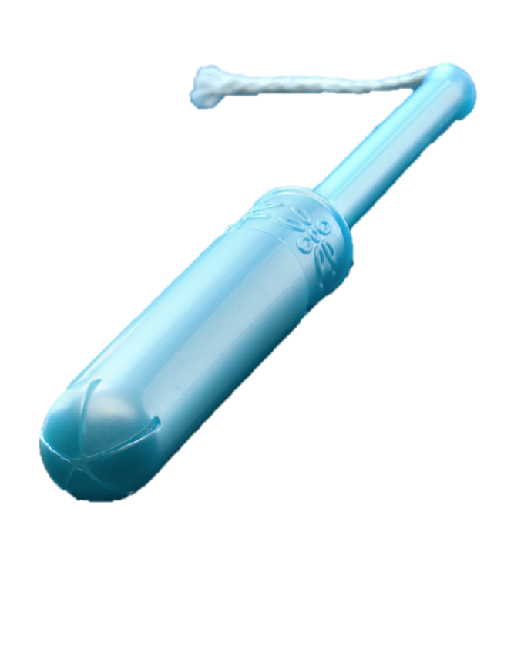
I learned today that once a month the inner wall of the uterus (the womb)-- the same place where the embryo turns into a fetus--will need to be replaced. During this process, the old inner wall comes out through the vagina.
Sanitary Pad
Tampon
This is called menstruation (men-stroo-ey-shun). For every individual with a vagina, the menstruation period, often referred to as “getting one’s period,” usually lasts between 3-7 days. During this time, persons should wear either a sanitary pad or insert a tampon into their vagina. Every few hours, ze should change zis pad or tampon.
Notes:
Tampon: http://www.freewoodpost.com/wp-content/uploads/2012/02/tampon.jpg
http://www.health-avenue.info/wp-content/uploads/2012/02/Sanitary_Napkin__Day_Use_.jpg

Slide 37
Wow! We’ve learned a lot about sexual education and how and when other children around the world learn about sex education. Before we go let’s recap what we learned. We learned about:
Sperms
and Eggs
Gender Differences
Abstinence
Menstruation
Sex and Masturbation
How a baby is born
STDs

Slide 38
I hope you had as much fun as I did on this journey around the world! I hope that as you get older, this information here in this book will help guide you as you make decisions about sex and sexuality.

Slide 39
Works Cited
Frayssinet, Fabiana. "Comprehensive Sex Education: A Pending Task in Latin America." Comprehensive Sex Education: A Pending Task in Latin America. Inter Press Service, 2014. Web. 20 Apr. 2015.
Kaidbey, Mona. Comprehensive Sexuality Education: Advancing Human Rights, Gender Equality and Improved Sexual and Reproductive Health. Rep. UNFPA, 2010. Web. 20 Apr. 2015.
Kaiser, Stefanie. Menstrual Hygiene Management. Rep. Sustainable Sanitation and Water Management, 2014. Web. 20 Apr. 2015.
Meyer, Debra. "HIV/AIDS and Education in Africa." African Women in Science and Engineering (n.d.): n. pag. Web. 20 Apr. 2015.
NFER. Sex and Relationships Education in Other Countries. Rep. NFER, 2009. Web. 20 Apr. 2015.
Tackle Africa. "What We Do." Tackle Africa. Tackle Africa, n.d. Web. 20 Apr. 2015.
UNESCO. Comprehensive Sexuality Education: The Challenges and Opportunities of Scaling-up. Rep. UNESCO, 2014. Web. 20 Apr. 2015.
UNESCO, UNFPA, and UNICEF. Sexuality Education: A Ten-country Review of School Curricula in East and Southern Africa. Rep. UNESCO, 2012. Web. 20 Apr. 2015.
UNSEC. Levers of Success Case Studies of National Sexuality Education Programmes. Rep. UNESCO, 2010. Web.

