Slide 1
“Tonight, we will be new maps, creating new constellations our our collective bodies and shapes
To create what freedom and love can look like,
feel like,
taste like,
Without any perfect body,
any perfect shape or form,
Without assuming any single way of thinking
or desire.
There is no right or wrong body of a conscious revolutionary mind.”
Image Description: Cara Page, a black femme with a shaved head and wearing a black cropped halter top and leggings, grips the hand of Nomy Lamm, a fat white femme adorned in a feathered body suit and outstretched wings. Nomy is perched above a tangle of prosthetic legs with her own leg hovering over the nest of limbs. Behind them is a background of blurry of green leaves and silhouetted tree branches.
[Cara Page’s Opening Poem to a Sins Invalid Performance in San Francisco, 2011]
Photo Credit: Richard Downing, 2009 https://www.sinsinvalid.org/media-1

Slide 2
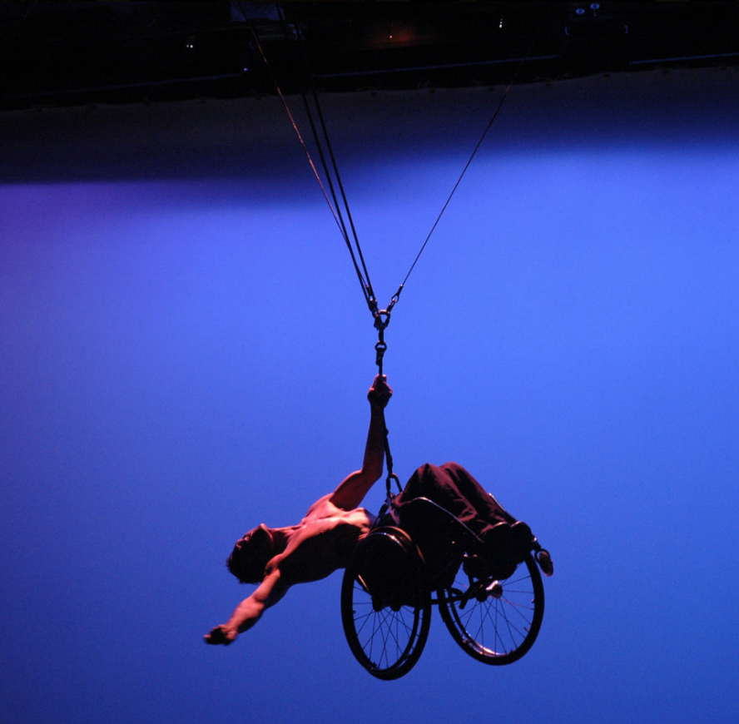
Sins Invalid: a New Paradigm of Disability Justice
My project was inspired by Sins Invalid’s mission to amplify artists with disabilities to wider public audience and center art performances that reclaim human rights to sexual culture, combating realities and narratives that deny, demonize and invalidate disabled sex*
* In their mission statement disability extends to communities “impacted by the medicalization of their bodies… and whose bodies do not conform to our culture(s)’ notions of “normal” or “functional.”” (https://www.sinsinvalid.org/)
Image Description: Rodney Bell, Deaf artist and activist, dangles shirtless in his wheelchair. Suspended in the air his back arched and one arm outstretched the other holding the suspension cords. His body is stands out against a glowing purple and blue backdrop.
Patty Berne:
“…we wanted a place that not just our thinking and visions were considered beautiful, but also our bodies…
My juice. My hotness. My beauty. The power of my sexuality. I think that was really why we started: Sins Invalid to include sexuality at the forefront of our work.” (https://medium.com/blue-heart/access-is-for-everyone-interview-with-patty-berne-co-founder-and-director-of-sins-invalid-a96bb7c5c192)
Leroy Moore:
“I used my disability as a fence to block the reality that everybody has a need to be wanted and to share their hearts.”
(Sins Invalid: An Unshamed Claim to Beauty)
Image description: Selfie of Sins Invalid Co-Founder Patty Berne, a light brown-skinned women with round-arched eyebrows and heart shaped lips, her hair is pulled back and she wears black square-rimmed glasses. She is wearing a striped blue, purple, and grey knit sweater and cherry red lipstick. There is a laundry pile over her shoulder.
Image description: Leroy Moore, a black man with a shaved head and a goatee, is grinning at the thought of his forthcoming nude scene in front of a live audience. He is wearing a neon orange hoodie.
Photo credits: Sins Invalid: An Unshamed Claim to Beauty Documentary 2013, https://www.sinsinvalid.org/staff

Slide 3
CW: homophobia, ableist sex shaming
Reflection: Histories of Sexual Dehumanization
Disability in mythology
Image Description: White marble statue of Hephaestus against a blue background sitting on an anvil. His right arm across his body is holding onto the edges of the anvil and he is supporting his body weight with his left arm. His gaze is upwards and his leg is propped to center his clubfoot.
Tom Shakespeare, author of The Sexual Politics of Disability, writes about the desexualizing (depriving sexual characters or power) of disabled people, citing the myth of Hephaestus as an example of prescribed loss of sexual power due to a physical impairment. He links judgements like the story of Hephaestus and other literary examples to attitudes rooted in eugenic ideology of an archetype describing a desirable human reproduction that reinforce present day ignorance and stigmatization of disabled sex culture.
Histories of disability and modern conception of disability are both products of scrutinizing body types and controlling what constitutes normal in both categories. Sexuality and sexual identity as we experience them today were constructed based on medical, legal and at its core, racial processes of pathologizing. Disability history shares similar biopolitical experiences of correcting and policing certain bodies and populations. For the social institutions that view economic dependency as the result of normalizing disability or sexual perversion, human variety has been crucial sites of intervention, policing and control. For example the immigration officers at Ellis Island rejecting those suspected of homosexuality by marking them as having ‘poor physique’ and the case of Donabet Mousekian underscore societal fears that difference equates dependency, when in reality cogs in our American industrial machine maintain status quos that keep abled-white-cis bodies and people in positions of power (Nielsen 107). But when modern history of sexuality and disability collide, the latter is paradoxically hypersexualized and yet “genderless, asexual undesirables,” a phenomenon describes by historian Butler-Wall in her chapter on disability in the Routledge sexuality reader. America’s repetitive history of forced sterilization at home and abroad emphasizes the extreme measures to normalize bodies by stripping sexual power from people with disabilities by medical intervention.
Hephaestus at the Forge by Guillaume Coustou the Younger (Louvre)
Image description: Sepia drawing of Hephaestus crafting a bracelet. He is sitting, hammer in hand, and his curly hair, sticking out from under a hat, matches his full beard and mustache. He is wearing a sleeveless tunic and has hairy arms and beefy hands. Behind him are figures of one-eyed smiths and a sketch of Aphrodite. The background is dark with stars.
Growing up I was obsessed with the D’ Aularies’ book of Greek Myths (and Norse mythology too) and in my memory the story of Hephaestus’ is that he is scapegoated by his father Zeus to prevent the outbreak of war over Aphrodite’s beauty by being married off to her. Hephaestus’ impairment, clubfoot (“shriveled of foot”), gets him kicked out of Olympus as a child and is Aphrodite’s reason for cheating, and ultimately she leaves him to be with Ares.
Photo credit: https://www.pinterest.com

Slide 4

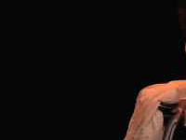
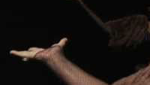
Performance Art and Reclamation
“Disability performance is a genre of autobiography particularly appropriate to representing the social experience of disability precisely because it allows for creating both visual and narrative self-representations simultaneously and because it traffics in the two realms of representation fundamental to the social construction of disability identity”
Rosemarie Garland Thomson, 2000
Performance art is a loud medium for reclamation; it breaks industrialized gallery-art models of being productive and successful by centering creative spaces in which emotional experience and body expression are valued over popular and financially incentivized art forms. Through theater and poetry and dance Sins Invalid mobilizes issues of sexuality and humanity that remind an able-bodied audience like myself of the power a performance group built by and for disabled artists, has to reclaim sexual spaces and narratives that have been defined by non-disabled gazes and nosiness into the personal lives of disabled artists.
Image description: A Black woman in a white button-down shirt and dark pin-striped. A naked Black man wearing only black need pads with a strip of white fabric hangs out of his mouth trailing to his bare feet. They stand chest to chest and the dressed person cradled the his naked head in her hands. They are both gazing upward and their shadowed forms are projected onto the wall behind them.
In Rosemarie’s essay “Staring Back: Self- Representations of Disabled Performance Artists”, she emphasizes the power disabled artists have when they invite an audience to encounter bodies and share their stories on the artists terms. Art repossess the view, more often spectacle, people with visible disabilities endure endlessly and the reassertions of representational cultural narratives is re-established though the sharing of lived experiences united on stage.
Clara Page & Leroy Moore https://www.sinsinvalid.org/media-1

Slide 5
References & Further Material
https://www.sinsinvalid.org/
D'Aulaire, Ingri, 1904-1980 and Edgar Parin D'Aulaire. 1992. Ingri and Edgar Parin D'Aulaire's Book of Greek Myths. New York: Dell.
Thomson, Rosemarie Garland. “Staring Back: Self-Representations of Disabled Performance Artists.” American Quarterly 52, no. 2 (2000): 334–38.
Berne, P. (Director). (2013). Sins Invalid: An Unshamed Claim to Beauty [Video file]. New Day Films. Retrieved April 30, 2021, from Kanopy.
Lindley Mease. Access is for Everyone: Interview with Patty Berne, Co-Founder and Director of Sins Invalid, May 1, 2018. https://medium.com/blue-heart/access-is-for-everyone-interview-with-patty-berne-co-founder-and-director-of-sins-invalid-a96bb7c5c192.
Neve Be(ast) (aka Lyric Seal), India Harville. #CriptWidsom: Interview with the Artists of Sins Invalid. Blog, October 10, 2016. https://disabilityvisibilityproject.com/tag/performance-art/.
Fixter, Aly. “The Taboos around Disability and Sex Put Limits on Everyone, Disabled or Not.” The Guardian, March 18, 2019, sec. Opinion. http://www.theguardian.com/commentisfree/2019/mar/18/disabled-people-sexuality-dating-society-taboo-marginalise.
Quarmby, Katharine. “Disabled and Fighting for a Sex Life.” The Atlantic, March 11, 2015. https://www.theatlantic.com/health/archive/2015/03/sex-and-disability/386866/.
Butler-Wall, Karisa. “Disability.” In The Routeldge History of American Sexuality, 154–65. New York: Taylor & Francis, 2020. https://doi.org/10.4324/9781315637259-15.
https://www.sinsinvalid.org/coloring-book PDF COLORING BOOK DOWNLOAD!!!!!!!!

