Slide 1
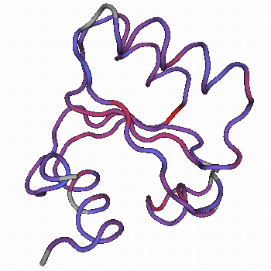

An RNA-Protein Interaction: Specificity and Shape of the Yeast L30 System
University of Ghana--Oct. 2014

Slide 2
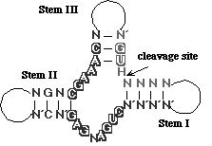
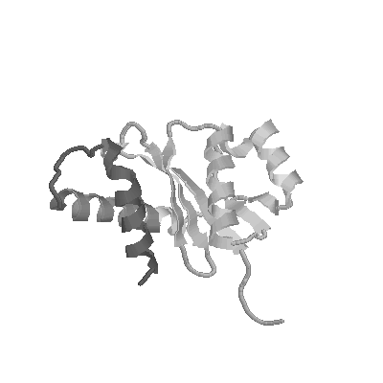
RNA is “central” in the Central Dogma
DNA
RNA
Proteins
Pley., Flaherty, & McKay. (1994)

Slide 3
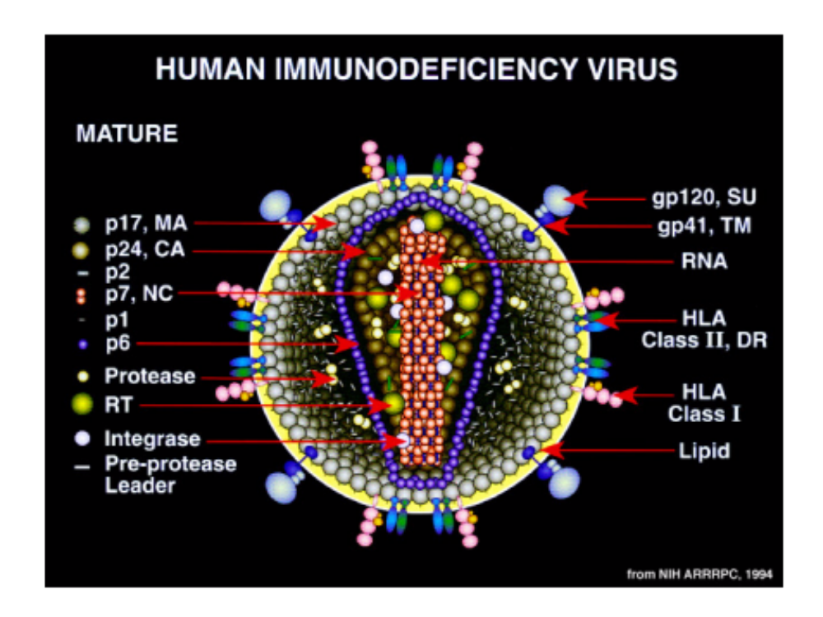
Retroviruses have RNA genomes.
Drugs may be targeted against HIV RNA.

Slide 4
L30e RNA-Protein Interaction
Structures of RNA and Protein Motifs
  Biological System
Thermodynamically Important Interface Residues
Rescue of RNAs that bind poorly
Long range goal--understanding specific recognition between conserved RNA and conserved protein motifs.

Slide 5
S. cer. L30e represses splicing and translation of its transcript
-both confer survival advantages
-structural work done on MBP-L30e/L30e RNA constructs
No further production of L30e
U1 snRNP
Pre-mRNA
L30e
L30e mRNA
Large ribosomal
subunit
Notes:
Normally, the L30e protein is incorporated into the ribosome. Under conditions of excess L30e, the protein

Slide 6
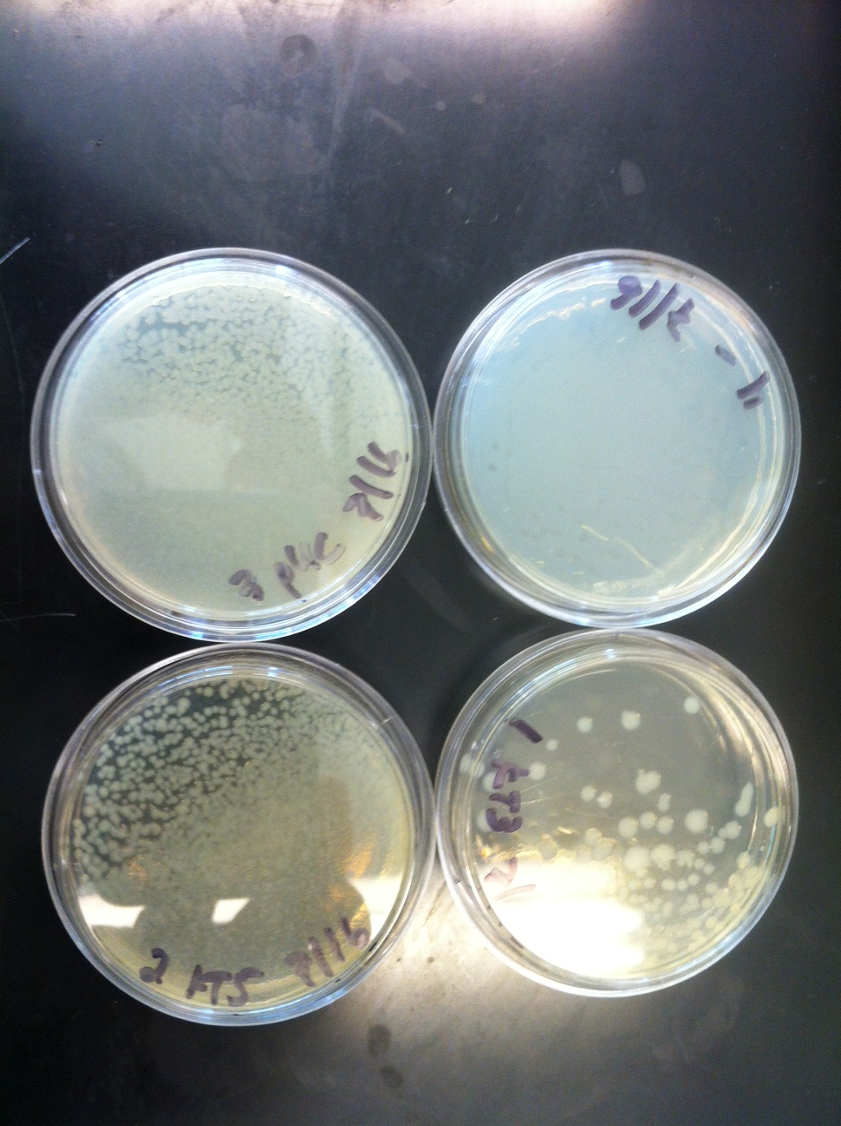
What do students do?
(Sarah, Amy, Tiffany, Ann, and Bash)
Synthesize and purify
  DNA, RNA, proteins
Mutate, clone, PCR—molecular biology
Pipet, dilute, autoclave,
Reactions with enzymes
Grow bacteria
Electrophoresis
Chromatography
Spectroscopy (UV, Fl, CD)
Biophysical (AFM, ITC, AUC)

Slide 7
Ribosomal Protein L30e
Not present in prokaryotes
Essential--part of subunit interface
  (Halic et al. Nat. Struc. & Mol. Biol. 12, 467)
Member of the L7/L12 class (Koonin et al., NAR, 22, 2166)
1H7M_A 3 VDFAFELR.[1].AQDTGKIVMGARKSIQYAKMG GAKLIIVARNARPDIKED IEYYAR.[2].GIPVYEF 65
gi 13124513 99 QQVSGWTP AHVRKQLVIGVNEVTRALERR ELLLVLVCKSVKPAMITS.[1].LIQLSL SRSVPAC 159
gi 6166592 21 AAVEELLV.[1].AQRQDRLTVGVYESAKLMNVD.[2].SVVLCLLAIDEEEEDDIA.[7].IQSFCC DNDINIV 90
gi 2500349 7 QKAMNLIG.[1].AMRAGKLITGEELTIADIRNE KAKIVFVANDASENTKKK VKDKSS YYEVPCF 67
gi 4583671 11 ELLSSKLK.[1].IIKTGKFSYGYKATLKNLRSG KCKMIIITDNCIPLRKLE LEYYAM.[2].KCHVHHF 73
1H7M_A 66 EGT.[2].ELGTLLGRP.[2].VSALAVVDPGESRILA 97
gi 13124513 160 QVP RLSERIAPV.[3].KCVLALAFKKNTTDFV 190
gi 6166592 91 RVS.[3].RLAQLLGEP AETQGTTEARDLHCLL 121
gi 2500349 68 ELF.[3].EITQMIGKP RKVFGIVDNGFAKKTK 98
gi 4583671 74 YGN.[2].DLGLSCGKS.[2].CSCLGITESGEVNFNE 105
T. cel. L30Ae
H. sap. RnaseP
H. sap. Gadd45
E. fae. RP
G. the. L30e
Notes:
Ribosomal Protein L30e is essential in yeast and according to recent EM work is part of the subunit interface.
As can be seen by sequence alignment, members of the L7/L12 class of proteins share homology over their full length and fold into a mixed alpha beta domain where two pairs of alpha helices sandwich four strands of beta sheets.

Slide 8
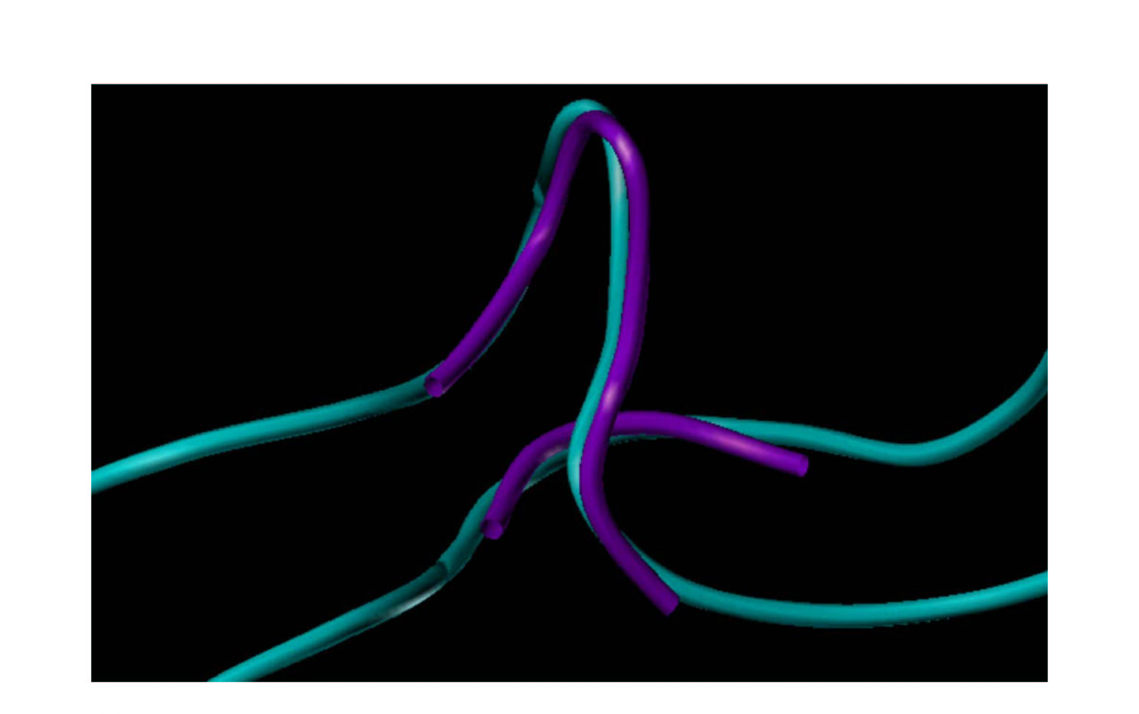
Kink-turn motif--
rRNAs often with
proteins, snRNAs
GA motif--snoRNAs
(Klein et al. EMBO
J. 20, 4214)
Consensus K-turn sequence
R N N
5’ G C G A N G 3’
C-stem
NC-stem
3’ C G A G N C 5’
Notes:
During the analysis of ribosomal crystal stucture, it was noticed that RNAs often fold into a strikingly bent configuration. These RNAs are often bound to proteins and share certain secondary structure characteristics. This motif was named “kink-turn” or the GA motif originally found in snoRNAs. The consensus sequence shows two stems separated by a three base bulge.
The non-canonical stem has two GA pairs and the tight turn is stabilized by an A-minor interaction between the circled bases. Based on ribosomal crystal structure and the L30 NMR structure, Klein et al suggested that the L30e complex also contained a K-turn RNA.

Slide 9
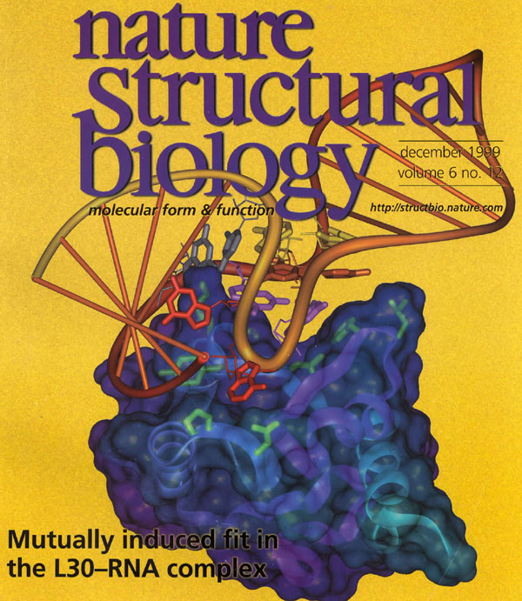
NMR Structure
(Mao, White,
and Williamson, Nat.
Struc. Biol. 6, 1139)
Crystallography
Structure
(Chao and Williamson
Structure (Camb). 12, 1165)
Notes:
Chao and Williamson crystallized the L30e complex and indeed found that the L30e RNA forms a K-turn with two GA sheared pairs. Both the NMR and the crystal structures indicate that upon binding both the RNA and the protein become more structured. Thus this is an example of mutually induced fit.

Slide 10
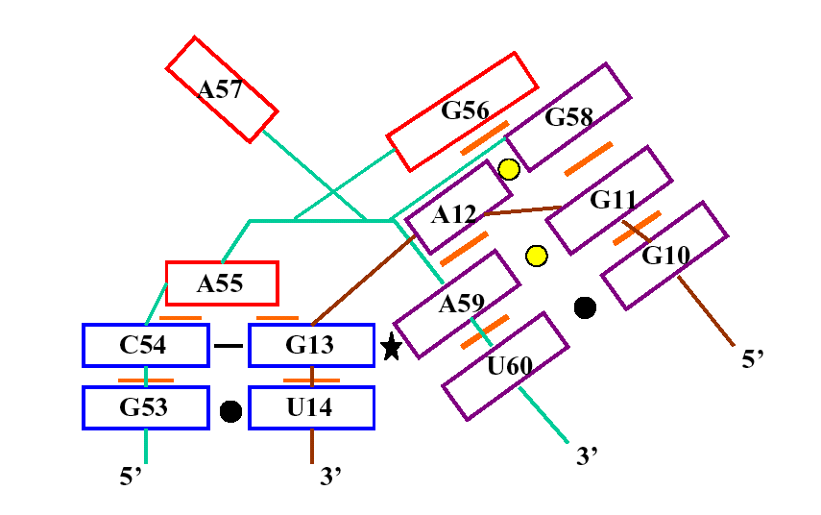
L30e K-turn RNA
A₅₅ G₅₆ A₅₇
5’ G C₅₄ G₅₈ A₅₉ U₆₀ G 3’
C-stem
NC-stem
3’ C G₁₃ A₁₂ G₁₁ G₁₀ C 5’
Notes:
This figure shows the secondary structure of the L30 K=turn RNA. The purple helix is the non-canonical stem and G56 is stacked on top of this stem. To anticipate a bit, Phe85 is in turn stacked on G56. The canonical stem is topped by A55 and A57 juts out into a protein pocket. In our earlier SELEX experiments we found almost complete conservation of the two GA pairs and some variation of the three unpaired nucleotides. The two stems come together at an acute angle and this is stabilized by an A-minor interaction between A59 and the G13-C54 pairs.

Slide 11
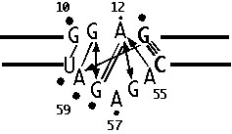
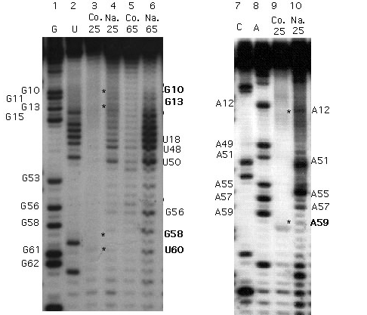
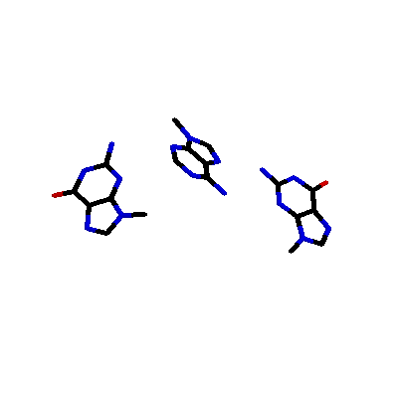
Free RNA sites protected from
chemical reactivity * or
A nascent K-turn?
A minor interaction
G13
A59
G11
Notes:
Even in the absence of protein, some protection from chemical modification is seen. The lines and arrows indicate the network of hydrogen bonding that occurs in the iternal loop and the circles indicate protection from chemical modification. About 10 mM magnesium was used and the reactivities of GN1 were probed with dimethylsulfate and AN1’s reactivity with CMCT.

Slide 12
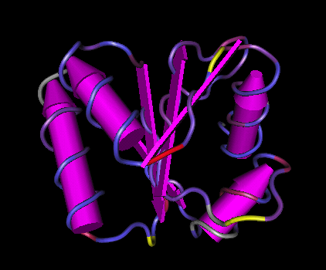
Red--conserved
Conservation of Tertiary Structure
(α−β−α−β−α−β−α−β)
Purple-similar
Gray--not aligned
Interface residues
L25, G26, Y27, K28
N47, P49, R53
N74
F85, R86, V87, G88
Yellow--mutation
weakens RNA
Binding--
K28, N47, F85
Notes:
The conserved portions are shown in red and purple and the fold is a alternating alpha-beta structure.
The protein contacts the RNA via the loops between the secondary structure elements.
Thus, this protein architecture affords a flexible platform for specific RNA recognition.
Generally single amino acid mutations do not greatly weaken protein binding and overall the effects of mutating one
Amino acid residue are not dramatic.
The yellow residues shown--K28, N47, and F85 by factors of 15-20X
All mutants tested are on outside protein surface and according to Circular Dichroism experiments, do not destabilize the protein structure.

Slide 13
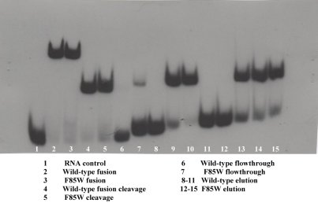
Wild Type L30 vs F85H andF85W
70
L30-F85W is
never found in Nature
but binds RNA
WT L30 Kd=112.4 nM
60
F85H L30 Kd= 292.3 nM
F85W L30 Kd= 280.0 nM
50
Percent RNA Bound
40
30
20
10
0
0.001
0.1
10
1000
10
5
10
7
Protein Concentration (nM)
Notes:
In collaboration with Jamie Williamson’s lab at Scripps, we targeted numerous interface residues for mutageneis. In the electrophoretic bandshift experiment, wild type maltose binding protein fusion is compared to the F85W mutant.
In the nitrocellulose filter binding experiment, the wild type L30 fusion is compared to the conservative histidine and tryptophan substituted proteins.

Slide 14
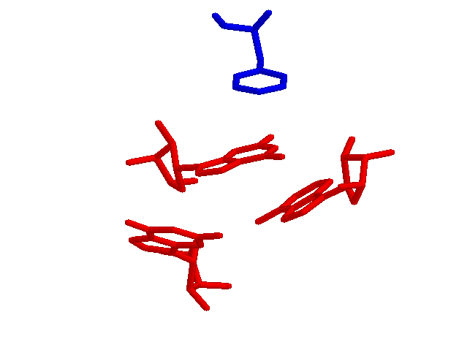
F85 stacks on the G56 that caps NC stem
F85
Mutant | Kd (±30%)
Wild type | 1
F85A | 15
F85W | 2.7
F85Y | 1.5
F85H | 1
F85I | 3.5
G56
G58
A12
Notes:
Here is an example of a single amino acid mutation. The binding affinities are measure by nitrocellulose filter binding.
Phenylalanine 85 stacks on top of the non-canonical stem and “enforces” the K-turn. Mutation to alanine weakens binding significantly, but conservative subsitutions are generally tolerated. Insterestingly, no L30’s have tryptophan or isoleucine at
This position and these substitutions weaken binding slightly. There are examples of proteins in the L7/L12 class where isoleucine is commonly found

Slide 15
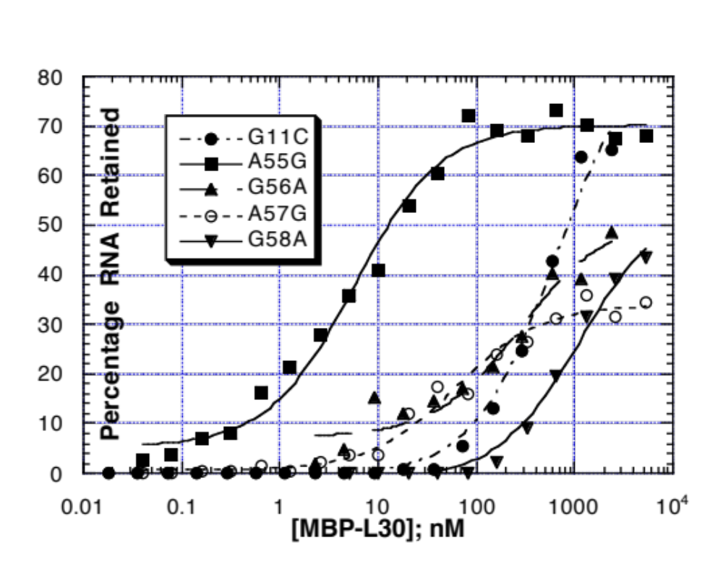
Internal loop RNA mutations greatly weaken protein binding
(Li and White, RNA 3, 245 and White et al. RNA 10, 369)
Notes:
Let’s turn our attention to the RNA. As you can imagine,
Problem with RNA mutations--can disrupt RNA-protein contact or intricate architecture of K-turn.
In this filter binding experiment only one substitution retains wild type binding ability and that is the A that stacks on the
Canonical stem.

Slide 16

The Two-Plasmid System
Transcription
Translation
Reporter
plasmid
pLacZ-LBE
mRNA
L30e
Binding
Element
lacZ
β-galactosidase
Wild type result: RR = 500
No β-gal
Repression Ratio
β-gal
w/no L30e repressor
_______________
β-gal
with L30e repressor
L30e RNA
binding
element
L30e protein
No Translation
i..e., repression
RR=
Notes:
So far, I have described in vitro experiments with purified RNAs and proteins. Now I will shift gears to
Describe an in vivo assay that tests L30e’s ability to repress translation of an enzyme. This is analalgous
to its autoregulatory activity.
The two plasmid assay was carried out in E. coli asks whether or not the L30e protein is capable of repressing production of
Beta galactosidase. In brief, one plasmid encodes the gene for the L30e protein.
The other reporter plasmid encodes the beta galactosidase gene preceded by the L30e binding site.
The repression ratio, RR, is just the ratio of b-gal produced in the absense of repressor, compared to
The amount of b-gal produced in the presence of L30 repressor. If a strong interaction occurs, the repression
Ratio is high, around 500, and the binding affinity low (about 10 nM).
Conversely, if binding is weak, the RR is 1 and the Kd is very large.
We used this assay to screen for protein mutations that restore binding to mutant RNAs that bind protein weakly.

Slide 17
Can gain-of-function protein mutations that restore protein binding to weak binding RNA mutants be found?
Pick your favorite RNA mutant that binds L30e
protein weakly (low repression ratio)
Randomly mutagenize the L30e protein gene
Screen for protein mutants that repress
β-galactosidase synthesis
(higher repression ratio)
Sequence the DNA
Hope the protein mutation is near the
RNA mutation and is specific
Test in vitro (on filters and on gels)
Notes:
Initially we picked an RNA with weak to moderate protein affinity.
The plasmid encoding the L30e protein was randomly mutated.
Both plasmids were inserted into Ecoli and bacterial colonies that
No longer produce Bgal were screened. The specific mutation was located.
Interesting mutations were then tested for specificity to make sure that
The increase in repression ratio was specific to the RNA and protein under consideration.
Finally, interesting protein mutants were tested in vitro.

Slide 18
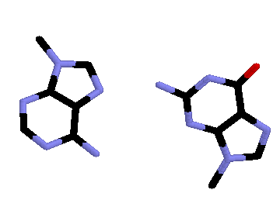
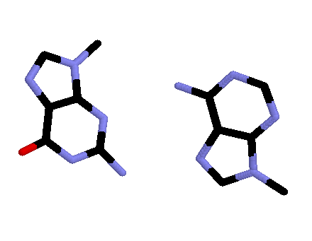
A59
Two plasmid proof-of-principle
RNA | Protein | RR
G11C | WT | 1
G11A | WT | 95
G11U | WT | 15
A12N | WT | 1
G58N | WT | 1
A59N | WT | 1
WT | F85A | 20
WT | WT | 500
G11
G58
A12
Notes:
In order to gain confidence in our system, the two plasmid system was used to study point
Mutations in the RNA or protein that we already knew weakened binding.
On the left we have the structure of the two GA pairs and on the right
We see that any mutations in three of the four nucleotides results in a repression
Ratio of 1 and thus no binding. We assume that these mutations disrupt the kink-turn
Architecture. At the G11 position and A or U depresses the RR and thus weakens binding,
But not as disasterously. Thus, these mutations are reasonable candidates for our
Suppressor search. Finally we see that a protein mutation also greatly reduces the
Repression ration.

Slide 19
Search for Suppressors (moderate)
RNAs | RR-WTL30e | Suppressor L30e | Improved RR
G11A | 95 | none
G11U | 15 | none
A55G | 55 | none
G56U | 13 | Gly88Ser | 40
A57G | 55 | Asn74Ala Pro49Cys | 85 62
Notes:
This table summarizes our search for protein suppressors of moderate RNA mutations. Unfortunatley, no protein
Supprssor was found to reverse the G11 mutations. Perhaps this is reasonable given that this mutation
May disrupt the kink-turn and not an RNA-protein contact. A55G makes protein contacts via its ribose,
Not via its base so it is not surprising that no suppressor was found for this mutation. G56 and A57 are both unpaired
And A57 makes extensive protein contacts. In both cases we see quite a moderate, but specific, increase in
The repression ratio.

Slide 20
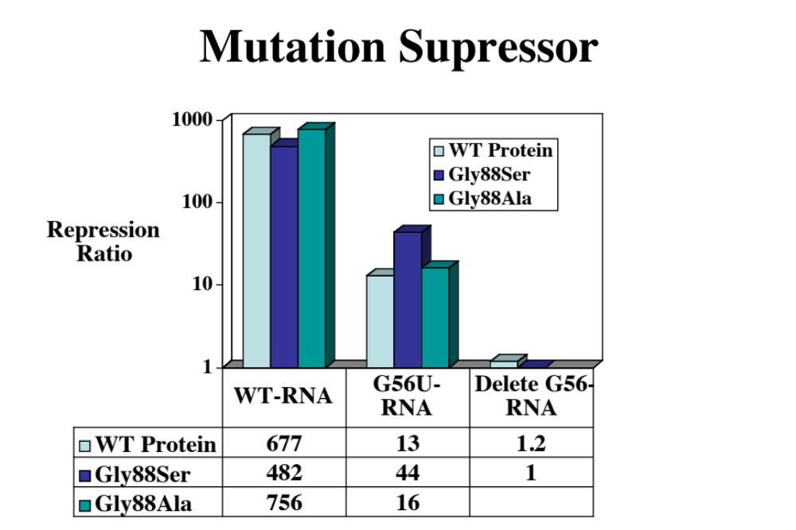
Gly88Ser is a specific suppressor of G56U mutation
Notes:
Let’s examine one supressor in detail. Wild type protein binds G56U RNA much more
Weakly than it does wild type RNA.
The Glycine 88 to serine mutation weakens binding to the wild type RNA but
Strengthens binding to the G56U mutant.
In contrast the G88 alanine mutant strengthens binding to both RNAs and
Would thus be non-specific.
This data supports the existence of an important contact between U56 and Ser88.

Slide 21
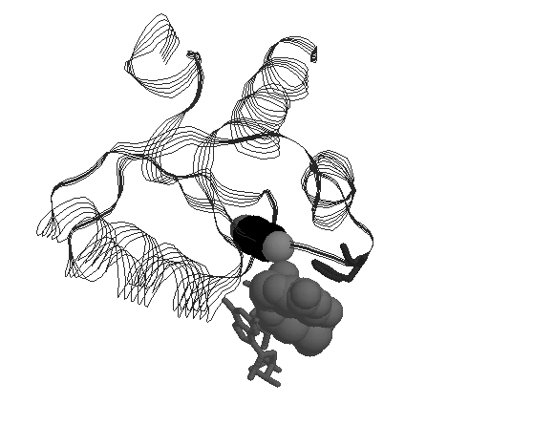
Gly88-->Ser
F85
G56-->U
Serine 88 partially restores binding to the RNA G56U mutant
James J. Schweppe, Chaitanya Jain, and Susan A. White (2009)
Compensatory Mutations in the L30e Kink-Turn RNA-Protein Complex,
Biochimica et Biophysica Acta (BBA)- Gene Regulatory Mechanisms, 1789, 469-476
Notes:
Shown here is the structure of the wild type RNA-wild type protein complex. Once again,
We can see F85 stacked on G 56. The glycine abuts the G and perhaps when the smaller
U replaces the purine, more room is created for the serine. Normally Gly 88 ‘s backbone
Amide makes a hydrogen bond with A57’s phosphate so it seems likely that this
Pair of mutations causes some localized rearrangements.
One reason to use this two plasmid approach is to find mutations that one couldn’t predict
Based on looking at the structure alone. Do we find surprises?

Slide 22
Suppressor Surprises
G56A
Strong binding
RR= 1290
A55G
Weak binding
RR = 65
A55G + G56A binds WT L30e protein (RR=510)
2) Arg52Leu and Arg52Ile better all around binders
Notes:
You may remember that the Search for Protein suppressor of A55 found none, but A55G mutation may be suppressed by an RNA mutation as shown here.
On the protein side, it appears that the R52 to leucine or isoleucine produce proteins that are better binders.

Slide 23
Conclusions
L30e RNA can be mutated within limits of K-turn architecture--other mutant RNAs bind protein very poorly.
L30e Protein has extensive RNA binding interface, but few residues are thermodynamically important.
Protein suppressors of RNA mutations can be specific but do not fully restore binding.

Slide 24
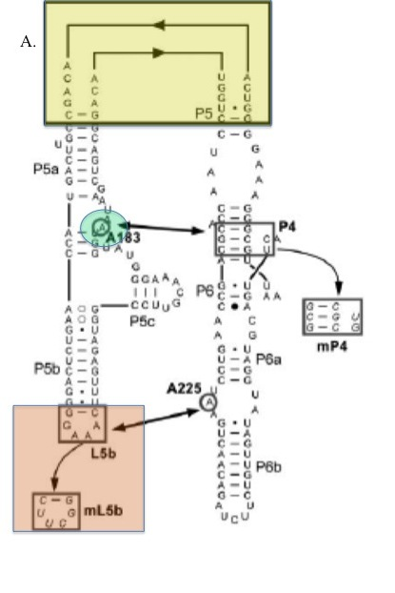
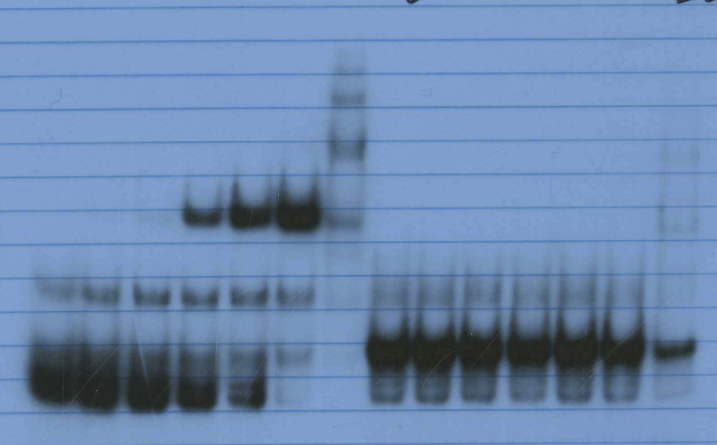
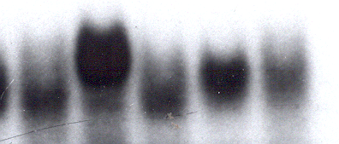
L30 K turn
Flexible turn
Base pairs
Magnesium binding is
required for mobility
differences.
L30-MBP binds only
L30-KT RNA.
[protein]
+ Mg ²⁺
KT BP Flexible
KTAU A12C
Matsumura, S., Ikawa, Y., and Inoue, T.
(2003). NAR. 31(5544-5551).

Slide 25
Is L30 RNA Kink-turn formation necessary for strong L30 protein binding?
Why do some RNA bases far from protein affect binding?
Mg ²⁺ can cause Kink-turn to form (Lilley, Inoue)
Hydrodynamic experiments
Larger RNA with KT-embedded
Native gels & AUC experiments

Slide 26
Sedimentation Experiments
@Haverford College/Bashkim Kokona
Centrifuge monitors Abs vs Tube Position
  Velocity
  Equilibrium
Sedimentation Coefficient—shape or MW
Rigorous biophysical interpretation (unlike gel experiments)
Methods routinely used for protein interactions—want to extend to RNA

Slide 27
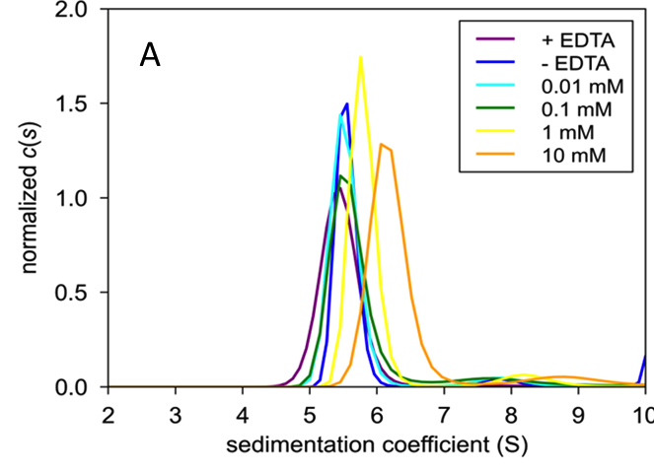
Sedimentation of KT-RNA (150 nts)
[Mg ²⁺]

Slide 28
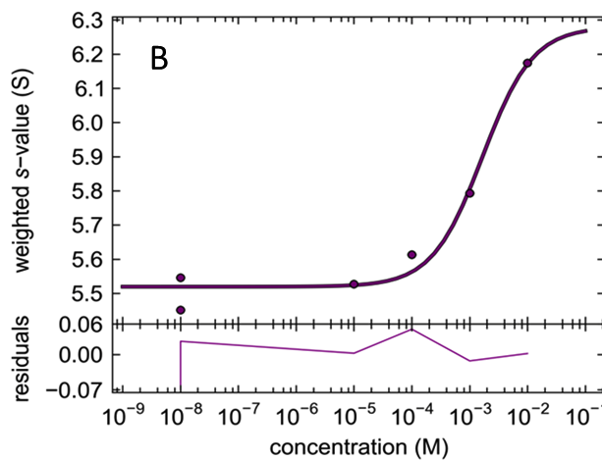
Magnesium dependence of KT-RNA sedimentation
Mg ²⁺ compacts KT more than BP RNA
[Mg ²⁺]

Slide 29
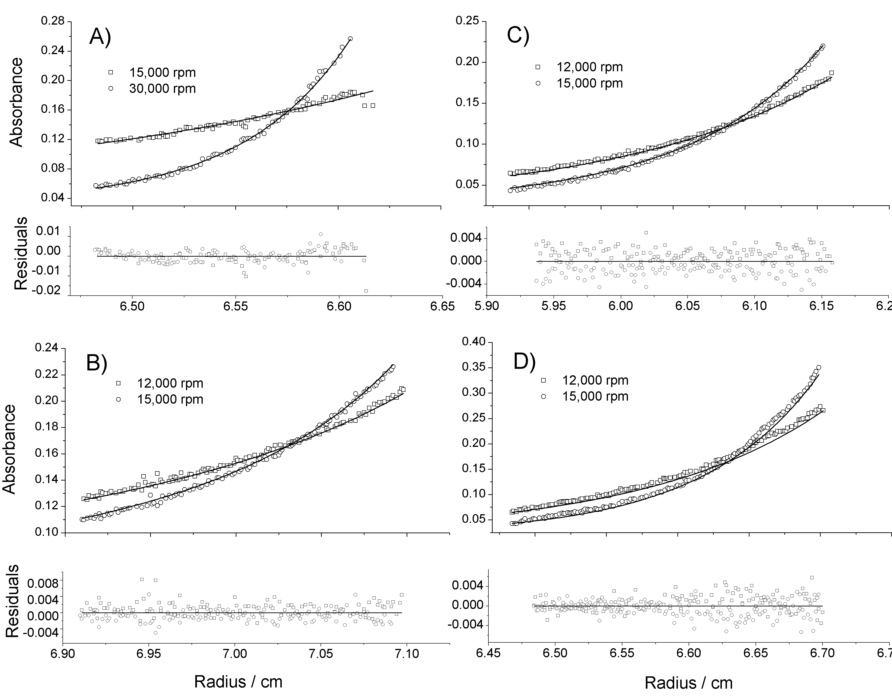
Sedimentation Equilibrium L30N-KT RNA as function of
[MBP-F85W]
RNA + Protein-←→Complex
0.22 nM
0
0.11 nM
0.42 nM

Slide 30
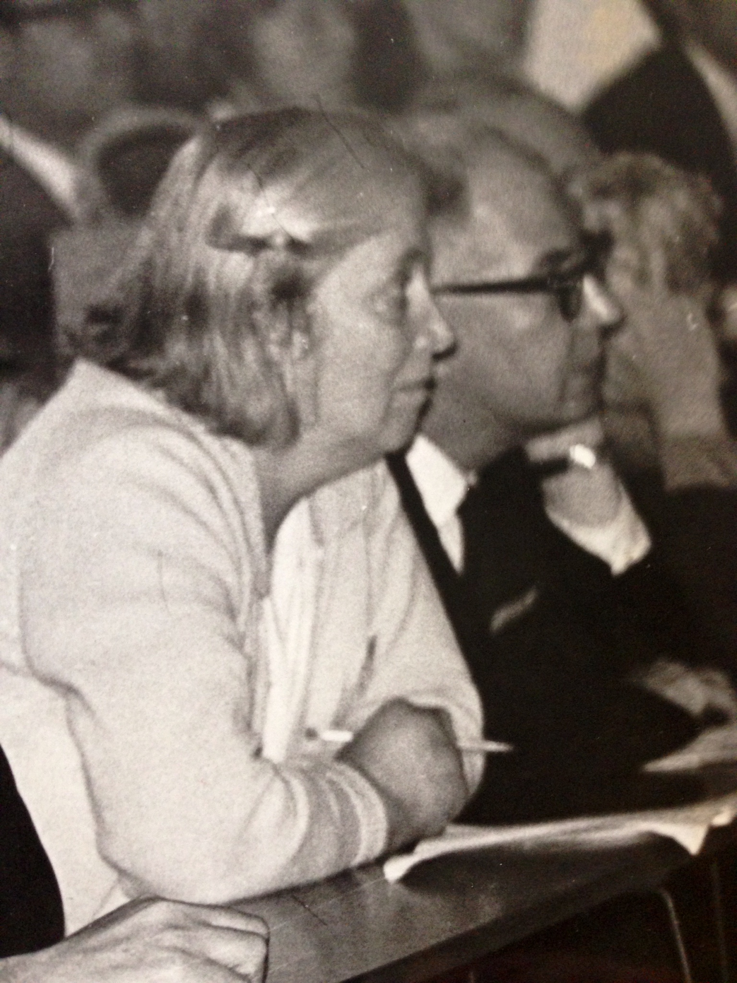
Dorothy Crowfoot Hodgkin, Jenny Pickworth, John H. Robertson, Kenneth N. Trueblood,
Richard J. Prosen, and John G. White (1955), The Crystal Structure of the
Hexacarboxylic Acid derived fromB₁₂ and the
Molecular Structure of the Vitamin, Nature, 178, 325-328

Slide 31

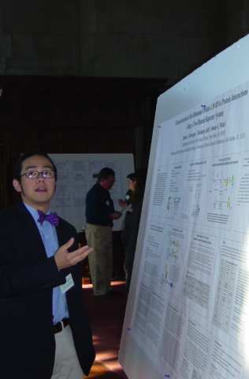
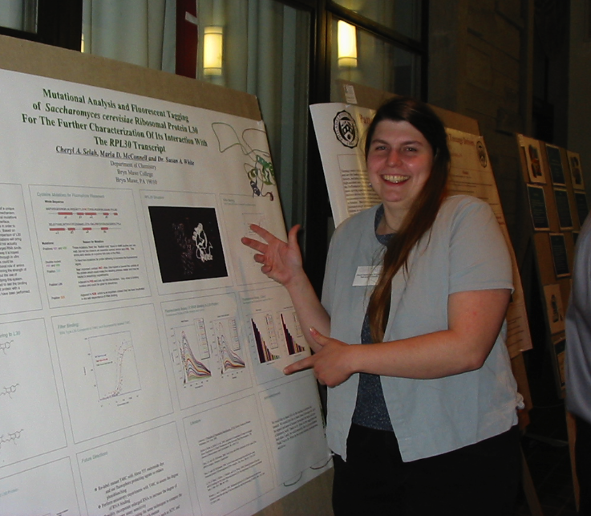
Collaborators
Chaitanya Jain (U. Miami)
Jonathan Warner (Albert Einstein)
Jamie Williamson (TSRI)
Co-workers
Dr. Cheryl Selah
Dr. Jim Schweppe
M. A. Bash Kokona
M. A.Mithila Rajagopal
Ann Roma
Ashton Shaffer
NIH--$$

