Slide 1
Vaccines—goal?
https://serendip.brynmawr.edu/oneworld/virus
HIV/lessons learned?
Ebola
Measles

Slide 2
RV144 HIV vaccine trial Thailand 2009
16000 adult volunteers/prime/boost
Vaccine safe/ modestly effective 31%
Targets HIV env protein (V1/V2 region)
Less protection for those with different env proteins

Slide 3
Science, Aug 13, 2010

Slide 4
Reaction against a wide variety of HIVs

Slide 5
Broadly neutralizing monoclonal antibody
Blue glycans/yellow CD4 contact

Slide 6
Bill Gates says HIV vaccine by 2030
What to do in the mean time?
Prevention by other means?
*******
Challenges for Vaccine Making
  Use genomics, proteomics etc
  Increased safety demands
  Activate both B (antibodies) and T (cellular immunity)

Slide 7
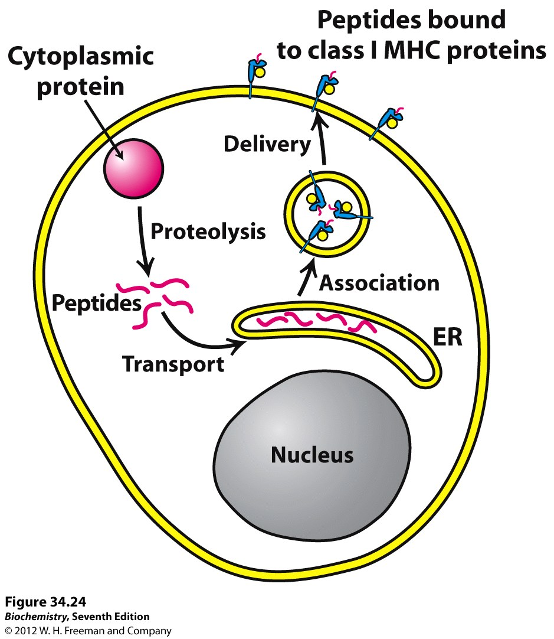
For intracellular
Pathogens
Need both antibodies
And cellular immunity

Slide 8
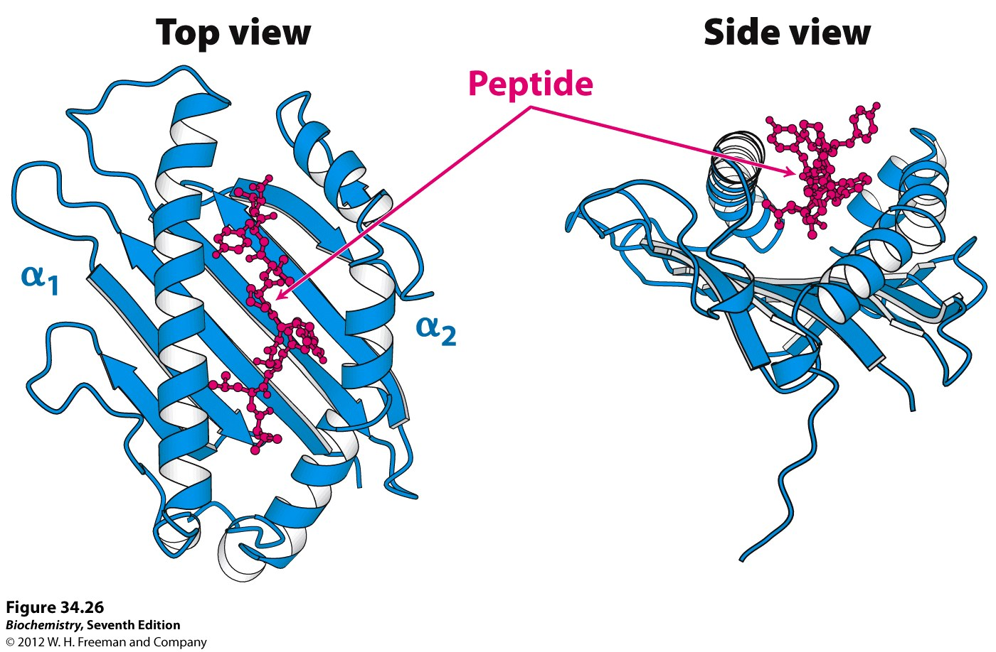

Slide 9
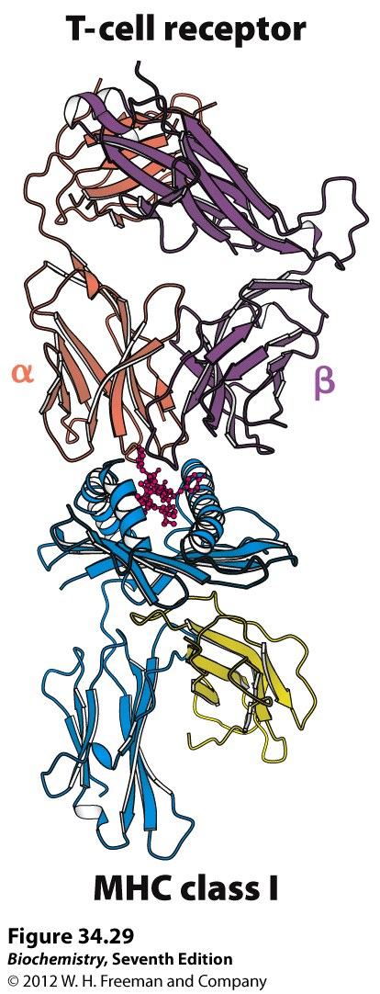
Peptide

Slide 10
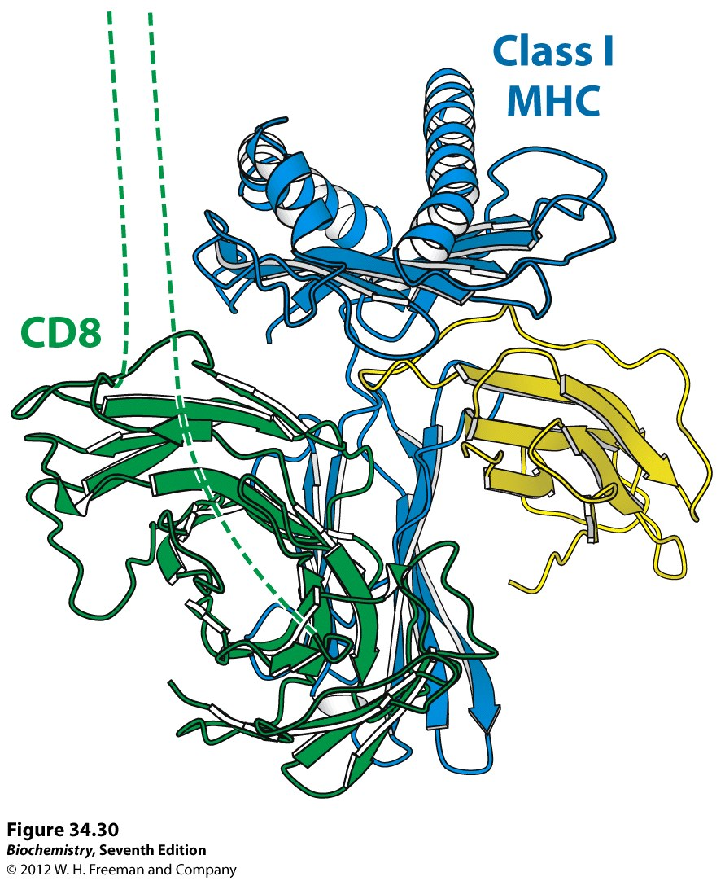

Slide 11
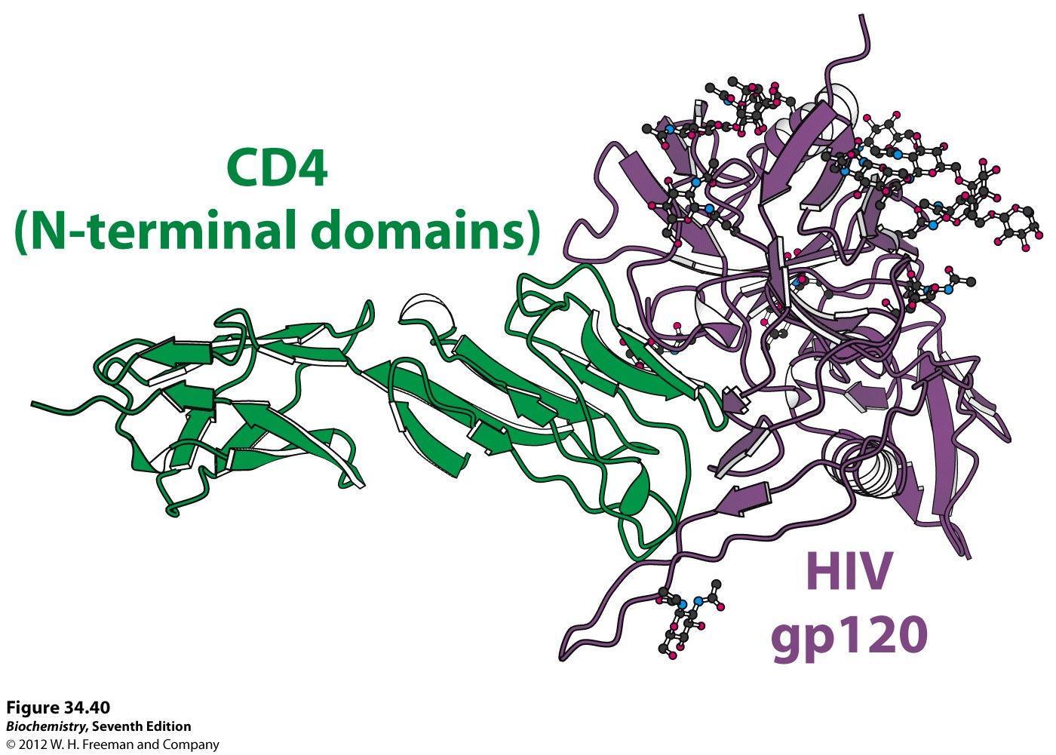

Slide 12
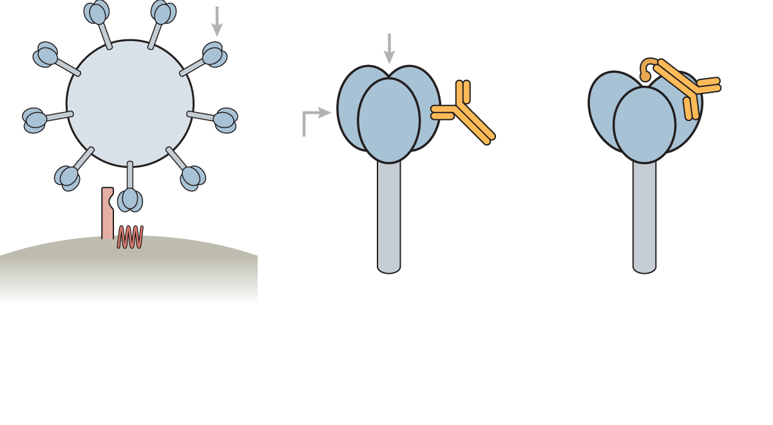
HIV ENV/Tcell ENV/CD4-Ab ENV/CCR5-CD4-AB
Most conserved part of env?
Antibody with CD4 and CCR5 binding—block HIV infection?
Neither Ab-CD4 or Ab-CCR5 works well enough

Slide 13
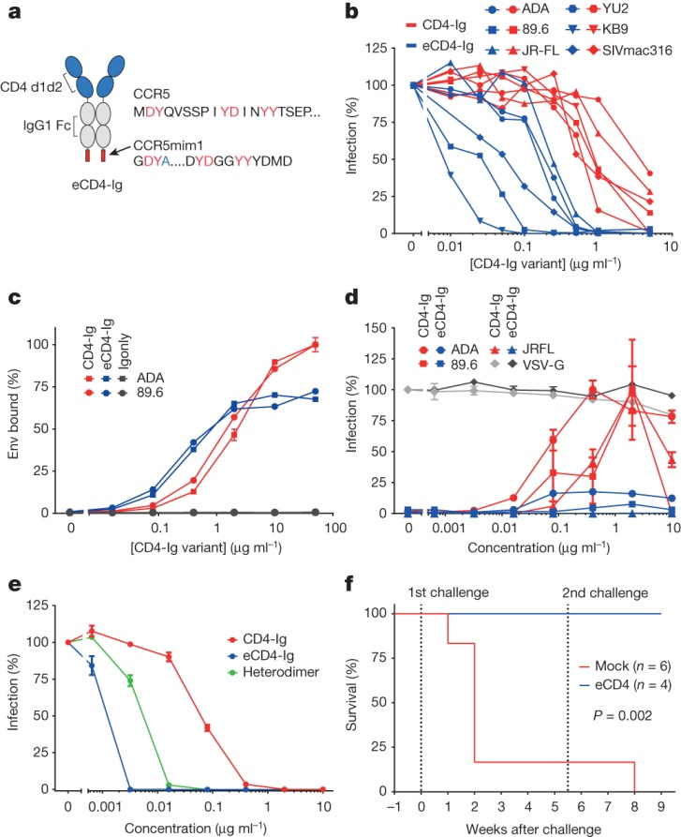

Functional characterization of eCD4-Ig.
Immunoadhesin
Blocks infection
Halts replication of HIV
In human blood cells (PBMC)
e=CCR5 mimic
Contains Tyr-SO₄
15 aa
In vitro c
Cell b, d, e
Humanized Mouse f
MR Gardner et al. Nature 000, 1-5 (2015) doi:10.1038/nature14264

Slide 14
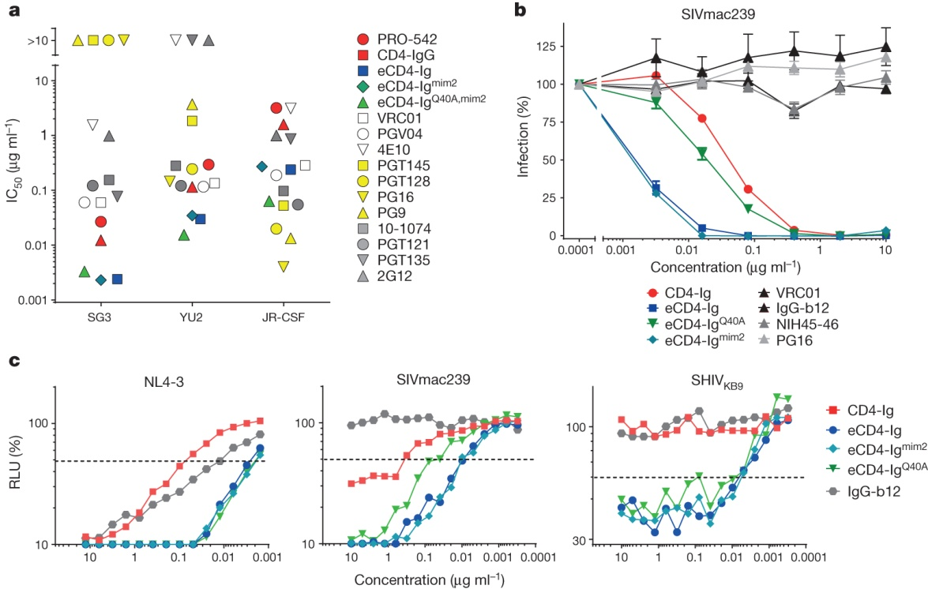
Comparison of eCD4-Ig variants and HIV-1 neutralizing
antibodies. (TZM-bI cells)
Mediates action of CD16+ natural killer cells/ AB mediated cytotoxicity
MR Gardner et al. Nature 000, 1-5 (2015) doi:10.1038/nature14264

Slide 15
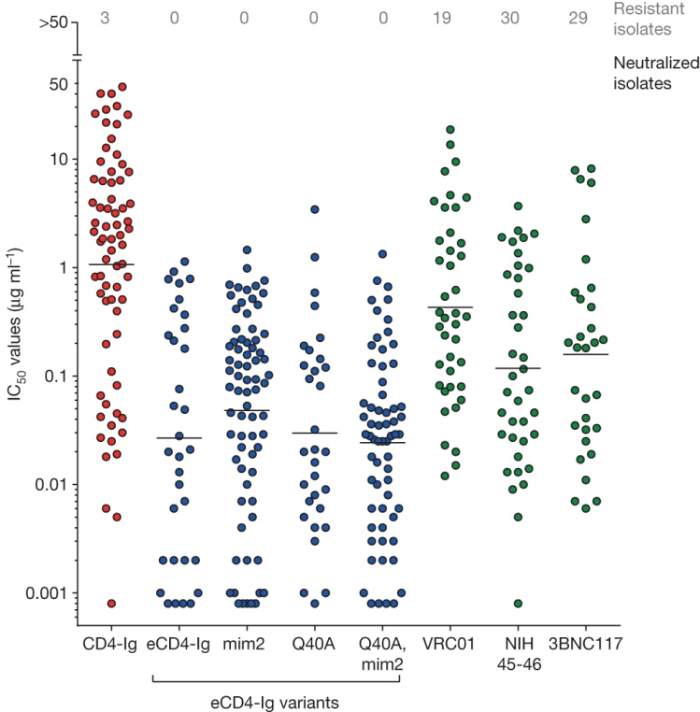
Summary of HIV-1, HIV-2 and SIV neutralization studies.
Neutralizes
Strains
Resistant to
CD4 ABs or BNC117
IC50< 1.5 ug/mL
(all strains)
Sustainable [ ] in
humans
MR Gardner et al. Nature 000, 1-5 (2015) doi:10.1038/nature14264

Slide 16
Vectors for macaque injection

Slide 17
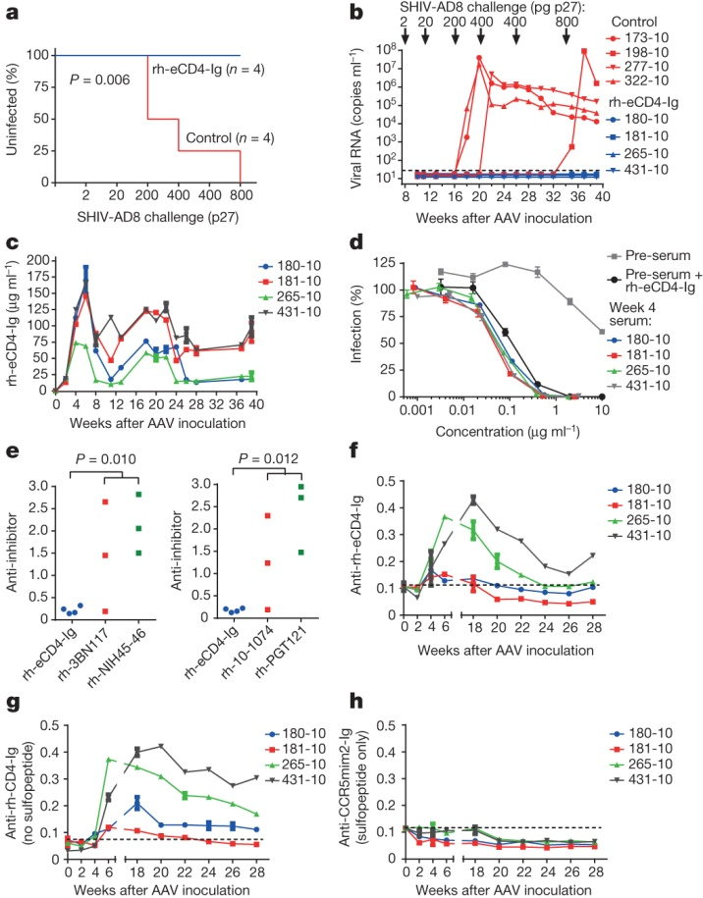
AAV-rh-eCD4-Ig protects rhesus macaques from SHIV-AD8.
Adeno associated
Virus vectors
ssAAV2 cloned
Rh adapted eCD4-Ig
2.5 x 10 ¹³ encapsulated
AAV particles injected
Similar construct with
Sulfotransferase also injected
Challenge with SIV
% uninfected
Viral load
[e-CD4-Ig] in sera ELISA
Neutralizing potency
F) antibodies to e-CD4?
MR Gardner et al. Nature 000, 1-5 (2015) doi:10.1038/nature14264

Slide 18
Can gels/pills replace vaccines?

Slide 21
US study (drug approved)
Studies from 2010 showed that Truvada reduced the risk of HIV in healthy gay men - and among HIV-negative heterosexual partners of HIV-positive people - by between 44% and 73%
Many of the men in the trials did not take the drug regularly enough to get the full protection.
BBC July, 2012

Slide 22
UK Study—cure as prevention
In the first year of the study, 19 people developed HIV out of the 269 men who were not given the medicine.
There were just two cases in the 276 patients given preventative drugs - a fall of 86%.
Concerns had been raised that men given the drug would adopt riskier behaviours including stopping using condoms.
But the scientists found no difference in levels of other sexually transmitted infections, such as chlamydia.
BBC 24 Feb. 2015

Slide 23
London Study (2015, not yet published)

Slide 24
Ebola Vaccine Development
Want anti-GP antibodies (acute infection)
Want longer term protection (CD8/T cell/cytokine)
Adenovirus can deliver GP, but develop immunity to human vectors→Chimp adenovirus
Use non-replicating form of virus
Booster with MVA (modified vaccinia Ankara) protects 100% Macaques

Slide 25
Comprehensive Functional Analysis of N-Linked Glycans on Ebola Virus GP1—Lenneman et al MBIO Aug. 1, 2014

Slide 26
Nature Medicine, 7 Sept. 2014

Slide 27
What does the vaccine do?

Slide 29
Measles cases US, 2015

Slide 31
Measles—why not vaccinate?
1954 measles virus isolated/ cultured in human kidney cells
Passage 24X human kidneys, 28X human placentas, 6X hens eggs, 6X chick embryos
1958 test 11 retarded/disabled children→too toxic, Ab’s produced
1960 test 23 retarded kids school—protects against measles, but severe side effects

Slide 32
Measles—why not vaccinate?
Add gamma globulin from measles survivor to toxic vaccine. Test on babies of women prisoners, then larger scale. Fevers, rashes greatly reduced.→ Enders vaccine (Merck)
Could vaccine contain chicken leukemia virus? (Rous sarcoma)
Formaldehyde-killed and dog kidney cell vaccines proved toxic/short-lived immunity→off market 1960’s

Slide 33
Measles—why not vaccinate?
1968—Enders 40X chick embryos→ more attenuated vaccine. No more side effects. GG no longer needed.
US and worldwide measles vaccination rates very high
1971 (US) 1988 (UK) Measles vaccine included in MMR
1998 MMR accused of causing autism
1999 Mercury preservative removed from vaccines

Slide 34
Measles—why not vaccinate?
Misperception of measles (just a childhood disease)
“personal freedom” vs herd immunity
0 tolerance for side effects
babies receive lots of vaccines $$
Christian
Autism/mercury
Anti-vaccine movement
Flu vaccine 30-40% compliance/partially effective
Would this convince parents to vaccinate their kids?

