Slide 1
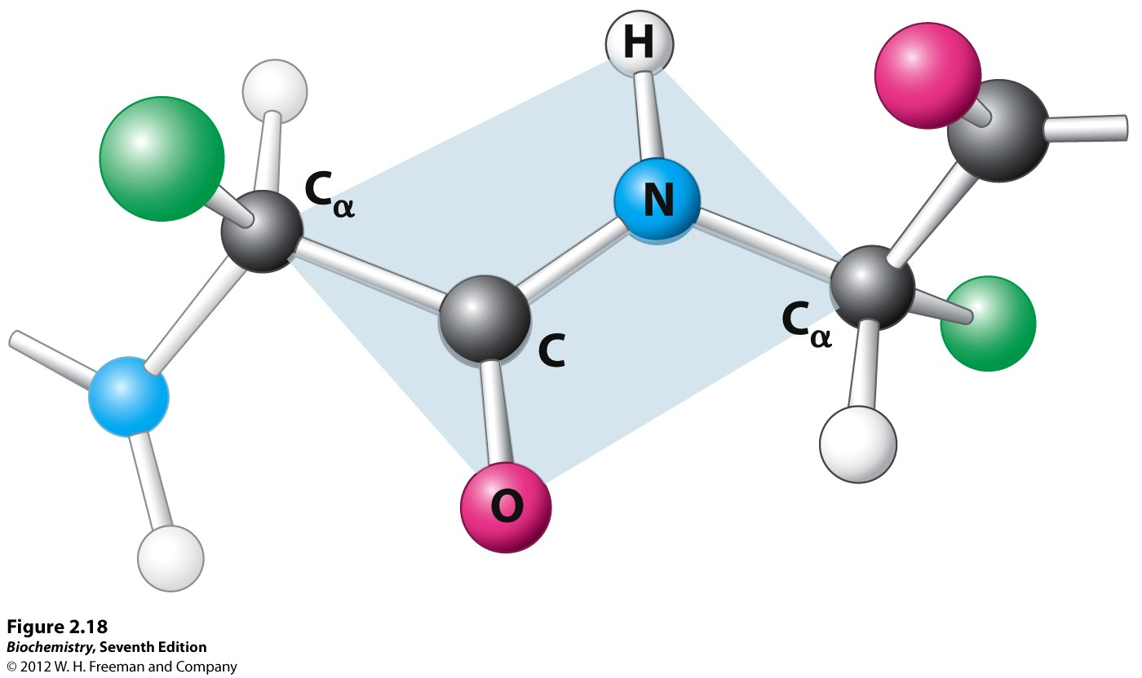
Trans peptide bond 180 °

Slide 2
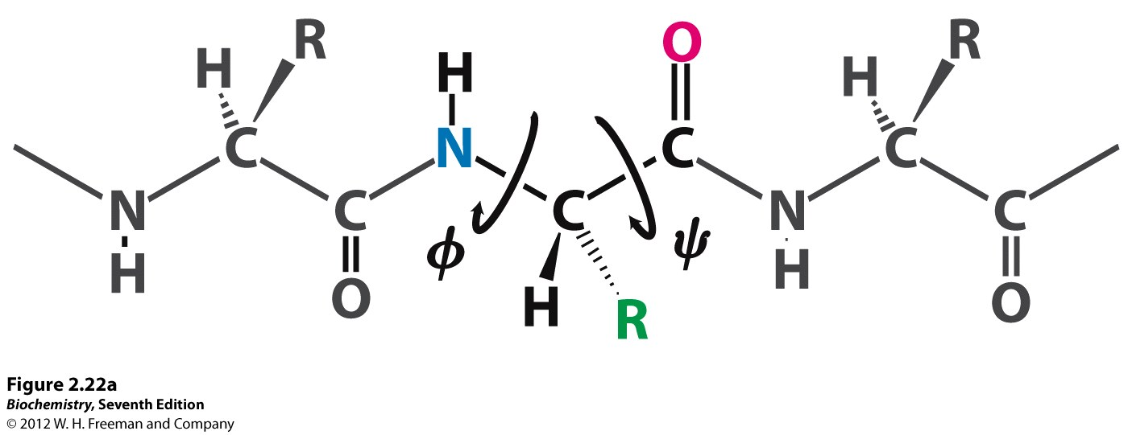

Slide 3
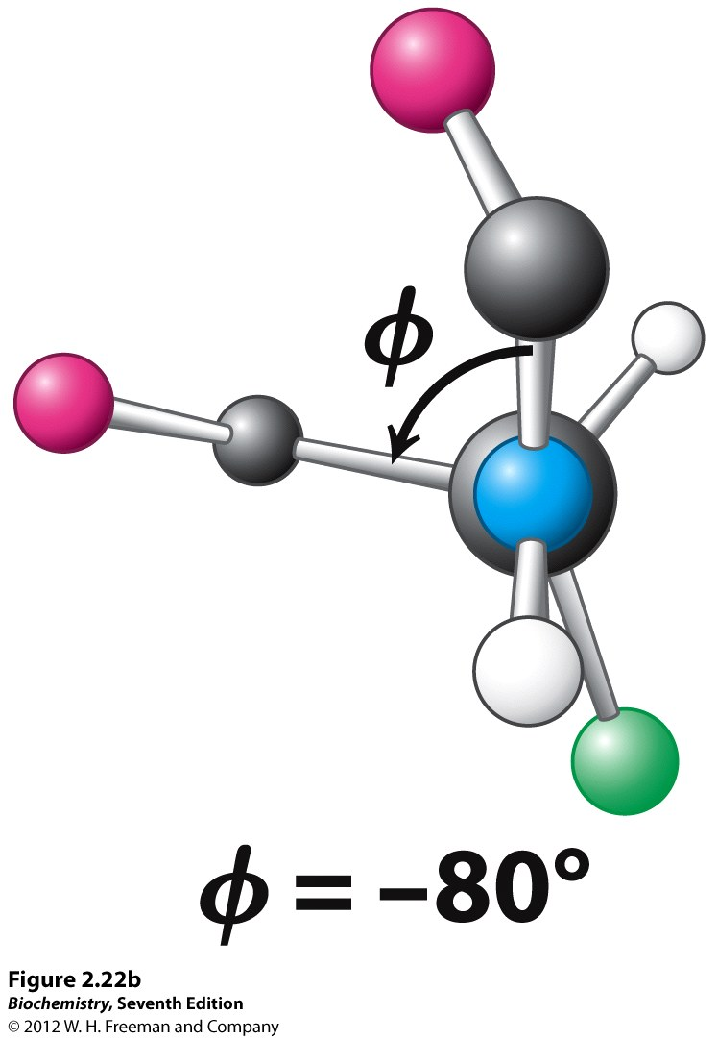

Slide 4
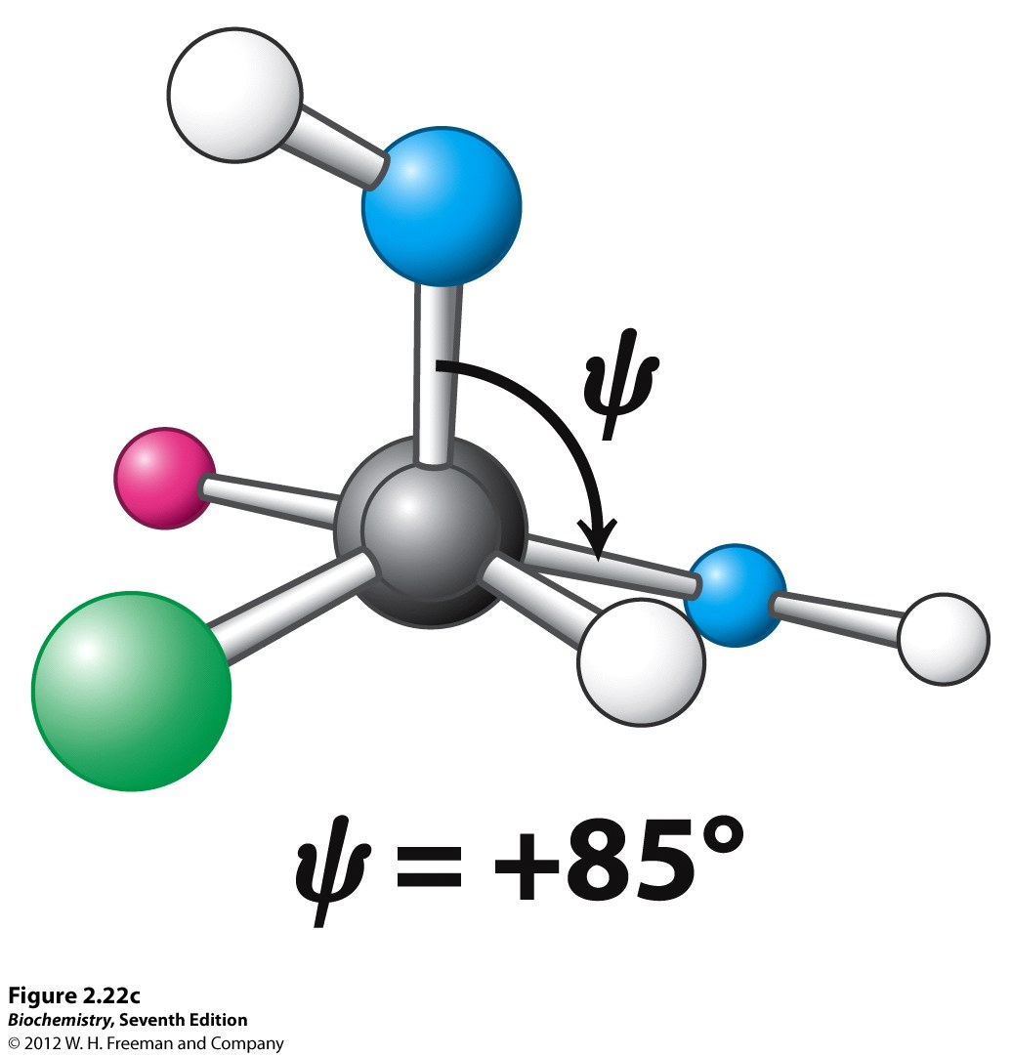

Slide 5
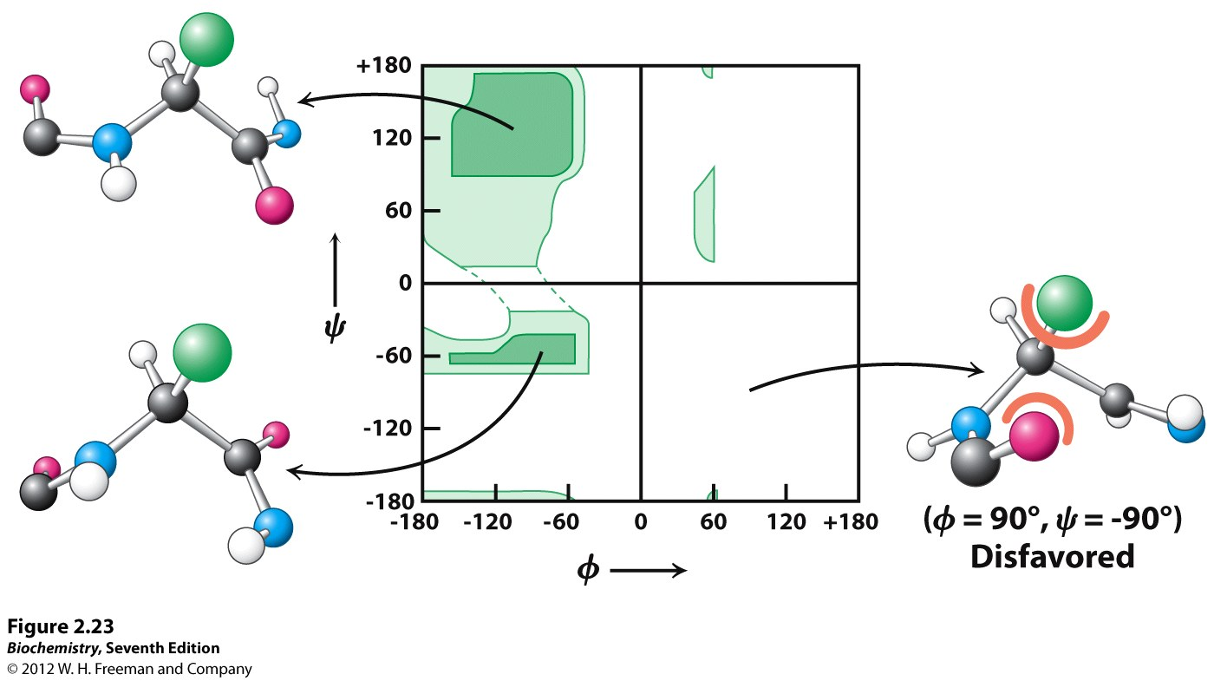

Slide 6
2e Structure
Regular pattern of H-bonding
Involves backbone (not side chains)
C=O …H-N
Several consecutive residues form 2e structure
α helices β sheets β turns

Slide 7
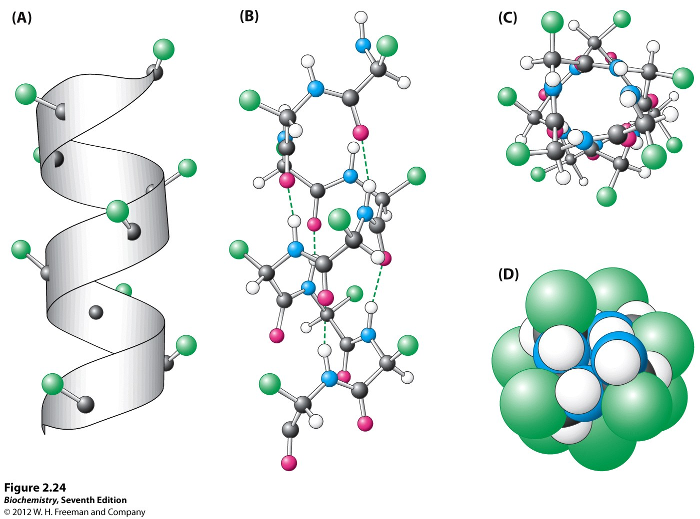
5.4 Å/turn

Slide 8
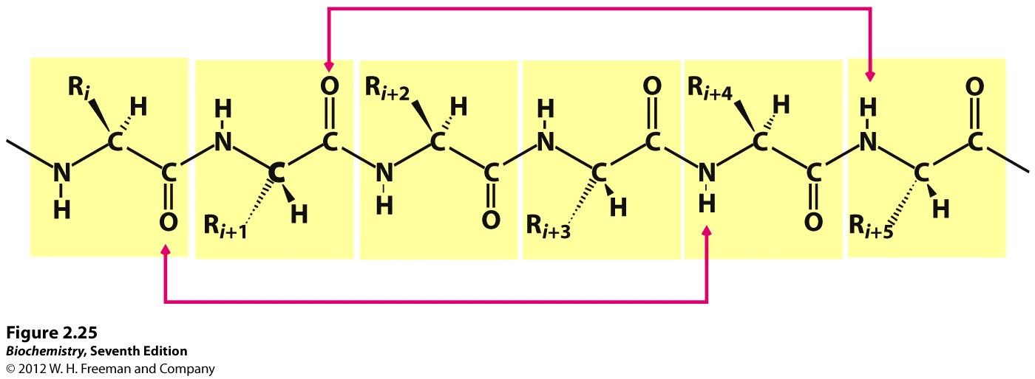
H bonding in alpha helix
3.6 residues per turn

Slide 9
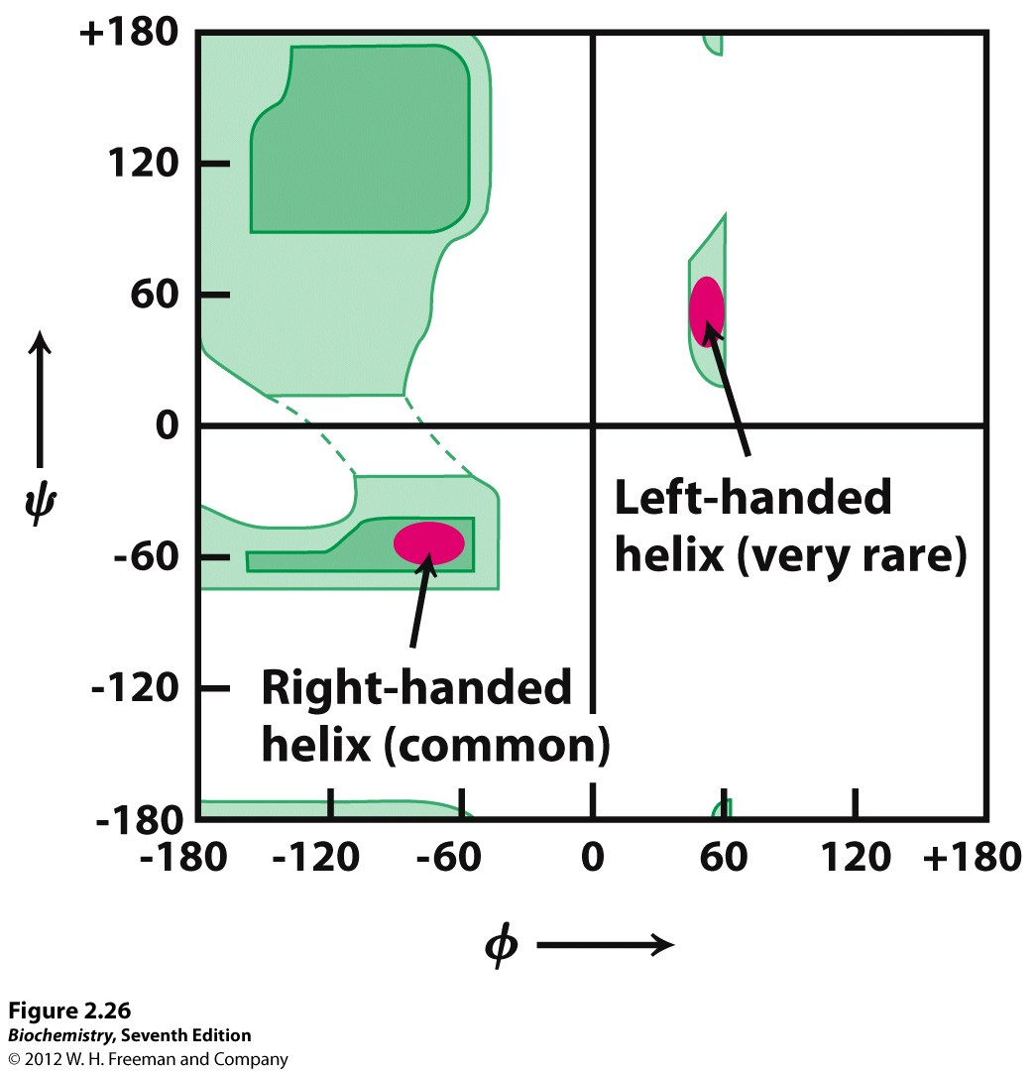

Slide 10
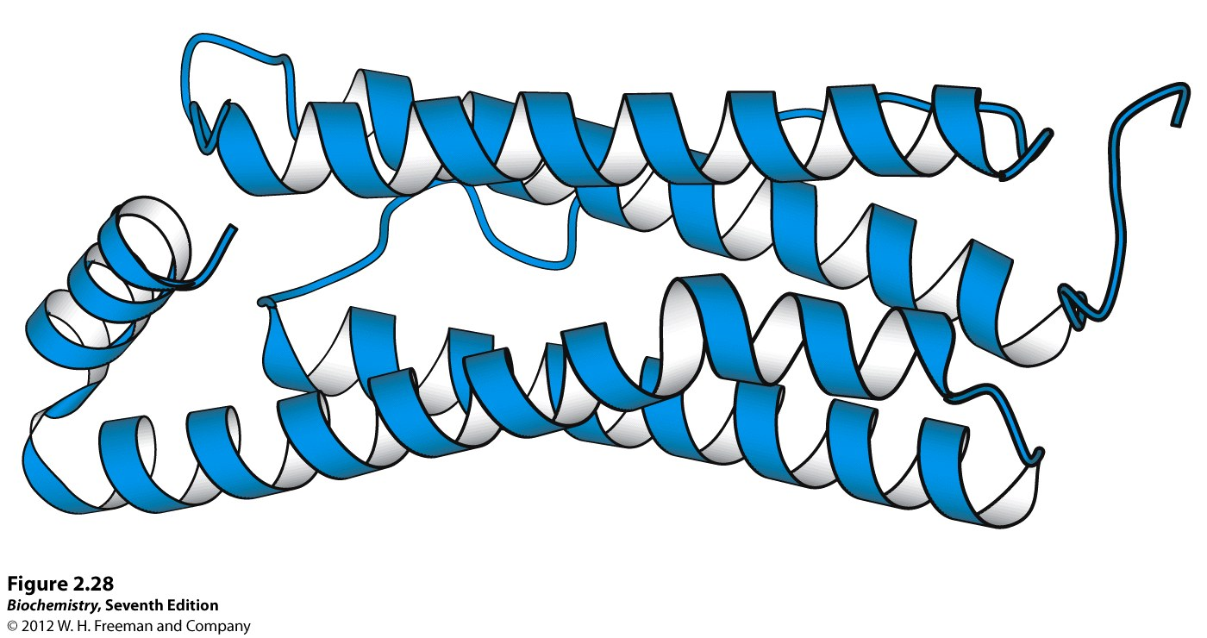

Slide 11
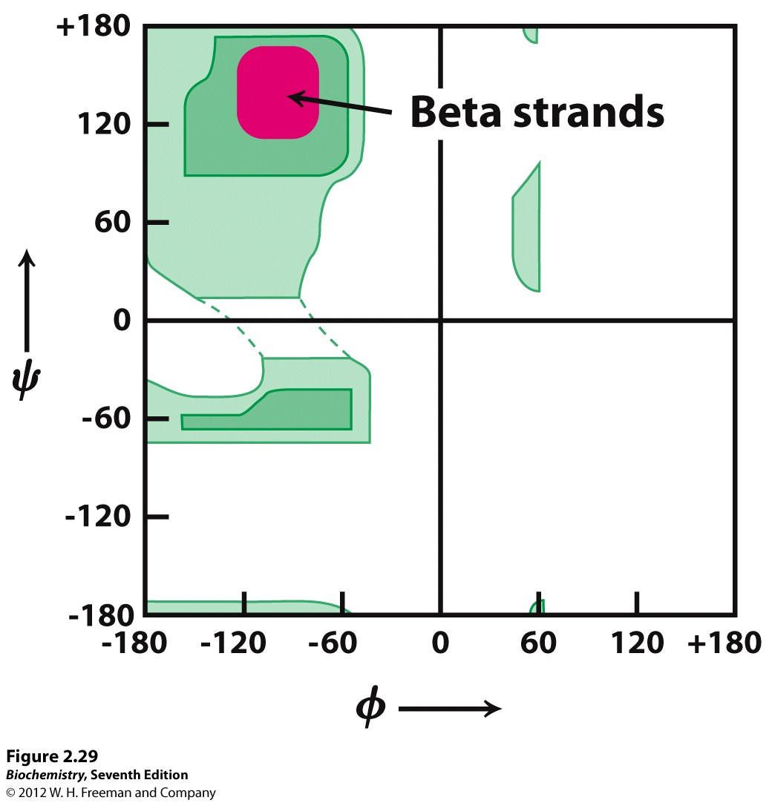

Slide 12
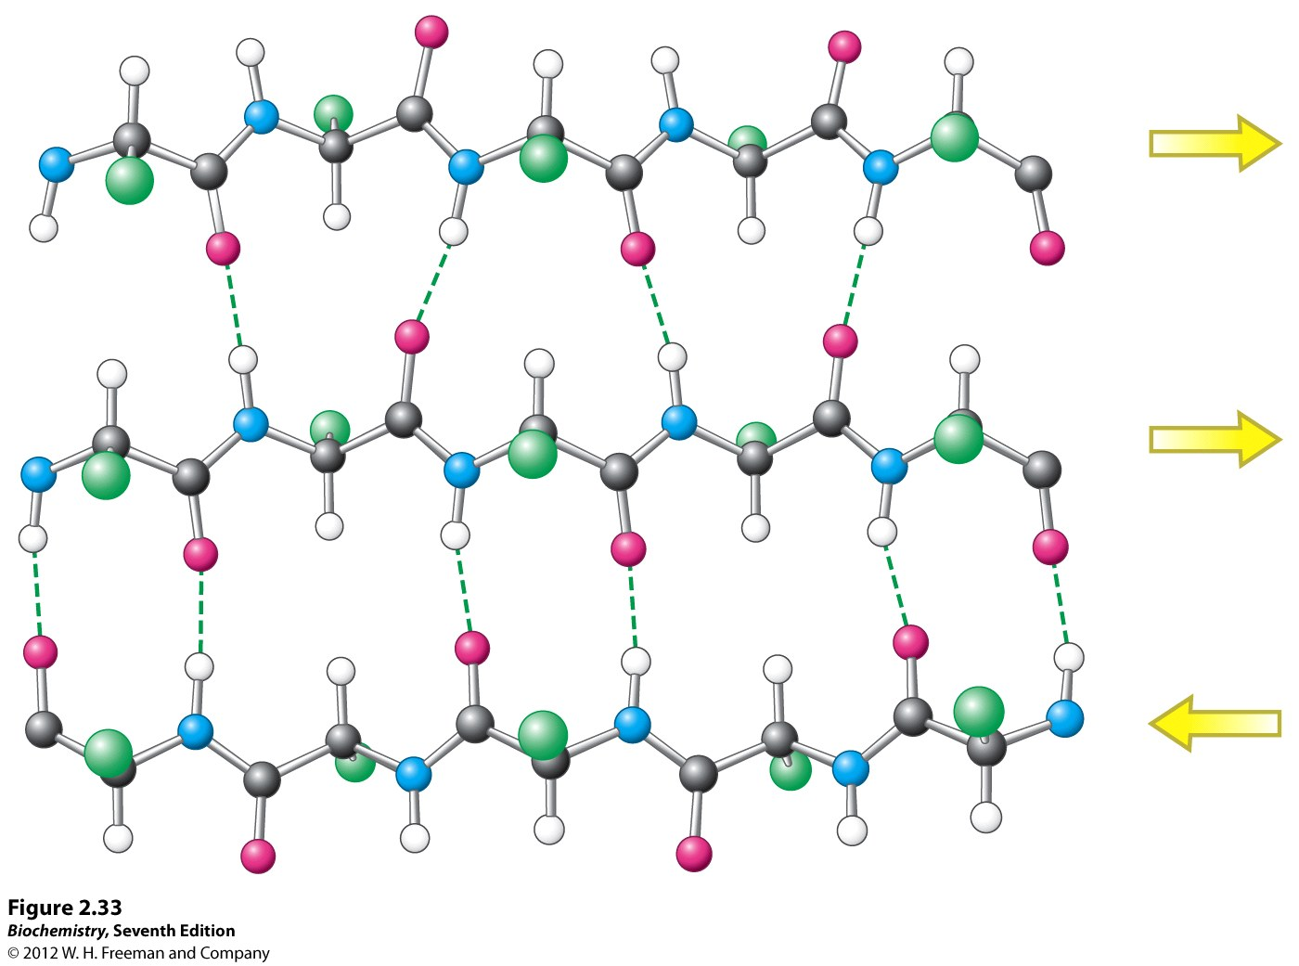
Parallel and anti parallel strands

Slide 13
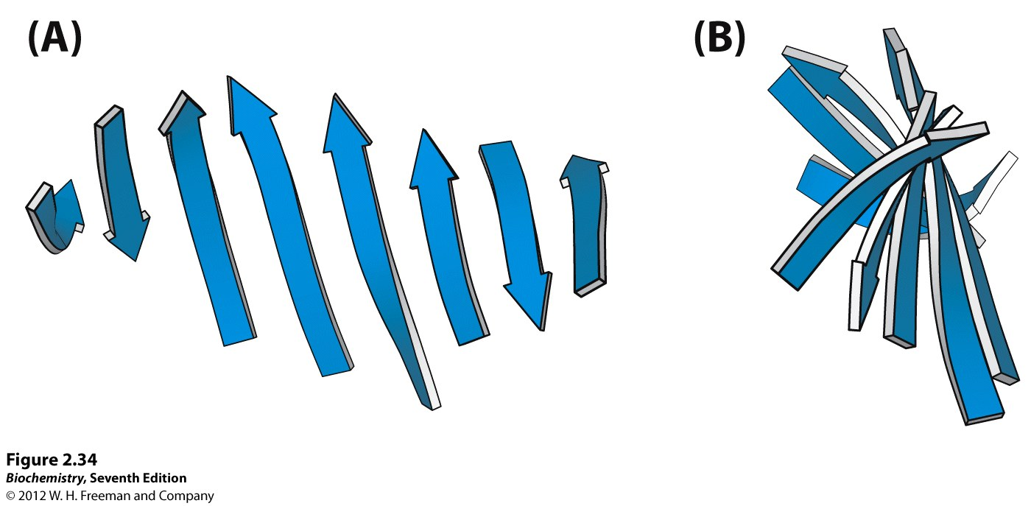

Slide 14
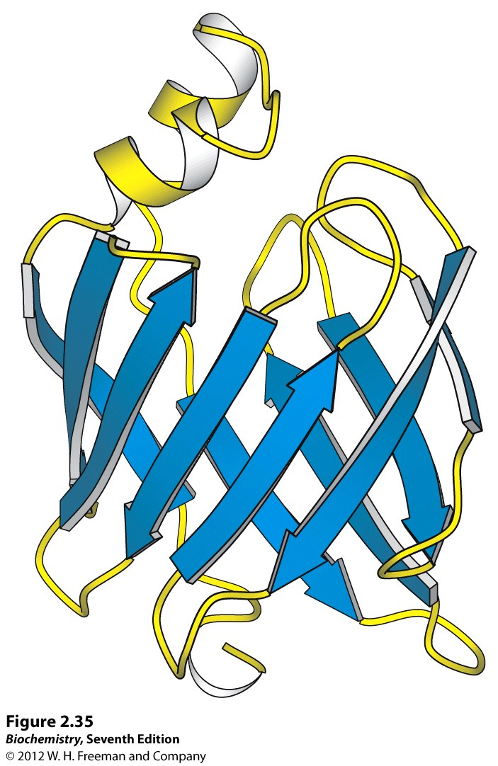

Slide 15
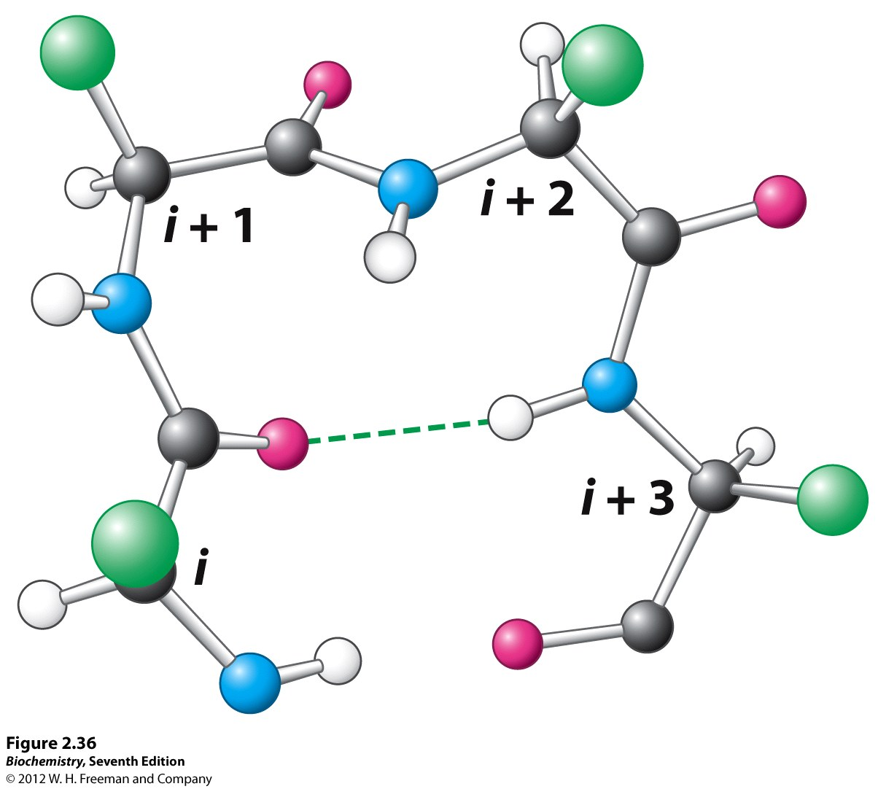
B turn

Slide 16
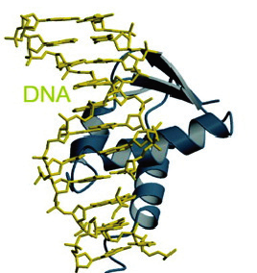
Indicate
Alpha helix
Beta sheet
What
type of
sidechains
interact with
DNA backbone?

Slide 17
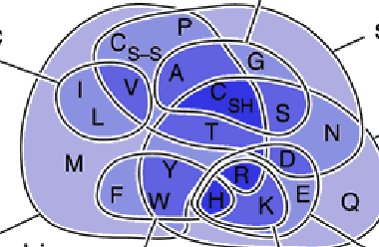
Where are the hydrophic amino acids?
Hydrophilic amino acids?

Slide 18
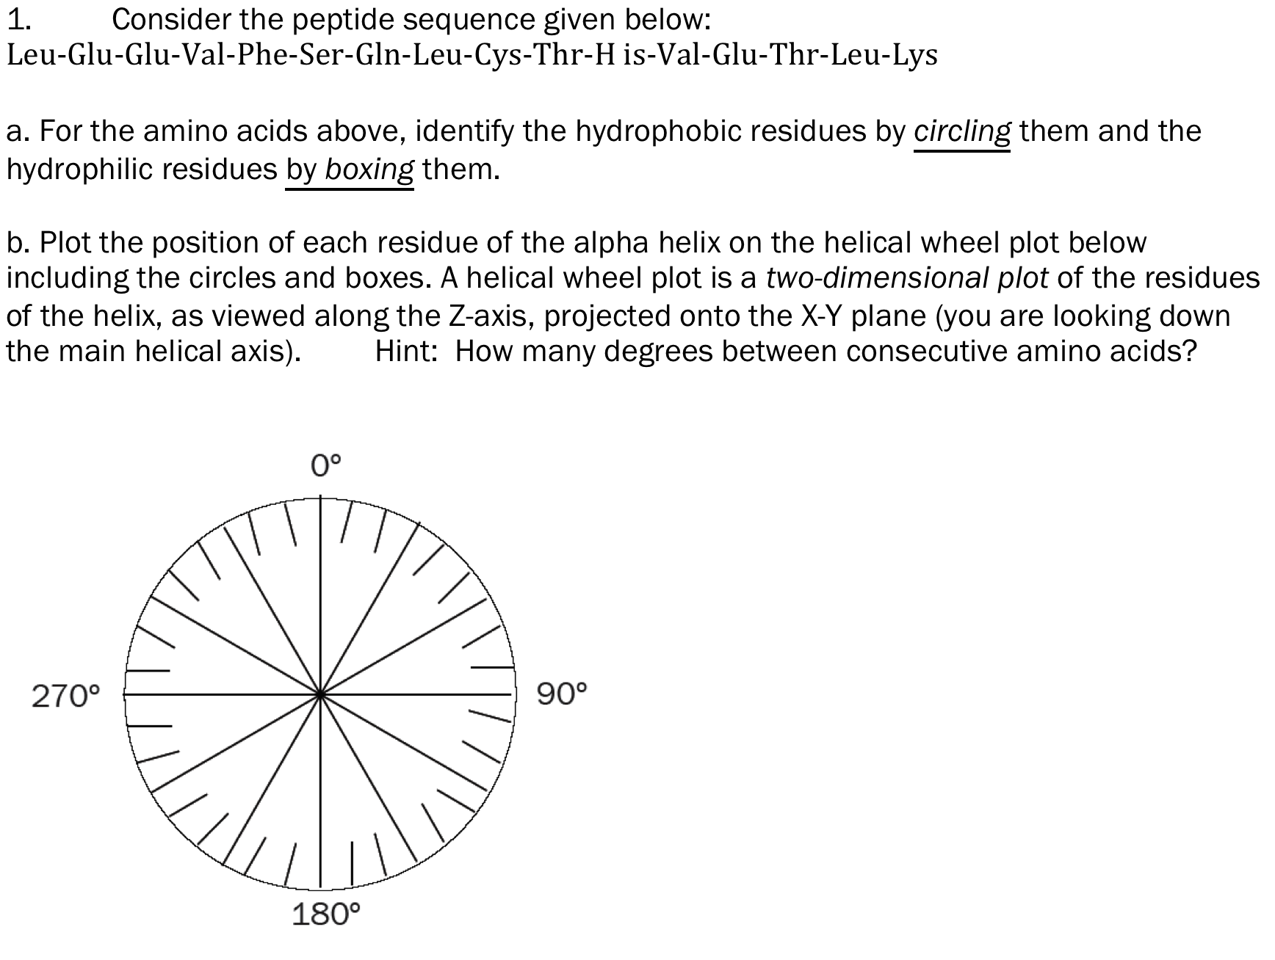

Slide 19
2. Suppose a protein has four helices identical to the alpha helix found in Problem 1 and folds into a “four helix bundle” where the alpha helices are packed together. What part of the helices interact with each other? What force stabilizes this bundle? Draw a the four helix bundle from the top and side

Slide 20
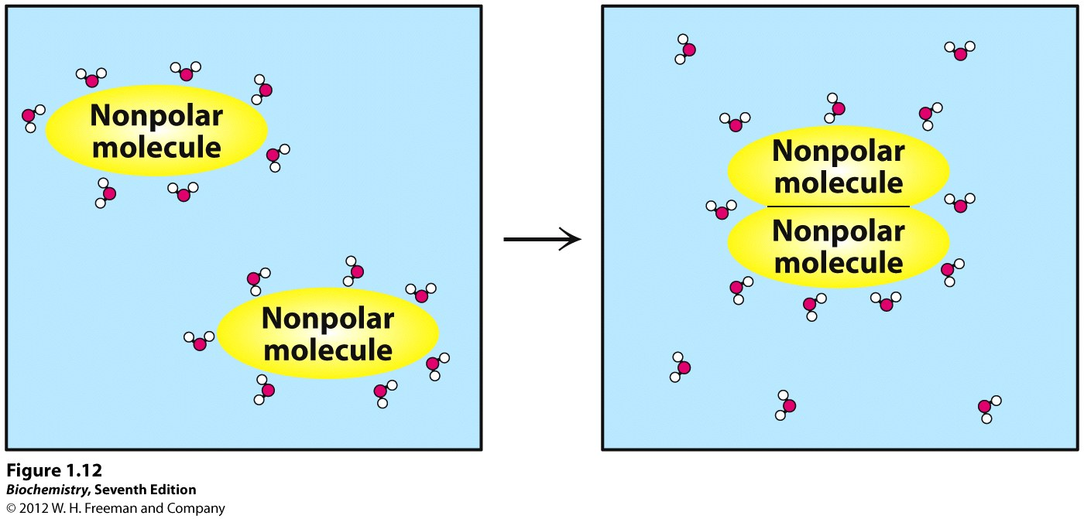
Learning Goal—Importance of hydrophobic and hydrophilic amino acids in protein folding.

Slide 21
Can Protein Structure and Function be Predicted from Sequence?
Globular Proteins
Fibrous Proteins (Hair, hooves, silk, collagen)
  Structural
  Repeated sequences
  Physical properties (strength, flexibility) can be fine-tuned

Slide 22
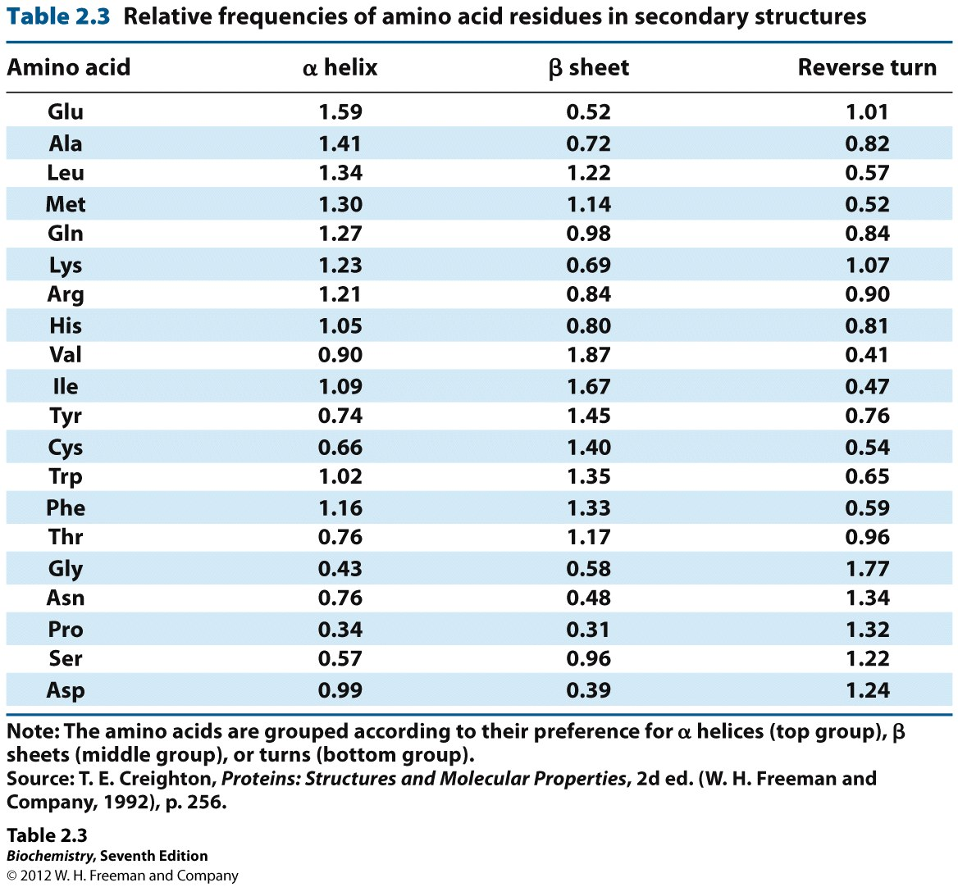

Slide 23
Silk=fibroin
Extended β sheets
Parallel and anti parallel strands

Slide 24
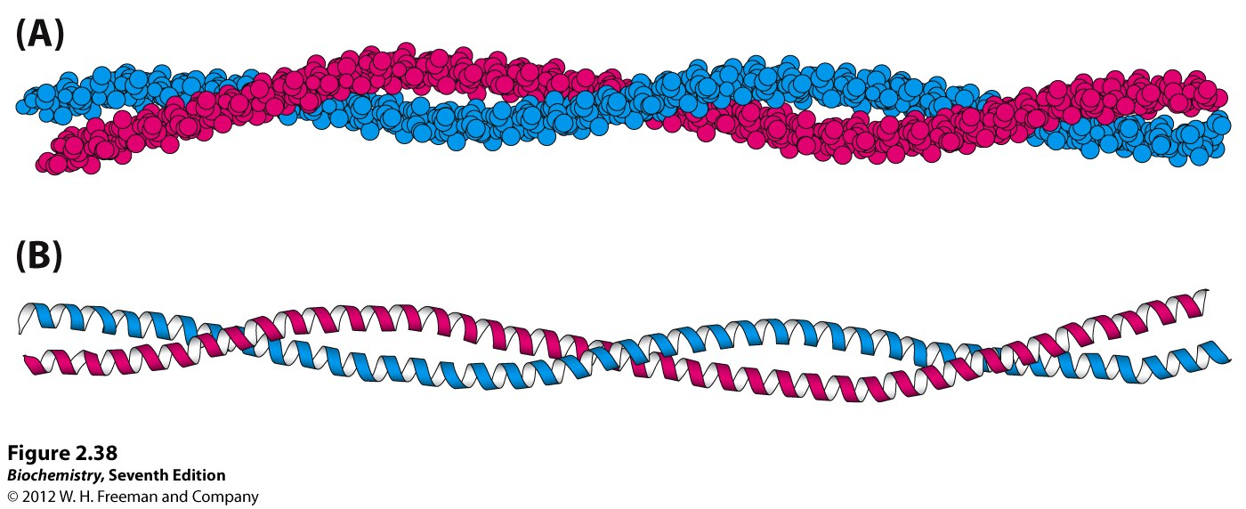
α-helical coiled-coil
α-keratin (wool, hair, skin)
Myosin & tropomyosin (muscles)
Long fibers
Heptad repeat

Slide 25
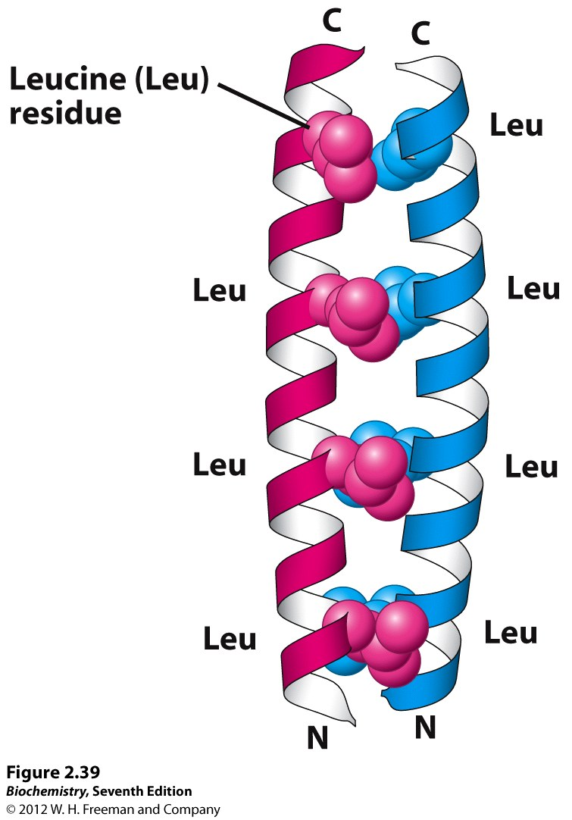
Heptad repeat
Coiled-coil

Slide 26
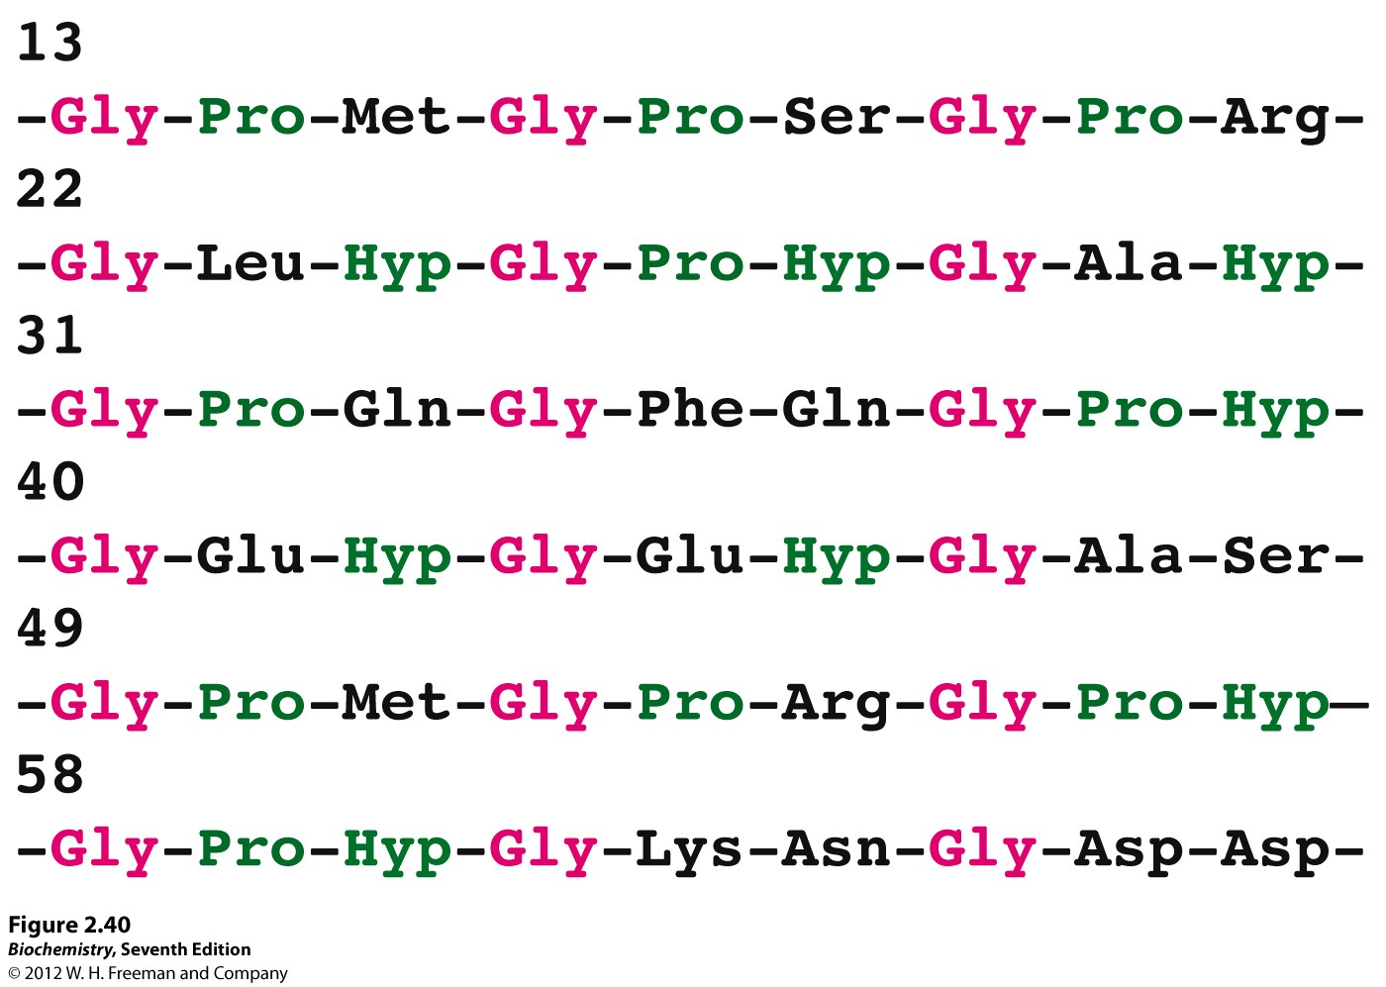
Collagen Triple helix

Slide 27
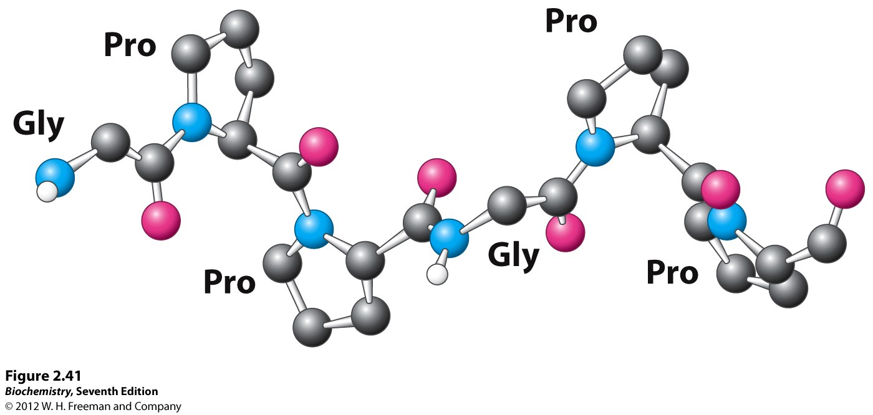
Collagen Triple Helix

Slide 28
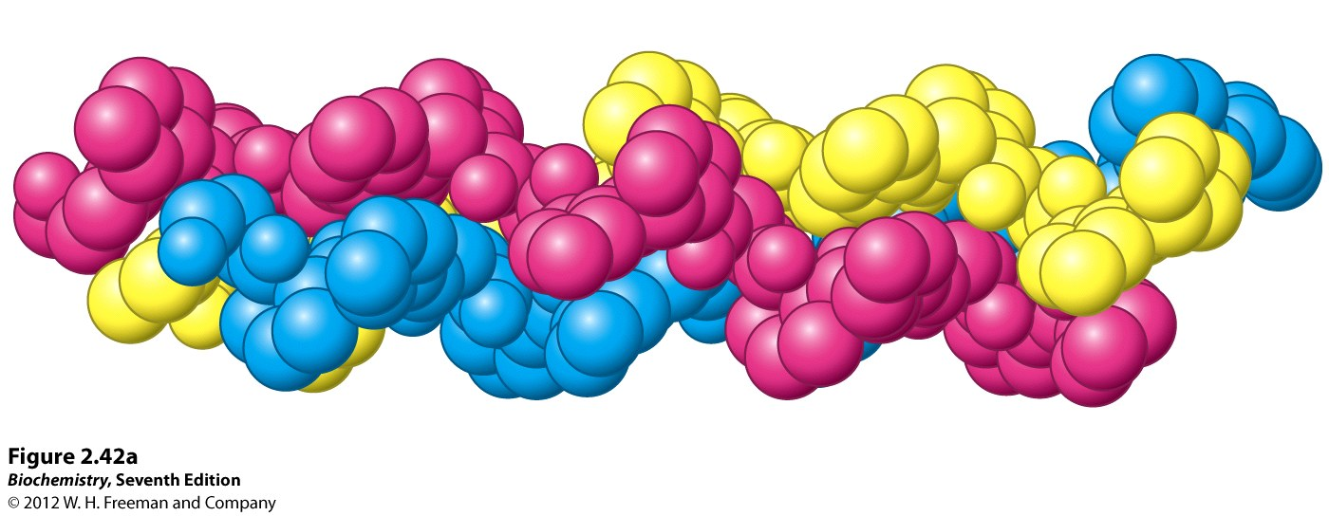
Held together by H-bonds between strands
Hydroxy Proline also H-bonds
3000 nm long x 1.5 nm diameter 800 aa’s per strand
300,000 g/mol for triple strand

Slide 29
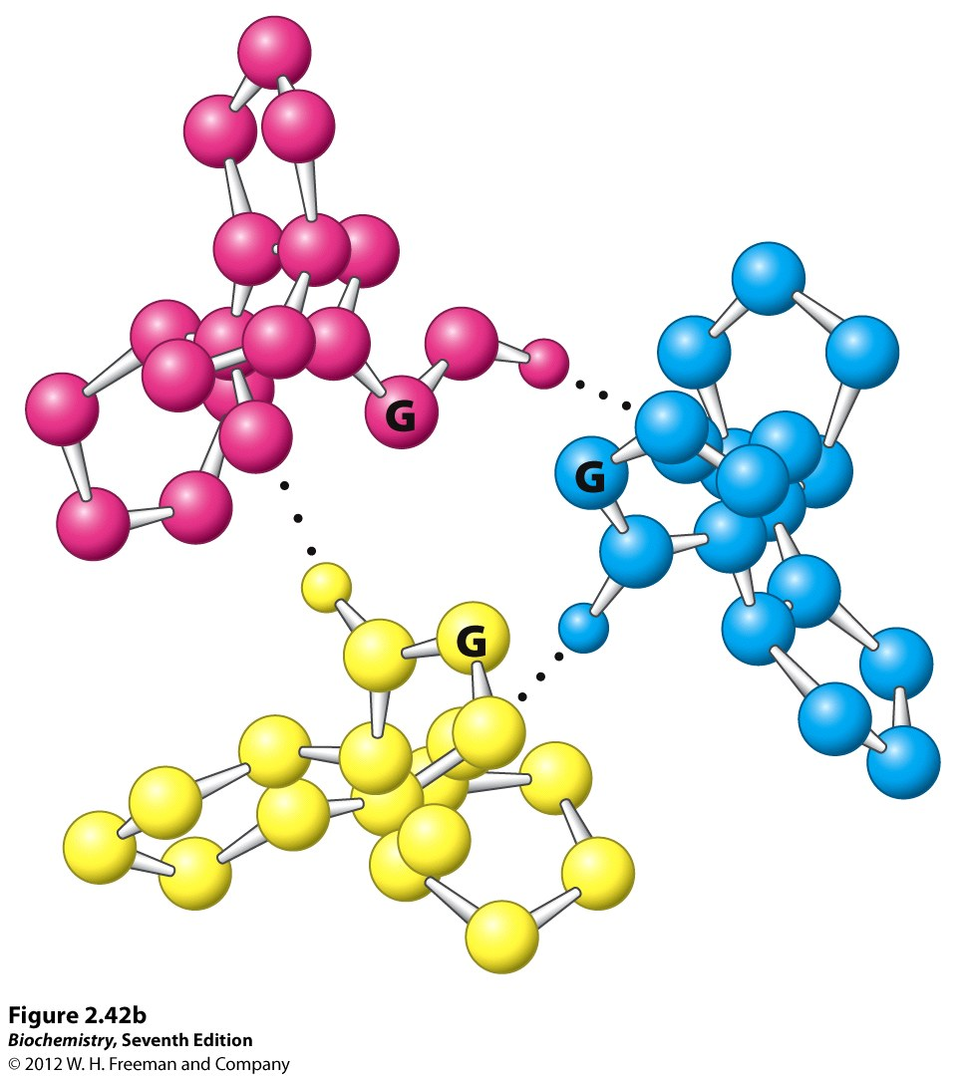

Slide 30
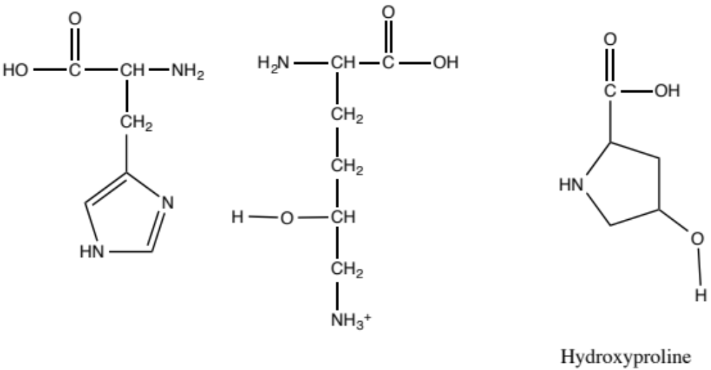
Triple strands also held
Together by covalent links=
Crosslinking
Intra- and inter strand
HIS-hydroxylysine
Aging→ more xlinks→stiffer,
less flexible
Vitamin C required
To make HYP
Scurvy= Vitamin C
Deficiency→fragile
collagen

Slide 31
Medical Application
Cornea of eye contains collagen
Keratoconus
  Excessive astigmatism
  Progressively worse vision not correctable
  Cornea bulges becomes very bent and thin
Treatment
  Corneal transplant
  Special contact lenses
  Laser crosslinking as early as possible

Slide 32
Experimental Methods--Spectroscopy
Circular Dichroism
  Depends on chirality
  Native or denatured
  % of each 2e structure
Infrared
NMR Cα chemical shift

